Slide 1
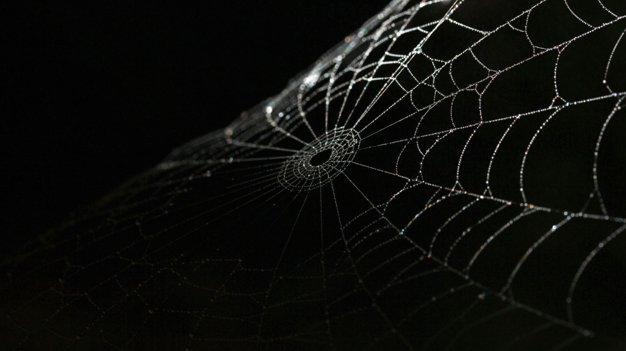
Spiders
(Araneae)

Slide 2
facts
Kingdom: Animalia
Phylum: Arthropoda
Class: Arachnida
48000 species
Not all spiders are carnivores
Spiders will only bite in self-defence
Spider silk is extremely strong

Slide 3
Appearance
8 legs
2 body parts: prosoma & abdomen
Several tiny eyes
Spinnerets on their tails
Fangs
This Photo by Unknown Author is licensed under CC BY-SA

Slide 4
Dynamics
Lifespan between 1-25 years, depending on specie
1
Carnivores: bugs & even other spiders
2
Capture prey by means of sticky web
3
Can survive weeks with no food
4
Can’t digest solid foods; must turn food into liquid
5
Females eat males
6
Move using muscle and hemolymph pressure
7
Produce silk all their life
8

Slide 5
Habitat
Found everywhere except Antarctica
From desserts to rain forests to backyards and everywhere in between
Float on water, live under water and dive under water

Slide 6
Did you know?
In the UK there’s never been a recorded death from spider bite
It takes an hour to build a web, they build one everyday
The largest spider is the Goliath tarantula
The smallest spider is the Patu Marlpesi
Not all those 8 eyes can see

