Slide 1
brownie in a mug
By Ronan Jenkins

Slide 2
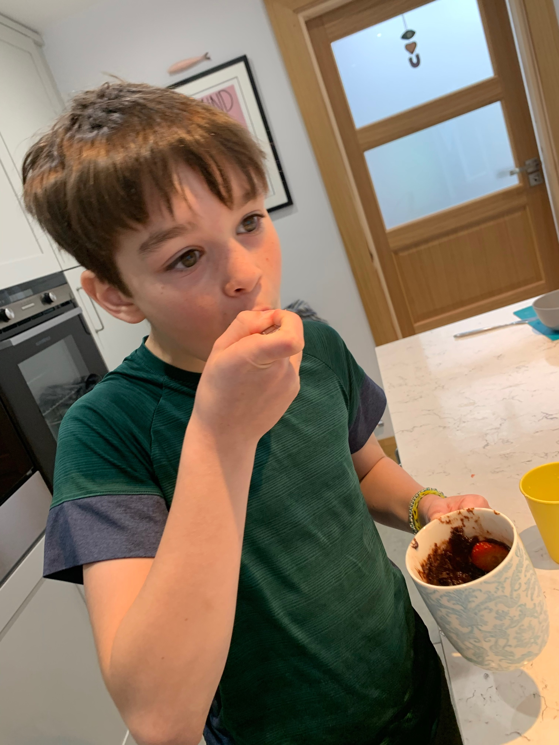
Equipment
Tea spoon
Table spoon
A mug
Ingredients
1.5tbsp of Chocolate powder
3tbsp of Milk
3tbsp of sugar
3tbsp of plain flour
1.5tbsp of melted butter

Slide 3
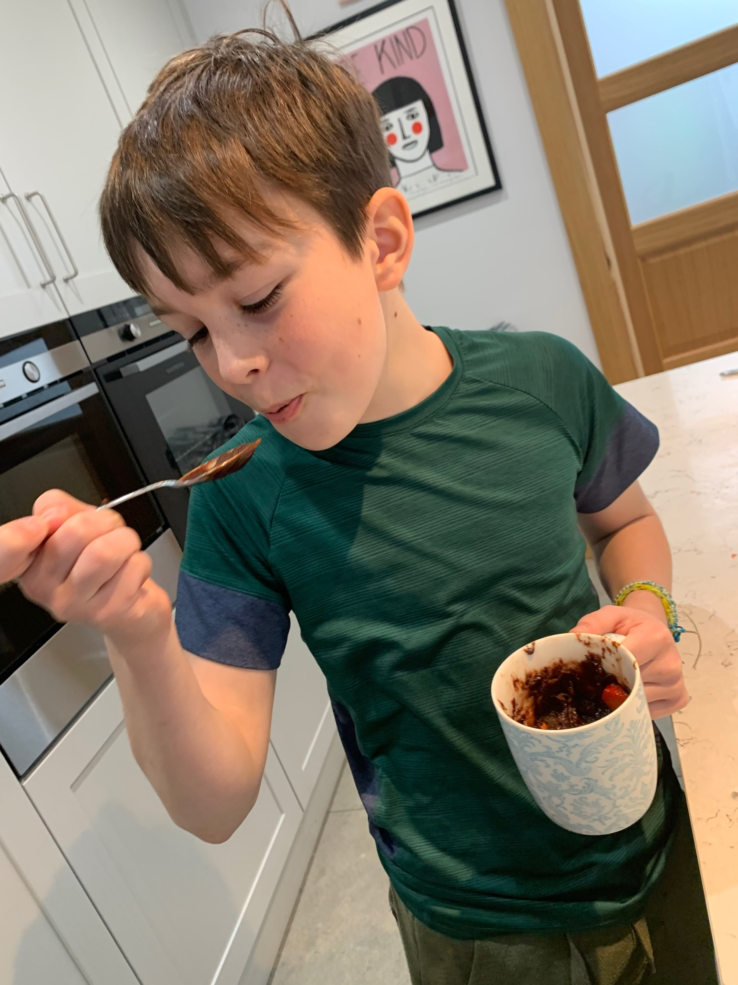
Procedure
Get your mug and add the flour ,chocolate powder and sugar
Stir until your mixture is free of lumps
Add milk and your melted butter
Mix until combined
Microwave it for 90 seconds
DONE!!!
And don’t forget to ENJOY

Slide 4
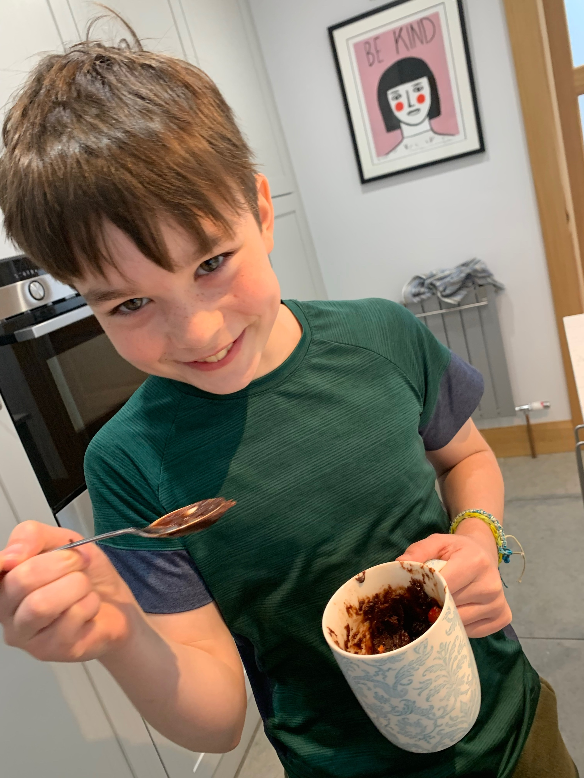
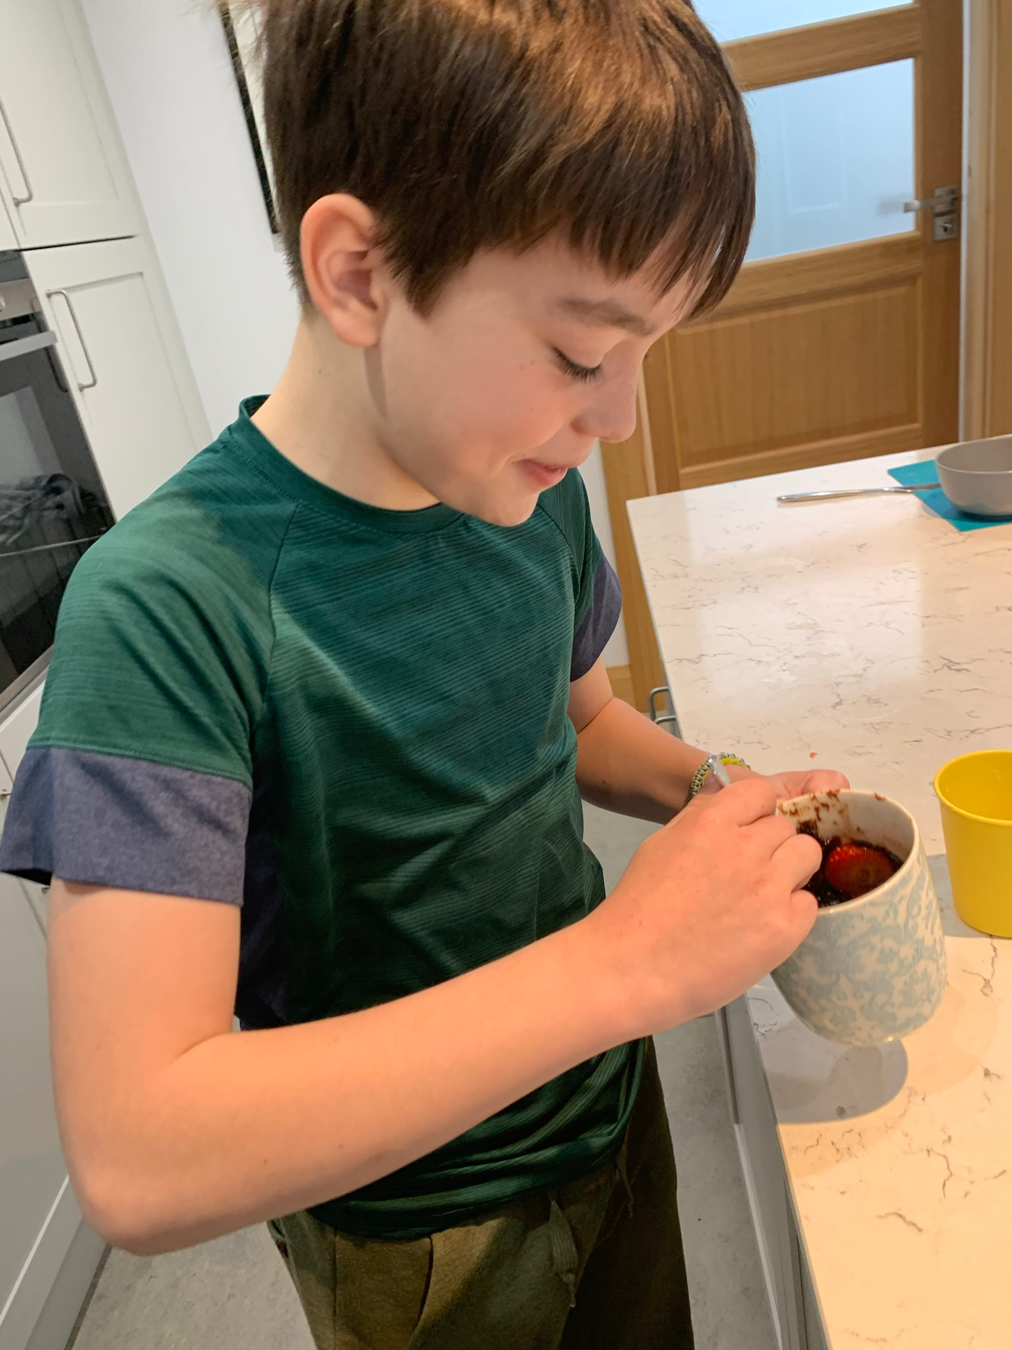
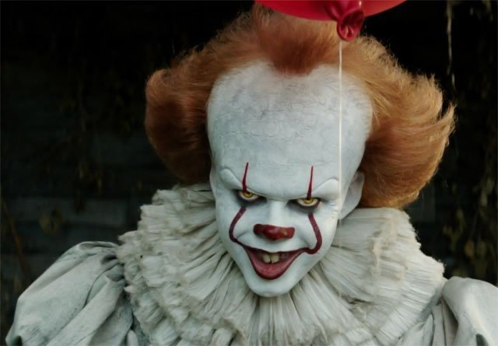
TWINS

Slide 5
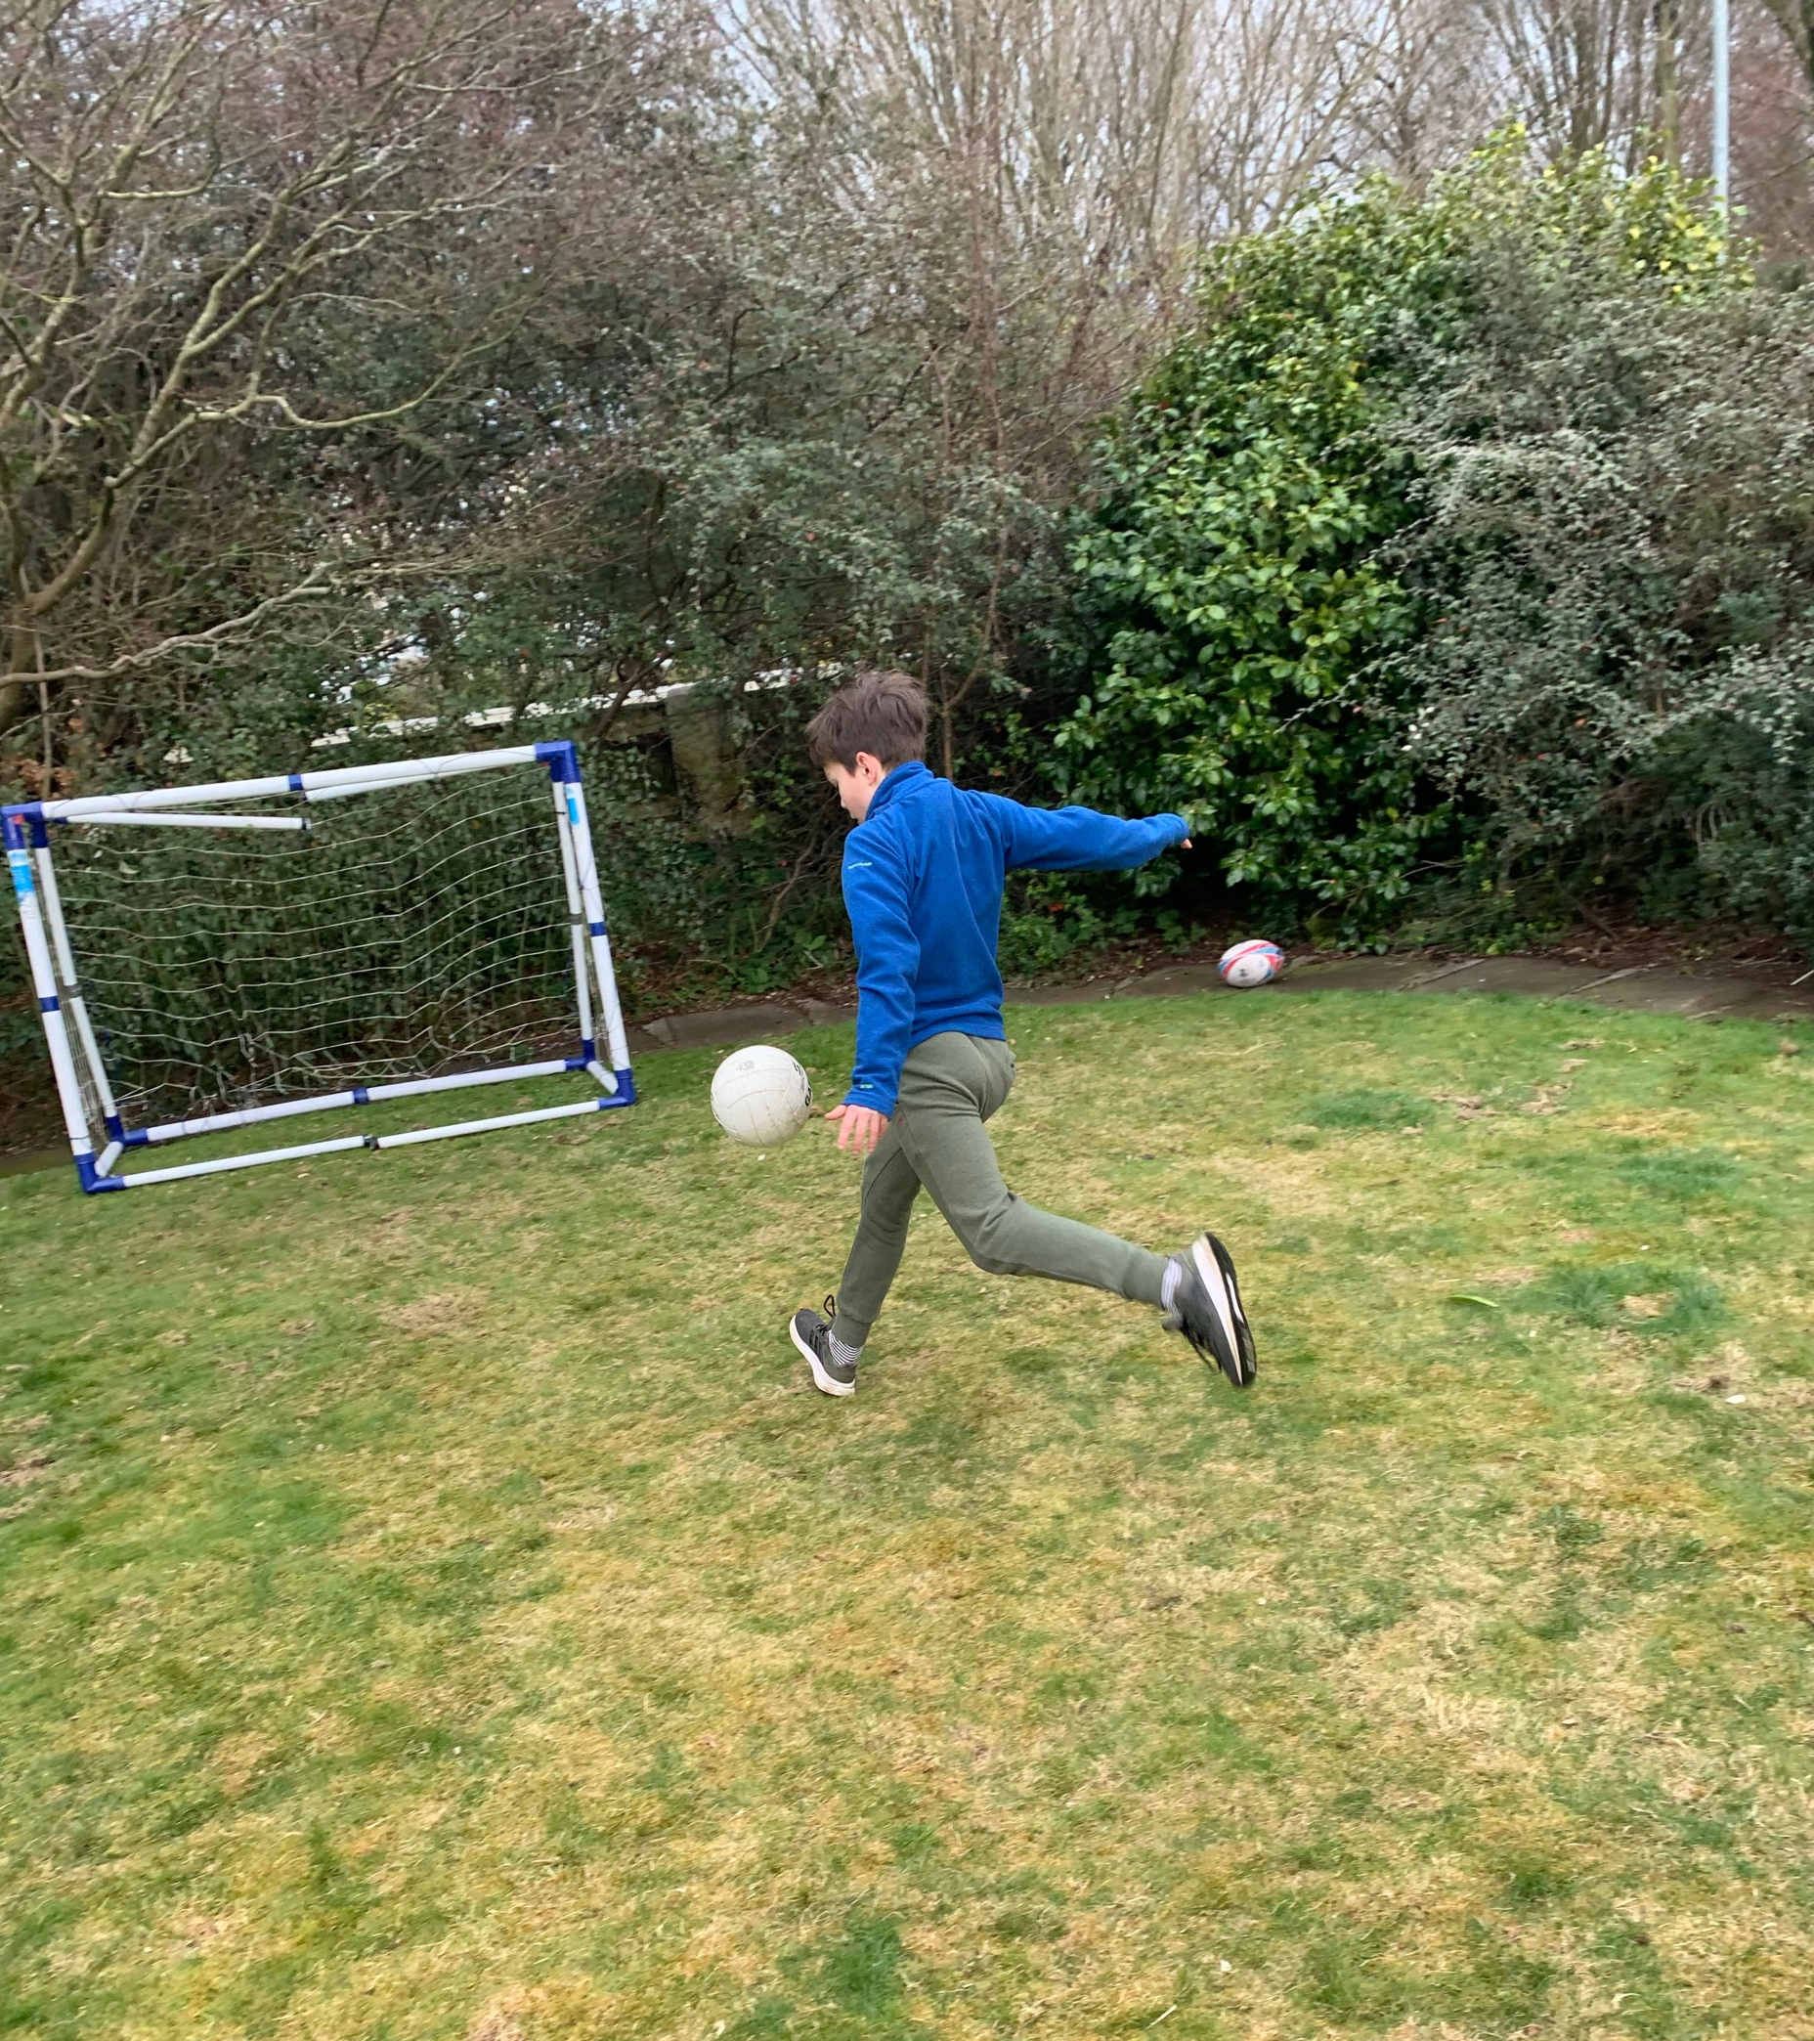
Burning it off 🤪

Slide 6
