Slide 1
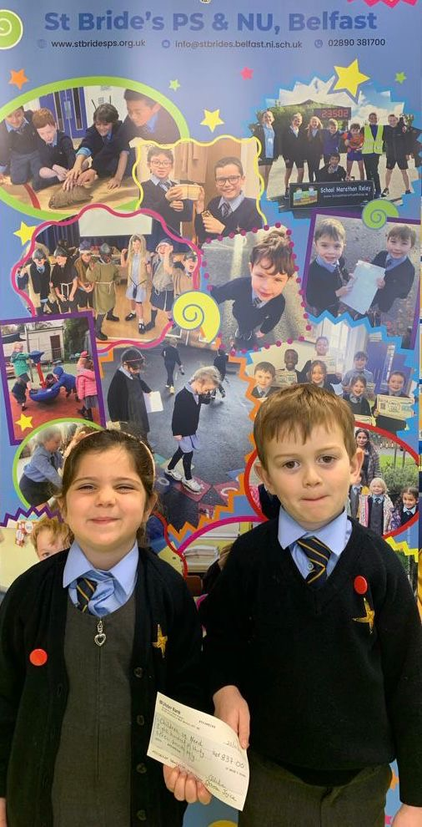
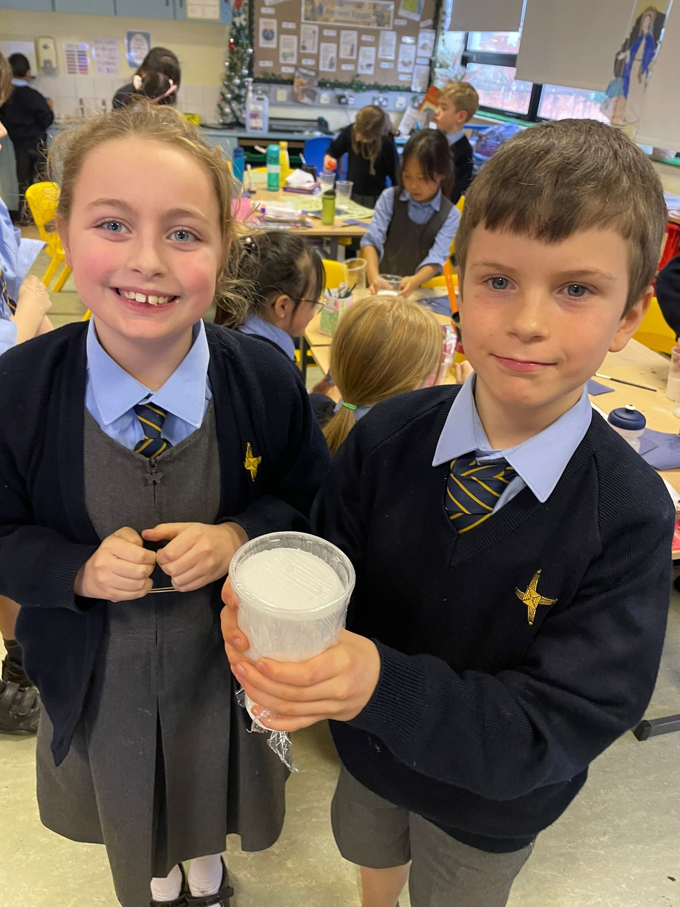
Welcome

Slide 2
Introductions
Top Tips For Parents
What is happening in the local area
SVDP
Positivi-Tea – a cuppa of tea

Slide 3
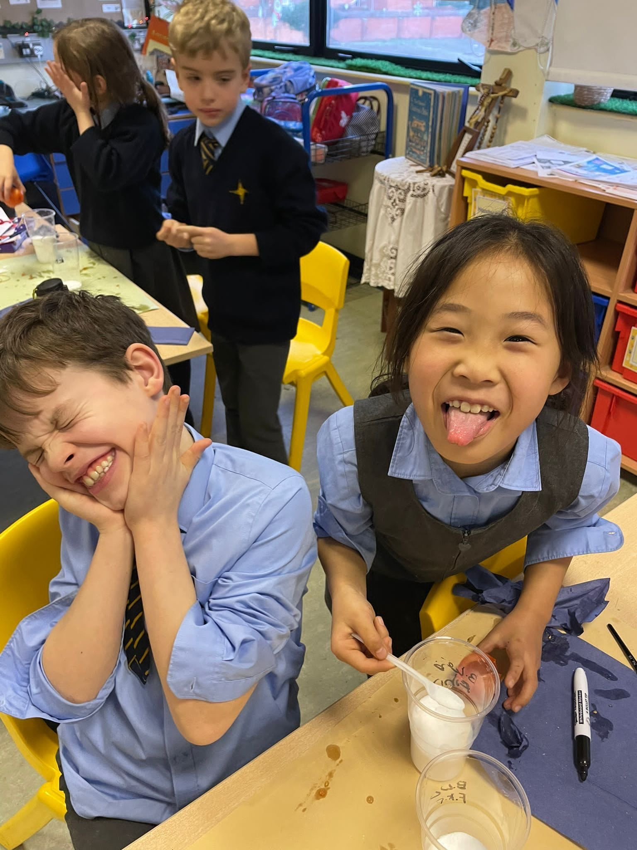
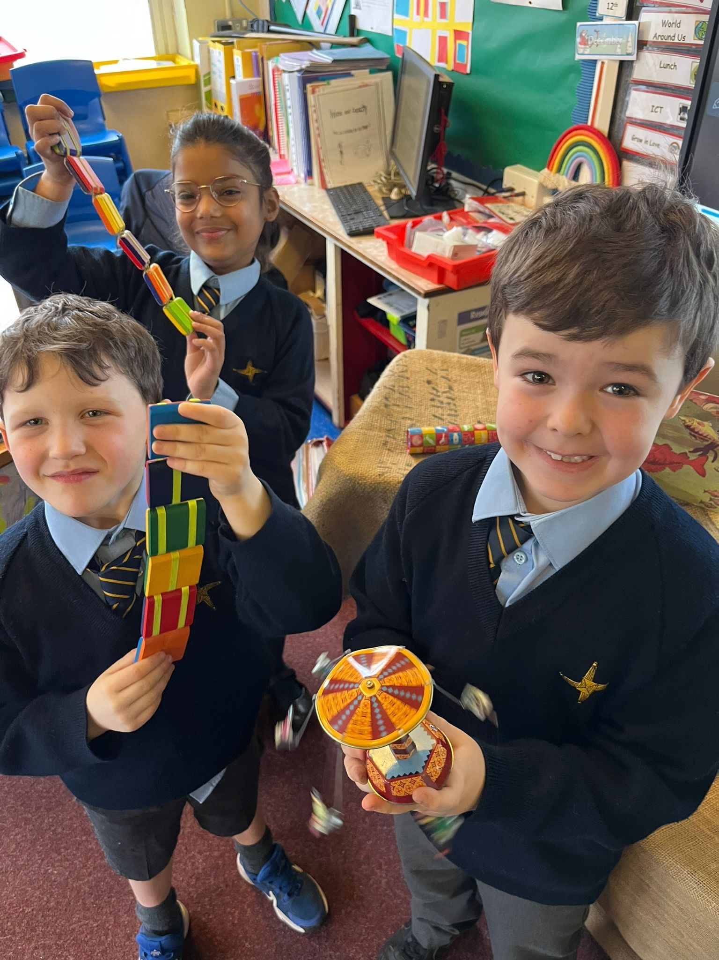
Top Tips for parents

Slide 4
Tip 1: Talk and Listen
Language – use positive words.
Change your tone- your voice is a powerful tool. Sometimes changing your tone and volume is enough.
Listening- get down to their level, sit beside them.
Feelings- Help them find the words to tell you how they are feeling, even if it takes time.
Explaining- If you say No, give a reason.
Involve your child- Where possible talk to them about the rules and what you expect from them. Be clear.

Slide 5
Tip 2: Play
If children are playing, they are less likely to be posting the remote control in the bin or wrestling with a brother or sister! If you’ve got a lot to do in a short space of time, set up an activity that will give you that all important extra half an hour. Play is important and enjoyable, and children can learn a lot from it. Children need time to play on their own, with others and with their parents, as long as they play safely.
A few ideas might be:
Painting, drawing and colouring.
Water
Imagination
Keep it simple and join in.

Slide 6
Tip 3: Understand Changes as They Grow
Children’s needs and understanding change as they grow, and what might be expected of a four-year-old can’t be expected of a two-year old:
■ Exploring: Young children find out about their world by touching, shaking, tasting, pouring, squeezing…the list is endless! This isn’t naughtiness, but a way of learning about their world. Make your home ‘toddler proof’ by storing valuables and breakables away from your child so they can explore safely. The mess of life with a toddler can be exhausting but think of all the learning they’re doing!
■ Independence: Part of growing up for your child will be pushing against the boundaries and becoming an individual. You can help them by letting them do as much for themselves as possible – for young children, keep toys at a child’s height, let them dress and feed themselves.
■ Encouragement: Your child will learn what’s ok to do from you, so give lots of praise and attention to good behaviour. If you only pay attention to your child when they misbehave, they’ll learn to misbehave to get your attention.

Slide 7
Tip 4: Set boundaries
Children need clear rules, boundaries and routine.
■ Be consistent.
■ Parents need to agree the rules. It will help the child if both parents take the same approach.
■ When you say no, mean no. Keeping to this can be hard work, but if you have a few clear rules, it helps you and your children.
■ If you make promises keep them.
■ Rules should be simple and clear.
■ Keep to as few rules as possible.
■ Try one new routine at a time and get it working before moving on the next.

Slide 8
Tip 5: Reward and Notice Good Behaviour
Sometimes it is easy to ignore your child when they are behaving well, and only notice them when they are misbehaving. Children love their parents’ attention, and if they have to behave badly to get it, they will. Give them lots of praise when they are behaving well, rather than focussing on misbehaviour.
■ Rewards do not have to be material things.
■ Real praise and encouragement is the best reward as it can boost a child and build self-esteem and confidence.
■Try not to stress over the little things. If you are praising things they are doing well, and ignoring the small niggles, your child will learn that unacceptable behaviour no longer gets them the attention.

Slide 9
Tip 6: Build Self Confidence
Building your child’s self confidence will help them to try out new things, make friends and cope with the upsets and problems they meet as they grow up.
■ Finding out: Give your child the chance to face new experiences and challenges with your support.
■ Love: Tell your child that you love them; it’s great to smile, cuddle and kiss them.
■ Independence: Don’t try to solve every problem for your child – sorting it out for themselves can be a boost to their confidence.
■ Praise: As a general rule, try to give five times more praise than criticism.
■ Avoid comparisons: All children are unique. Don’t compare your child to other children and share that with the child, they will grow up to compare themselves unfavourably with others.

Slide 10
Tip 7: Have Realistic Expectations and Allow Consequences
Children are children. They will be messy, noisy and, at times, disobedient.
■ Give them the freedom to make mistakes.
■ Encourage your child to think for themselves and take responsibility for their actions.

Slide 11
Tip 8: Deal with Meltdown Moments Positively
There will be difficult times for every family – usually when there’s too much to do in a short space of time, or when what you need to do, clashes with what your child wants to do.
Recognise Triggers
There might be some specific triggers or times when your child misbehaves. Be aware of these and try different approaches.
The morning rush- Be prepared, get the kids to help.
At the supermarket- List , sing, involve them.
Playtime- Ration toys, have a calming place.
Early evening to bedtime- Give the children sometime when you get home. 5 minute warnings. Bedtime routine

Slide 12
Tip 9: Look after yourself
If you make sure you get a break to relax, this may help you cope better.
Try to:
■ take time for yourself;
■ keep interests outside the home;
■ take up the offer of help from family and friends;
■ get rest when you can;
■ look after your health;
■ know your limits;
■ get together with other parents and their children – children also need company.

Slide 13
Tip 10: When things are getting difficult.
■ Stay calm.
■ If it is impossible to stay calm, leave the child in a safe place and leave the room for a few minutes. This will give you breathing space to think.
■ When you return, talk to your child about what has happened and how you will deal with it.
■ Think about what happened, what set off the behaviour, has it happened before and what could be done differently?
■ Ask for help and advice – nobody gets it right all the time.
■ As a general rule, try and give five times more praise than criticism.
■ Don’t try to change too much at once – take one tip and use it until you’ve worked it out and then try another.
■ Flexibility is fine – life can be chaotic and having a flexible approach will help your children learn to do the same.
And Remember The most important thing is that your child feels loved and happy even when sometimes things are difficult.

Slide 14
Parentingni.org (App)
It is a leading charity for parenting support in the North of Ireland It has an app which is easy to download and navigate
14 Top Tips for Parenting It has top tips on; Managing Behaviour Emotions Friendship Digital Parenting Separation Bullying Transition Help with Homework
Free support line and web chat It offers parenting programmes and workshops

Slide 15
St. Bride’s Mothers and Toddlers
St. Bride’s Mother and Toddlers – Every Thursday ( when school is open ) 10-11.30am in St. Bride’s Parish Hall – Facebook : St. Brigid’s Parents and Toddlers Group Belfast

Slide 16
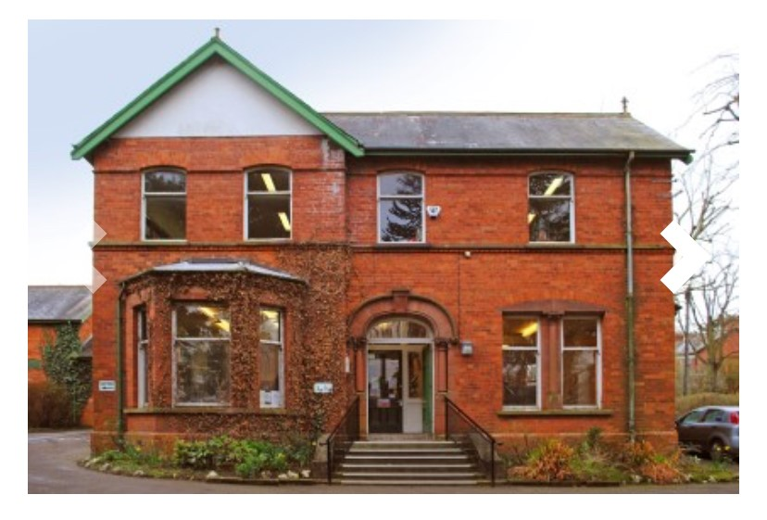
Lisburn Road Library
Google Library NI - Enter Lisburn Road ( 02890509223 )
A wealth of activities E.g.
Rhythm & Rhythm for 0-4 yrs. old every Tuesday 9:45-10:15 & 10:45-11:15 & the first Saturday of each month 9:45-10:15
Lego Club 6-8yrs old every second Saturday 10-11am
Story Time every Wednesday 4-8yrs old 4:00- 4:30
Knit & Natter for adults every Thursday 10:30-12:30
Tea & Newspapers every Friday 9:15-12noon
Woman and Money 26/1/24 11am

Slide 17
Ulster Museum
Ulster Museum- Discovery Centres are open Tuesdays to Sundays 10:00 to 17:00 - they can be bo0oked by school groups so not always available – just phone ahead and check.

Slide 18
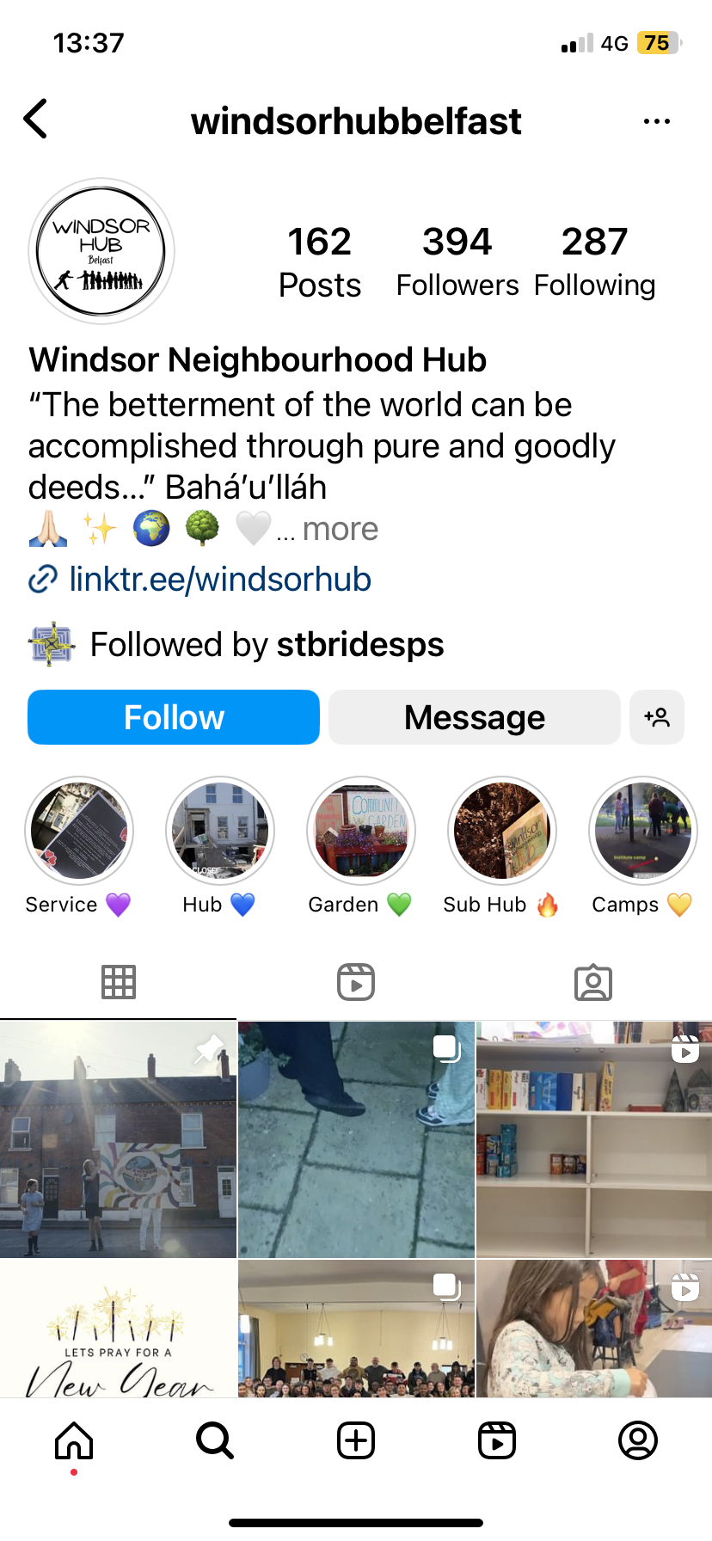
Windsor Hub

Slide 19
Windsor Hub
The Windsor Hub is an educational facility open to people of all backgrounds, located at 22 Lower Windsor Avenue. Classes/groups for children, youth and adults use a curriculum developed by the worldwide Baha’i Faith Community to assist young people to make a contribution to the betterment of their local area in the context that “the betterment of the world can be accomplished through pure and goodly deeds.”
Have a look at their wonderful work on Instagram.
https://www.instagram.com/windsorhubbelfast/reels/?hl=en

Slide 20
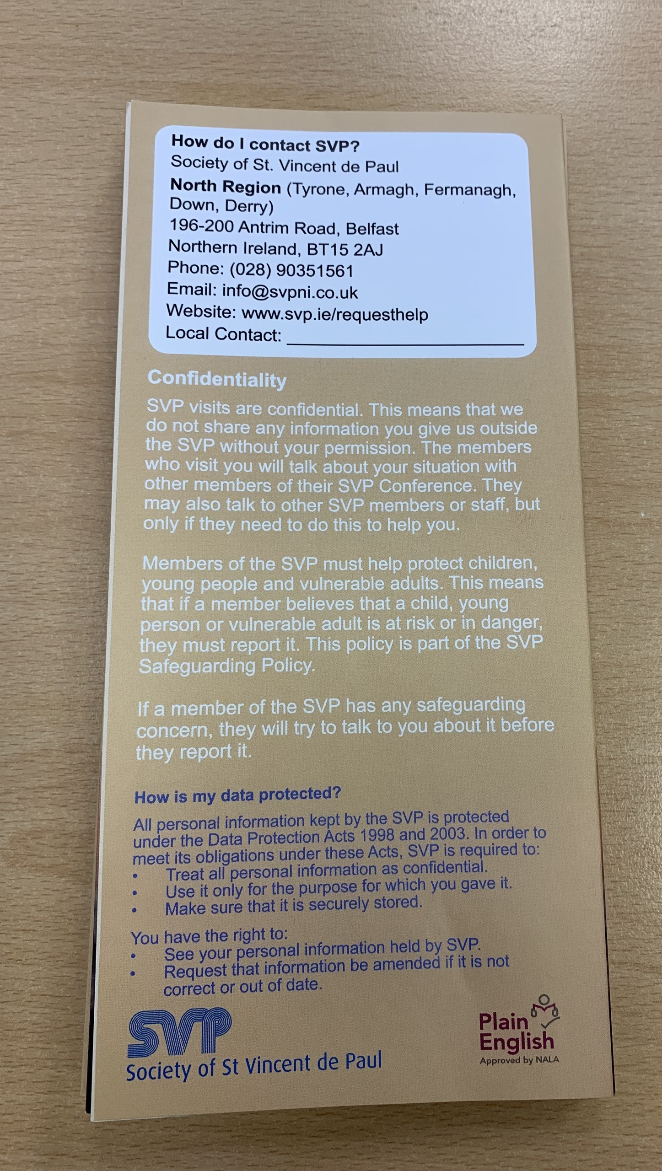
SVDP : St. Vincent De Paul

Slide 21
Positivi-tea

