Slide 1
The Chinese new year
By Zahra

Slide 2
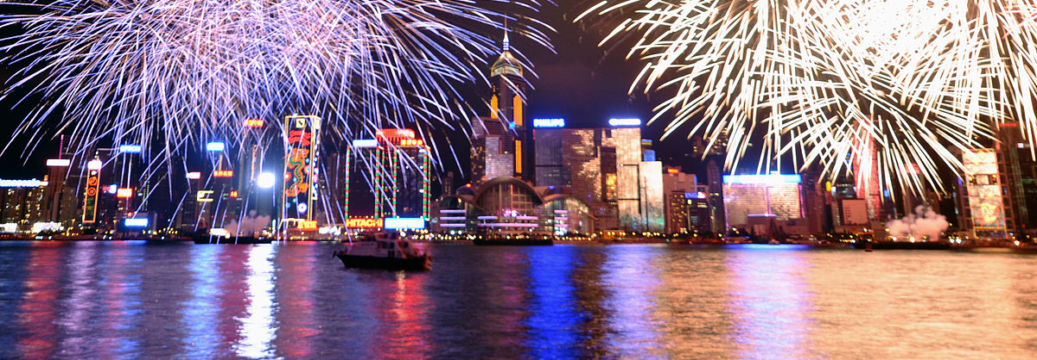
What is the Chinese New Year?
The Lunar New Year is the most important social and economic holiday for billions of people around the world. The holiday is tied to the lunar-solar Chinese calendar and was originally observed as a time to honor household and heavenly deities and ancestors.

Slide 3
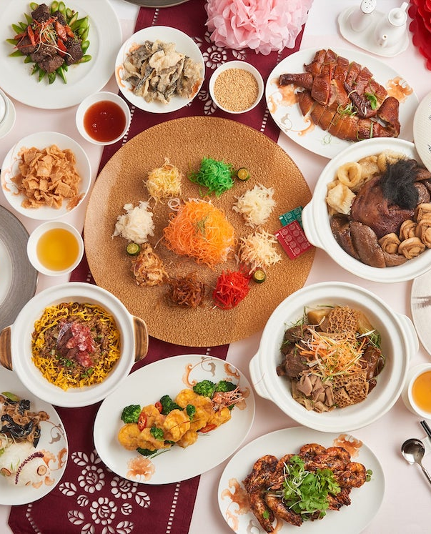
Food at Chinese new year
Oranges, kumquats, tangerines and pomelos are common Chinese New Year food gifts because they're believed to bring good luck and happiness. The Chinese words for orange and tangerine closely resemble the words for luck and wealth. The gold colour also symbolizes prosperity.
Dumplings, Fish, Whole Chicken, Sweet Rice Balls, Fresh Fruit, Spring Rolls ,Noodles and Wontons are also eaten at Chinese new year.

Slide 4
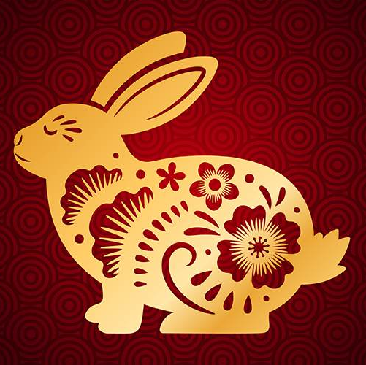
What does the year of the rabbit symbolise
The year of the rabbit is said to be the luckiest symbol as it brings mercy, elegance and beauty. People who are born in the year of the rabbit are calm and peaceful. They avoid fighting and arguing at all times, but are artistic and have good taste in life.

Slide 5
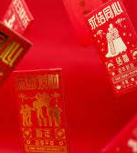
Red Envelopes
A tradition at Chinese New Year is to give children red envelopes with money inside. This tradition started from the Republic of China (1912–1949) era, it evolved into a hundred coins wrapped in red paper, meaning "May you live a hundred years!".

Slide 6
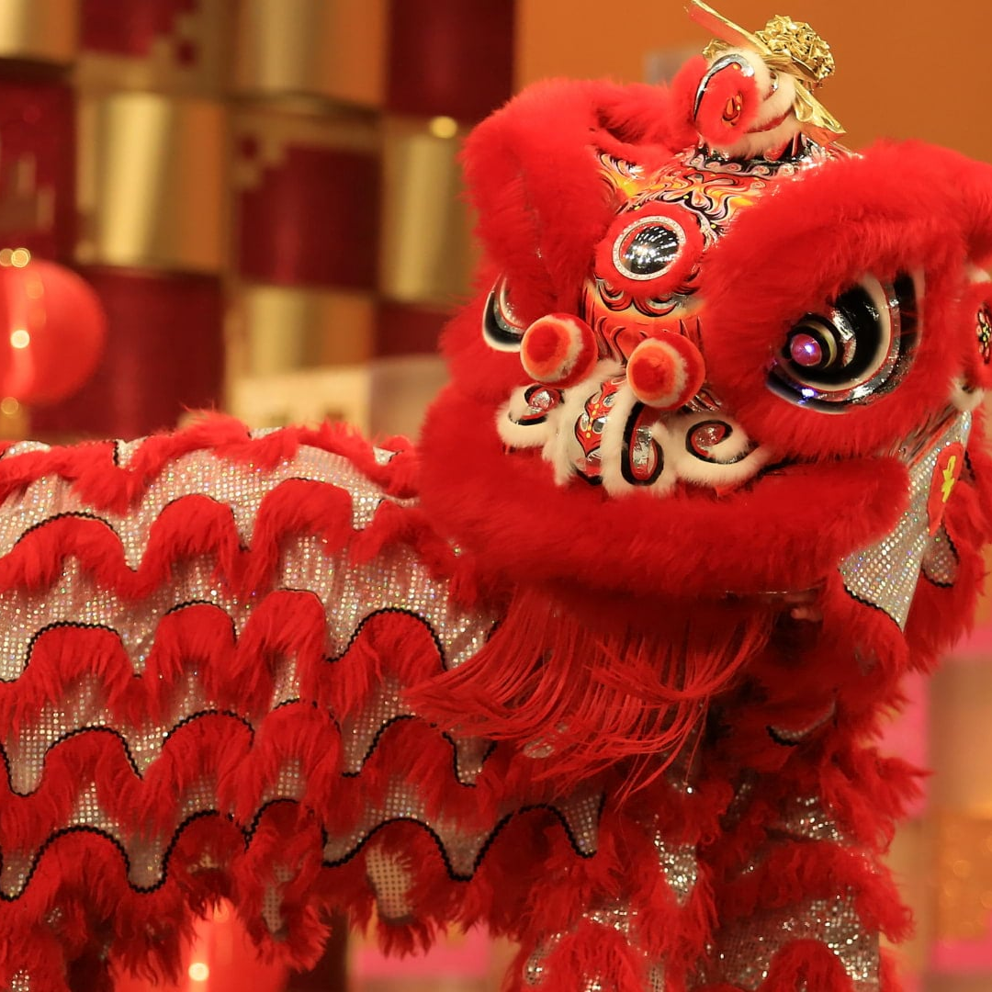
Dragon Dances
The traditional dragon dance began as a ceremony for worshiping ancestors and praying for rain. It later became more of an entertainment, often performed during Chinese New Year. In Chinese culture, dragons symbolize wisdom, power, dignity, fertility, and auspiciousness, and have also become a symbol.

