Slide 1
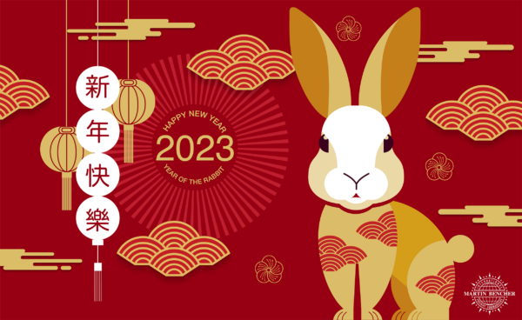
Chinese New Year 2023
By Kevin He

Slide 2
Chinese new year animals

Slide 3
2023 the year of the rabbit
There are 12 Chinese zodiac animals.
I was born the year of the dragon and my sister was born the year of the snake.
In order, the 12 animals are Rat, Ox, Tiger, Rabbit, Dragon, Snake, Horse, Goat, Monkey, Rooster, Dog and Pig.
The rabbit is the fourth animal in the Chinese zodiac.
It symbolizes mercy, elegance, and beauty.

Slide 4
Chinese new years food

Slide 5
Chinese new year foods
Chinese New Year food traditions are hugely symbolic.
Traditions include serving two whole fish and saving one for leftovers to represent surplus in the new year, serving a whole chicken to represent wholeness and prosperity, and serving items like spring rolls, which resemble gold bars and symbolize wealth.
The most common Chinese New Year foods include dumplings, fish, spring rolls, and niangao.

Slide 6
Chinese new year traditions

Slide 7
Chinese new year traditions
It's a time to worship ancestors, exorcise evil spirits and pray for good harvest.
Lion dance, dragon dance, temple fairs, flower market shopping and so on are just a few of these rich and colourful activities.
It is also known as ‘Spring Festival’.
The celebrations last for 15 days.
Children receive red envelopes with money inside.
Chinese New Year ends with the ‘Lantern Festival’.

