Slide 1
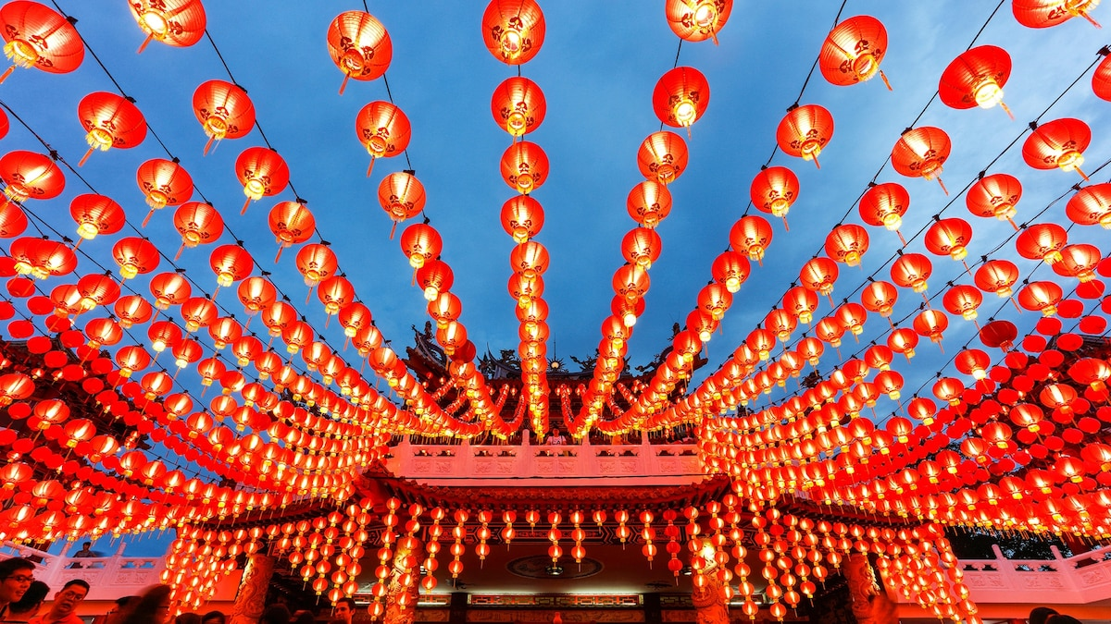
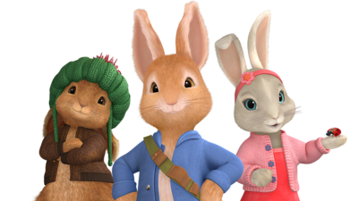
Chinese new year
In the Chinese culture, the rabbit is known to be the luckiest out of all the twelve animals. It symbolizes mercy, elegance, and beauty. People who are born in the year of the rabbit are calm and peaceful. They avoid fighting and arguing at all times, but are artistic and have good taste in life.

Slide 2
Chinese New Year Traditions
putting up decorations,
offering sacrifices to ancestors,
eating reunion dinner with family on New Year's Eve,
giving red envelopes and other gifts,
firecrackers and fireworks, and.
watching lion and dragon dances.

Slide 3
More facts
Chinese New Year falls on a different day each year. ...
It is also known as 'Spring Festival'. ...
In China, each year is linked with a different animal. ...
The celebrations last for 15 days. ...
Guo Nian Hao means Happy New Year! ...
Children receive red envelopes with money inside.

Slide 4
The Year of the Rabbit 兔年 symbolizes longevity, positivity, auspiciousness, wittiness, cautiousness, cleverness, deftness and self-protection,” Li explains. The new year brings new fortunes, and in 2023,
Each new year in the lunar calendar, which the holiday is based on, is represented by one of 12 animals in the Chinese zodiac: rat, ox, tiger, rabbit, dragon, snake, horse, sheep, monkey, rooster, dog, or pig.
“On his birthday, he called together all the animals of the land to a race. Twelve (although some say 13) showed up,” Lauren Nechamkin, Director of Education at the Museum of Chinese in America and Nora Chen, Education Manager at the Museum of Chinese in America.

Slide 5
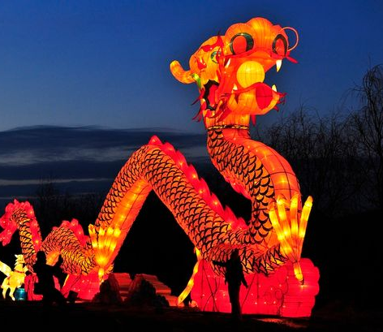
Why is the rabbit the fourth animal in the Chinese zodiac?
The rabbit was the fourth animal to finish in the Jade Emperor’s race. “In order to win, the animals had to cross a river with rapid currents and reach the finish line on the shore,” Li says.
To reach the end, the rabbit hopped along the river bank, Nachamkin and Chen explain. “To cross the river, it hopped from stone to stone, but slipped along the way.

Slide 6
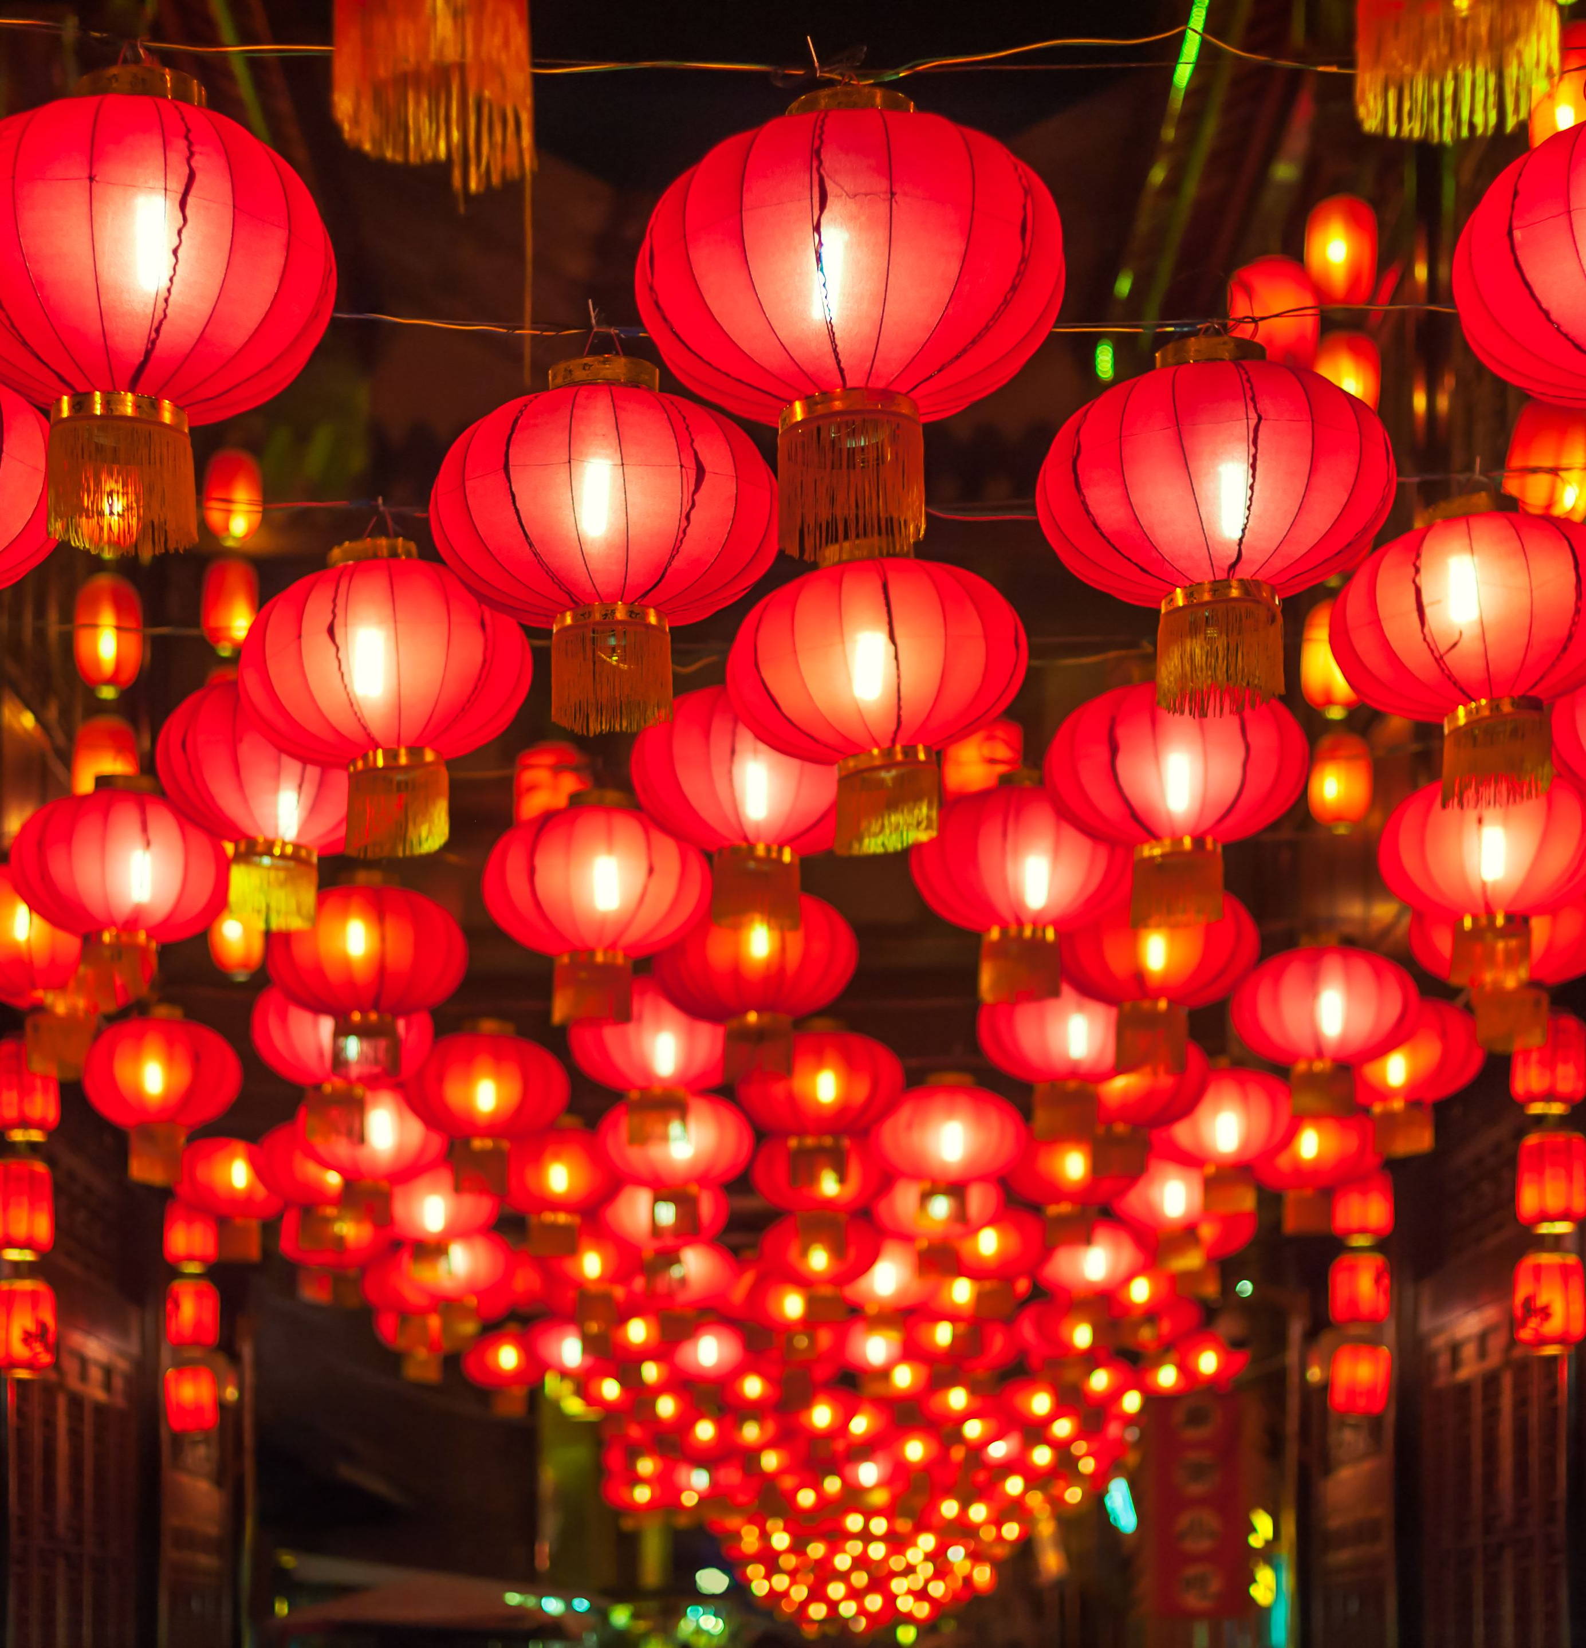
Fun facts
Putting Up New Year Decorations. ...
Offering Sacrifices to Ancestors. ...
Enjoying a Reunion Dinner. ...
Watching CCTV's New Year Gala. ...
Giving Red Envelopes (Lucky Money) to Kids. ...
Staying Up Late.

