Slide 1
We are grateful for....
Catholic Schools Week 2021
P6K

Slide 2
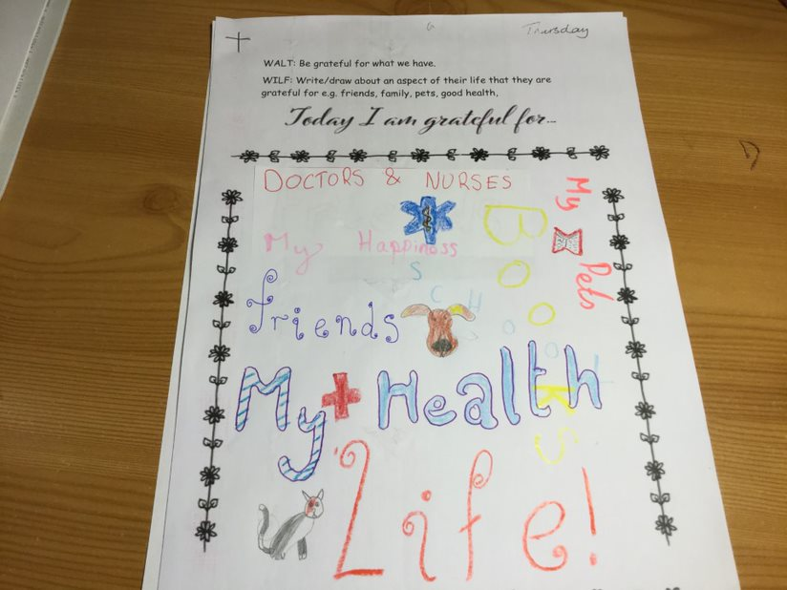
Today we are grateful for…..
Aoife T
Aidan

Slide 3
Oliver V
Alex

Slide 4
Today we are grateful for……..
Leah
Riyan
Charlie

Slide 5
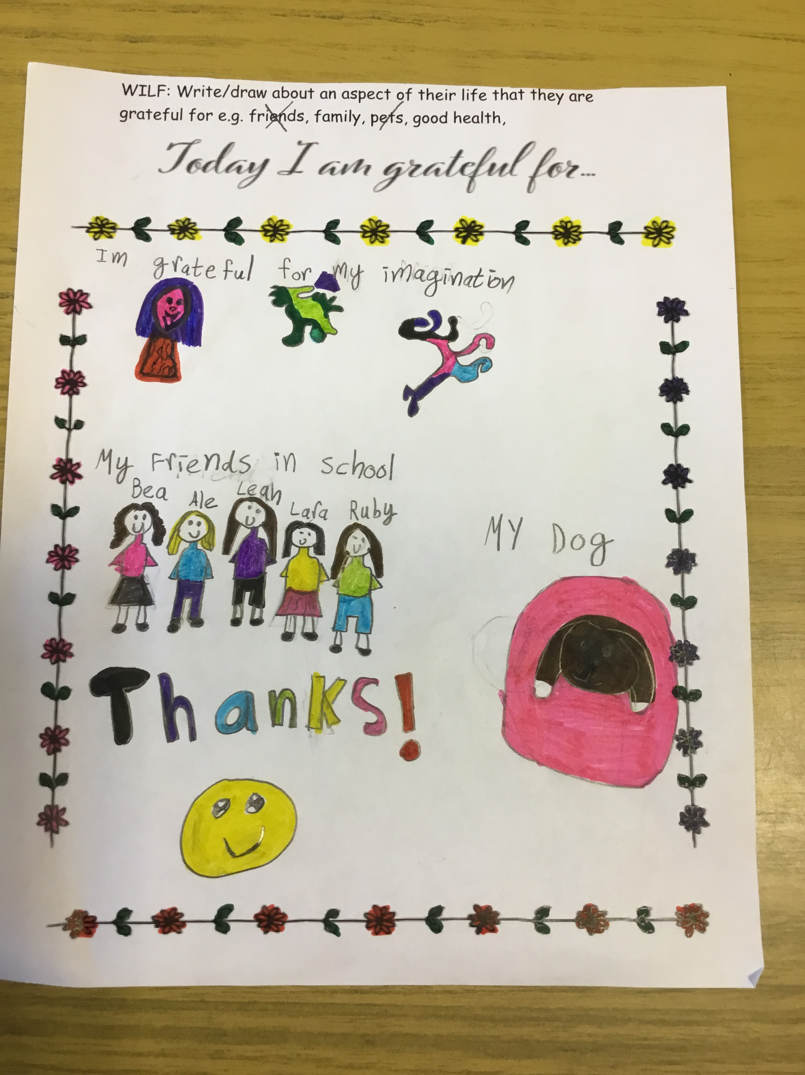
We give thanks!
Molly
Lucy
Alessia

Slide 6
Joseph

Slide 7
Lara
Edmund

Slide 8
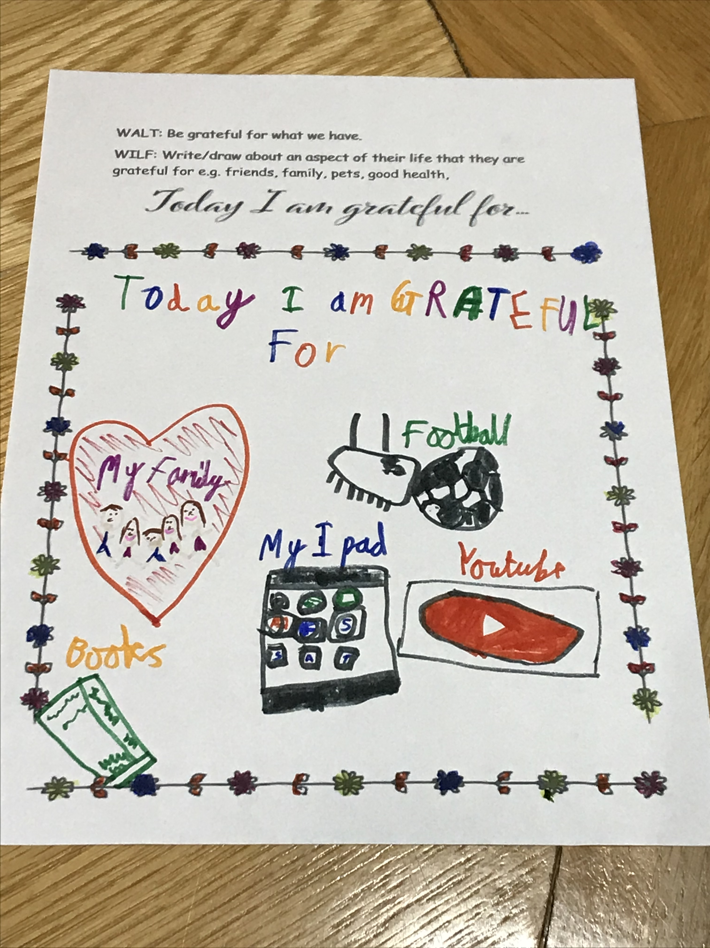
Today we are grateful for….
Tom D
Zak

Slide 9
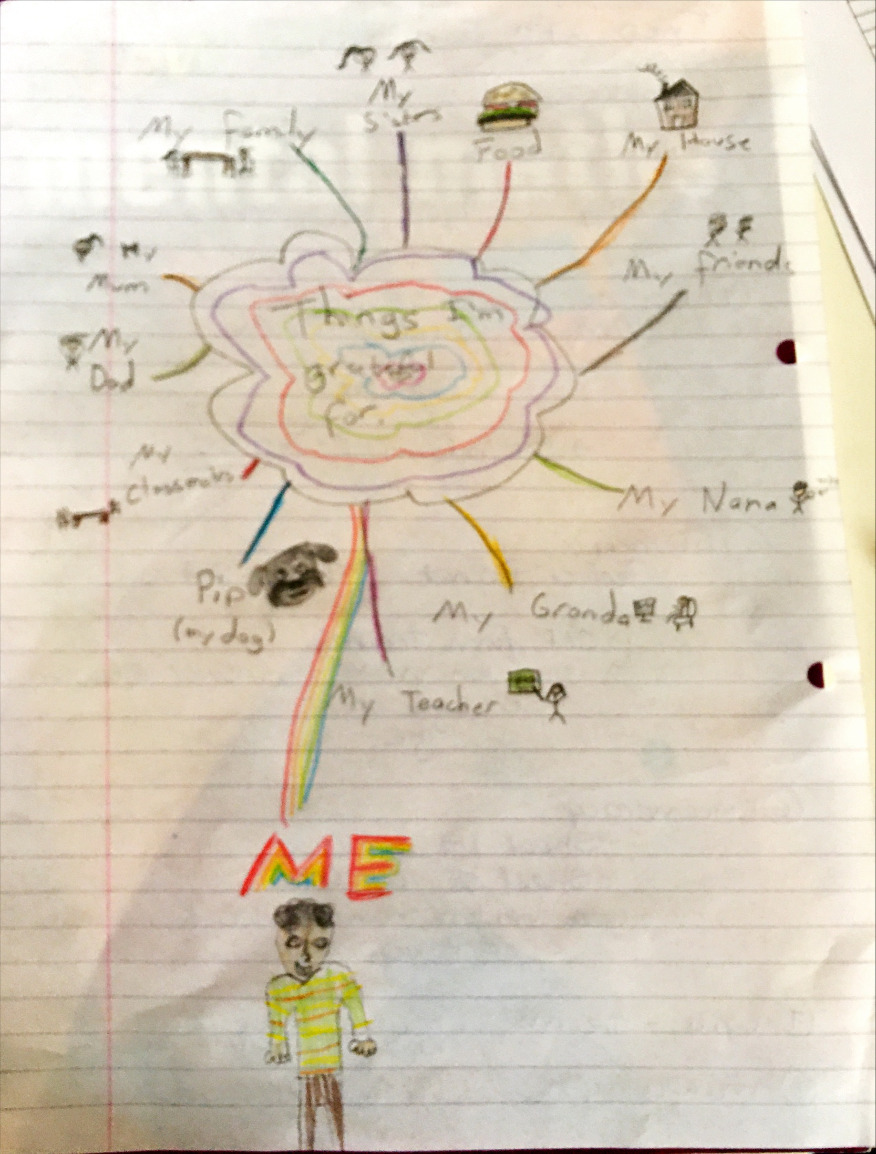
We Give thanks!
Thomas
Beatrice

Slide 10
Holly

Slide 11
Denis
Sean

Slide 12
Oliver C & Aoife H

Slide 13
