Slide 1
Mrs Kennedy’s Class 2019 - 2020
June
2020
My Farewell to you boys and girls!

Slide 2
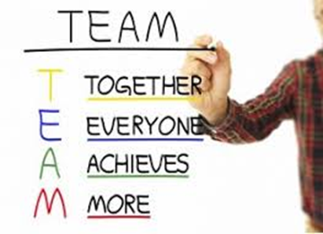
P5K - you were a great team!

Slide 3
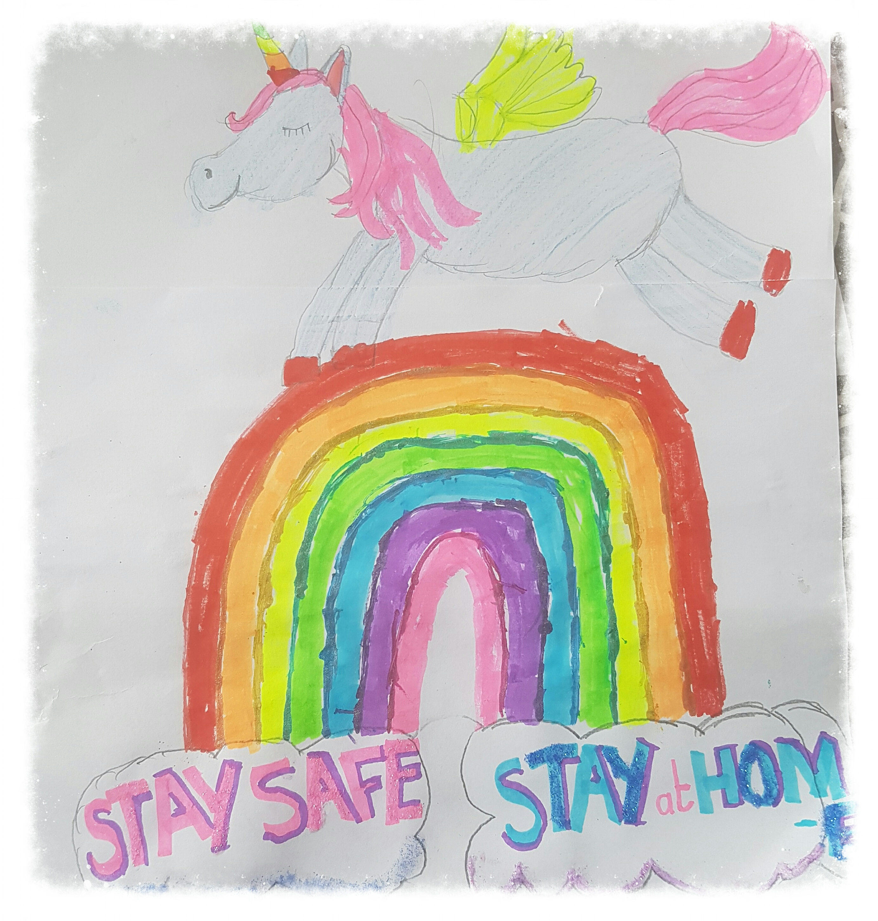
P5K -I loved that you thought of others!
STAY POSITIVE

Slide 4
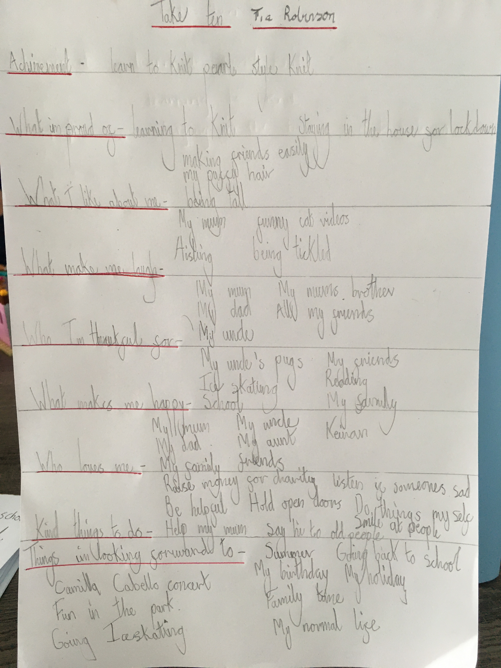
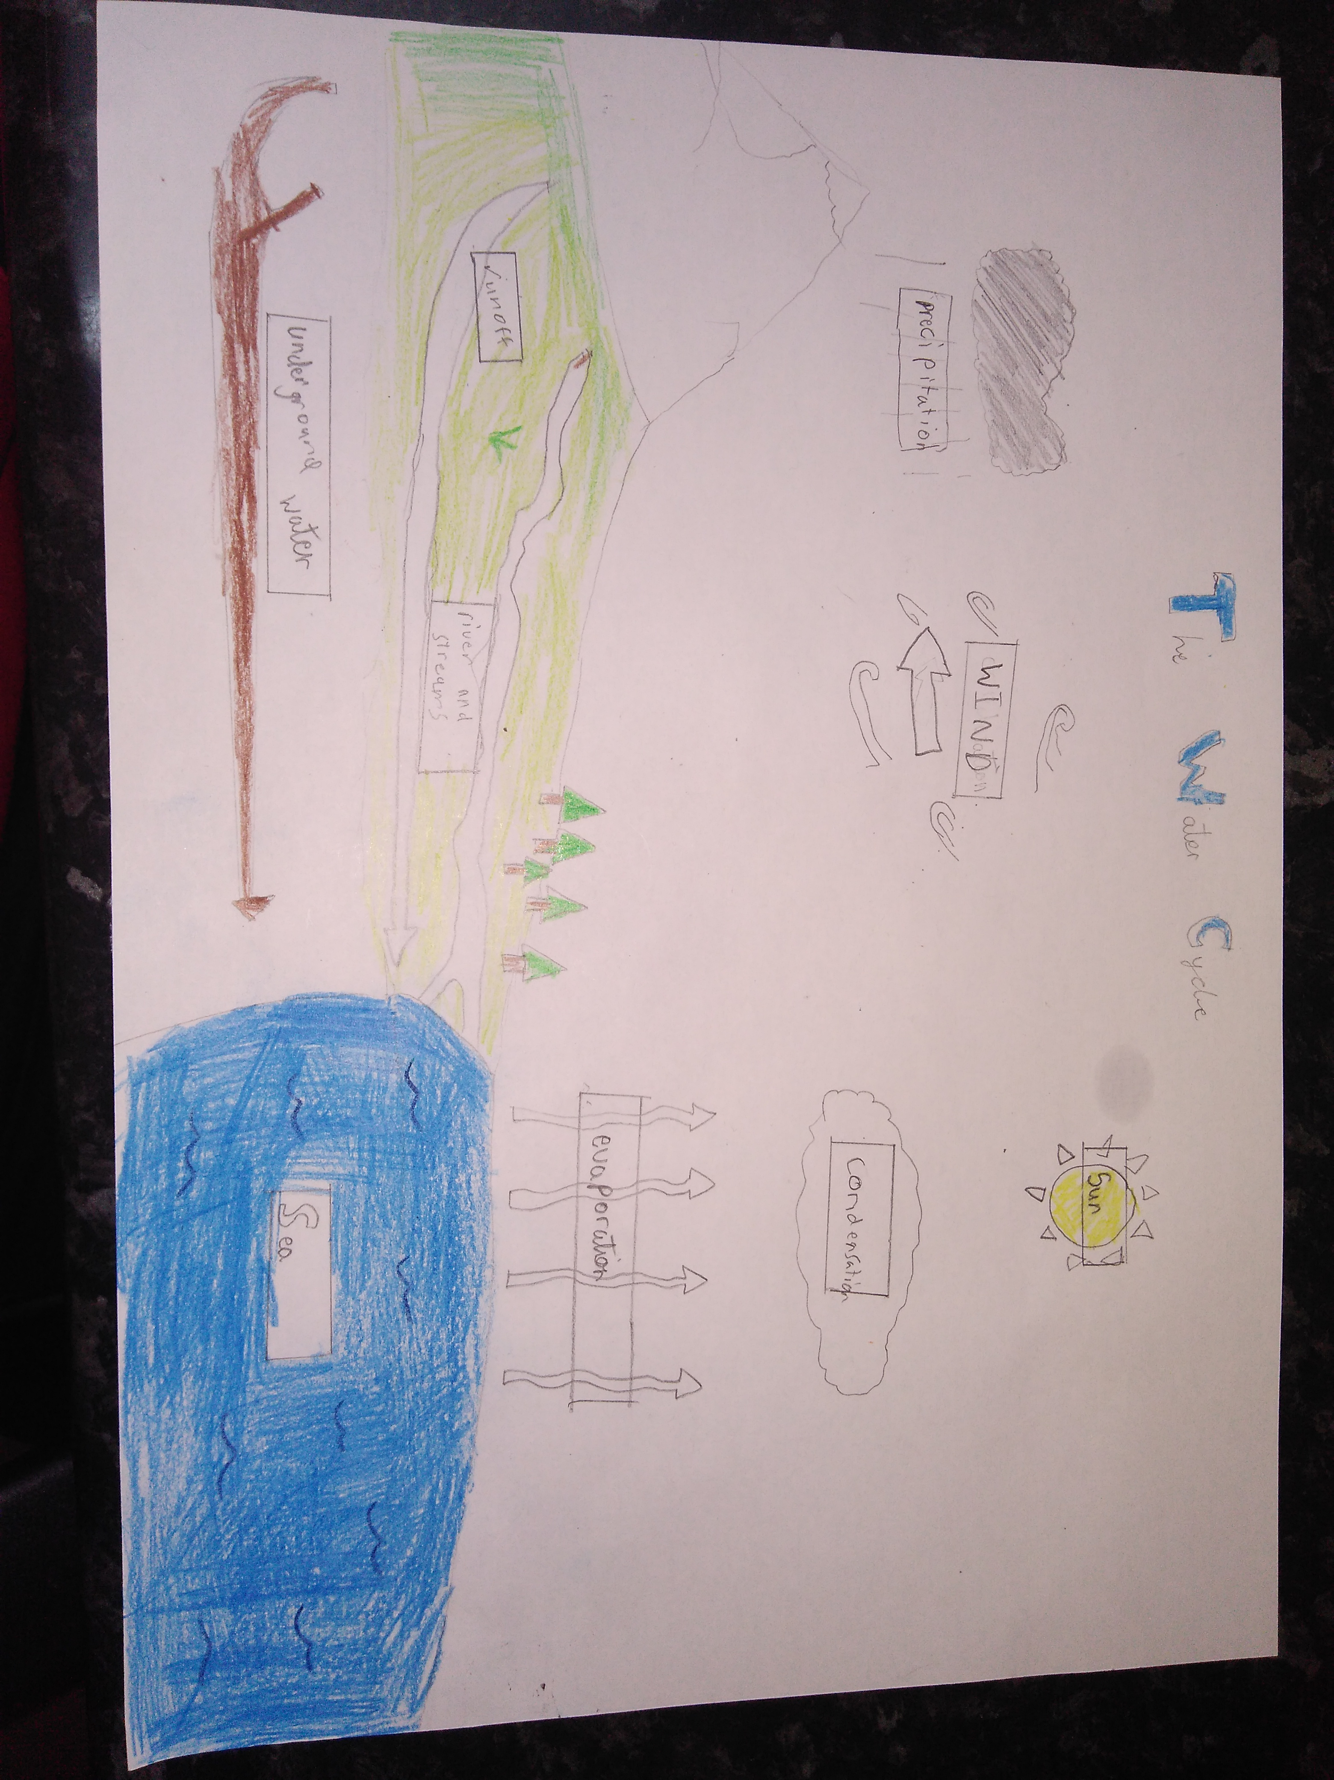
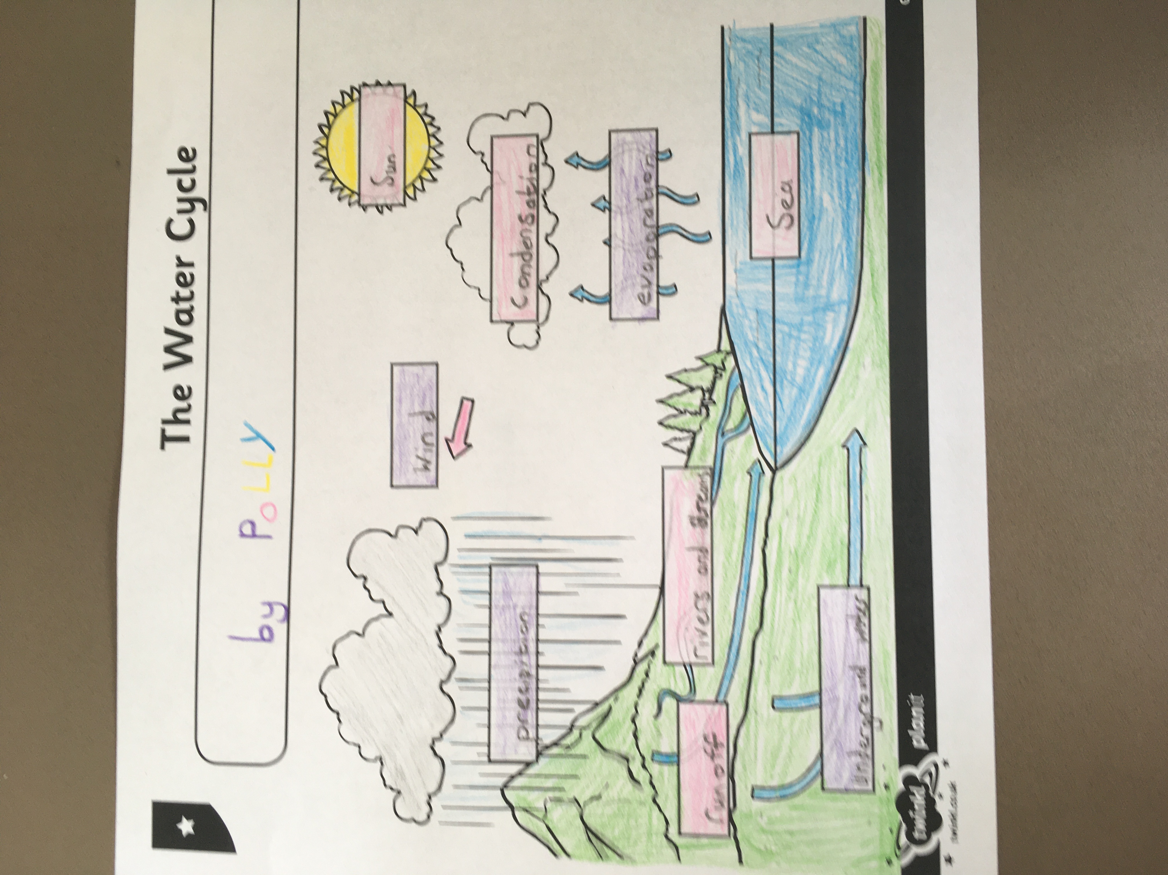
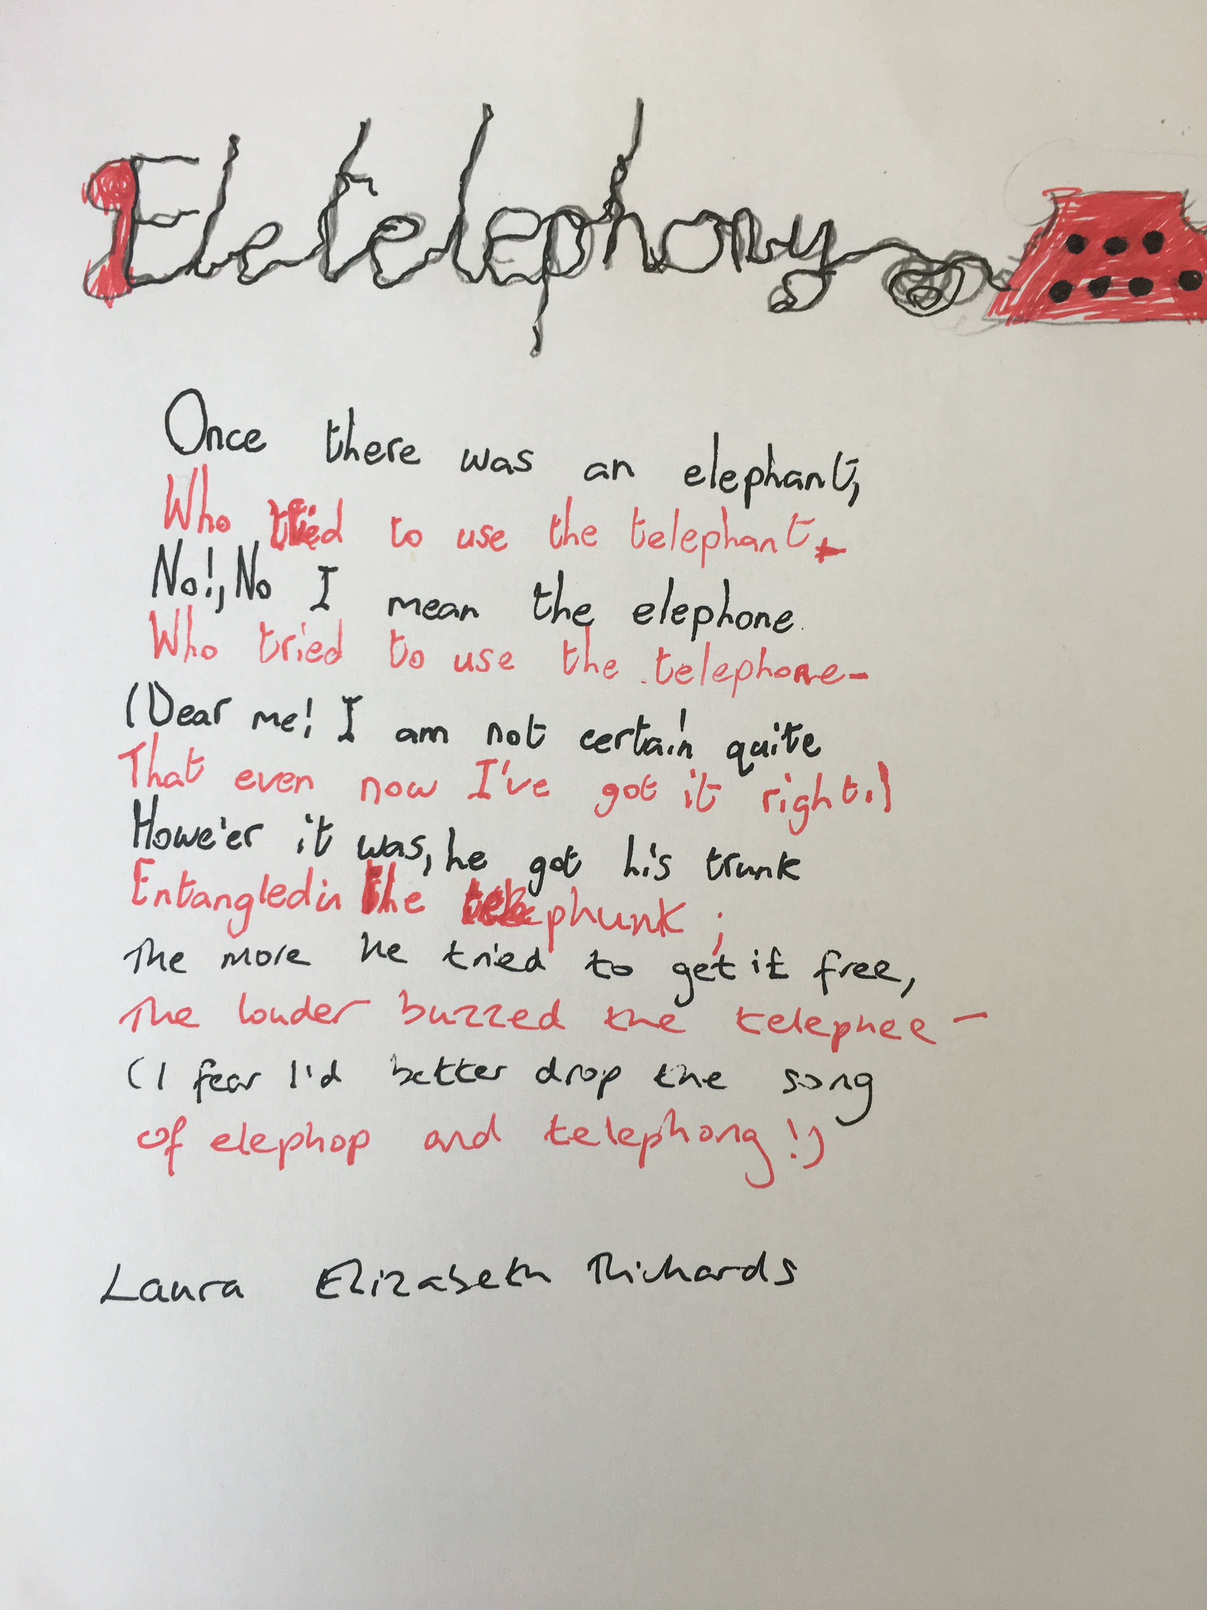
P5K - I thank you for working so hard
WAU
PDMU
Reading activities
Writing Genres
Manga High
Spellings
7 min Tables Tests
Art, Music, PE
Handwriting

Slide 5
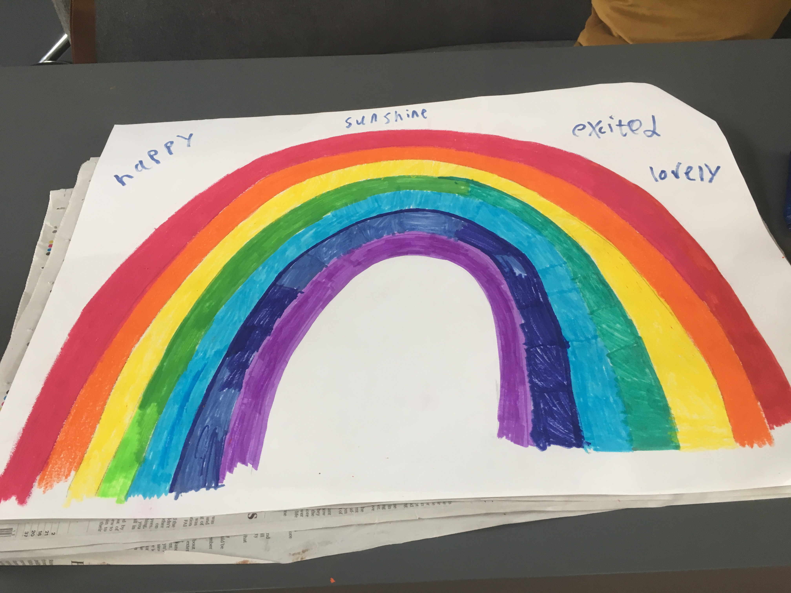
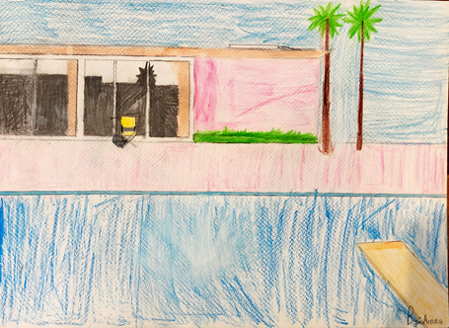
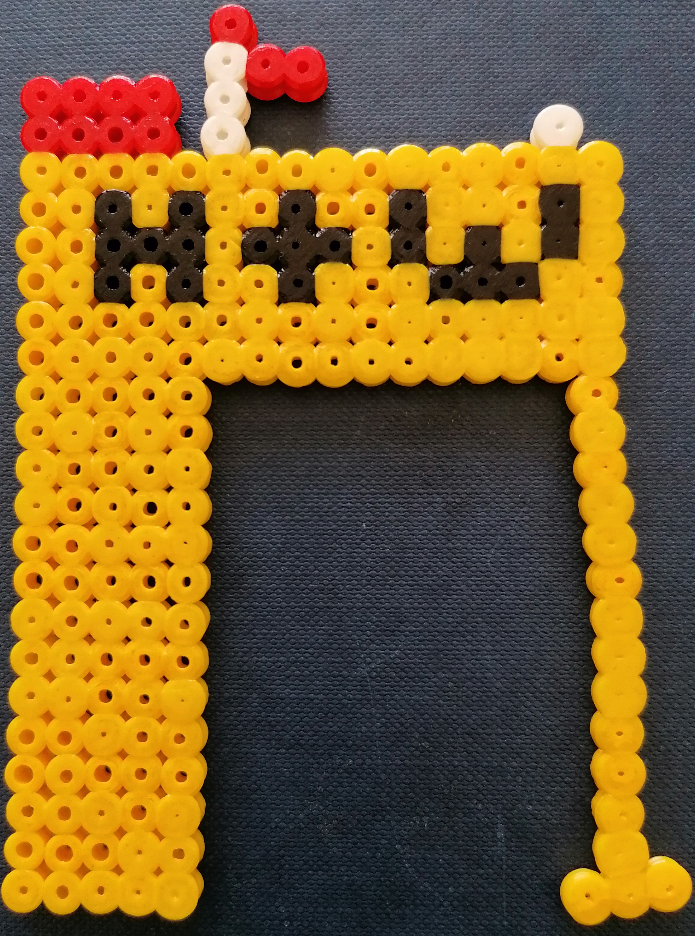
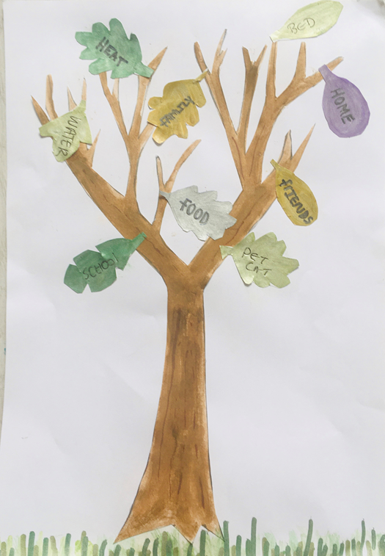
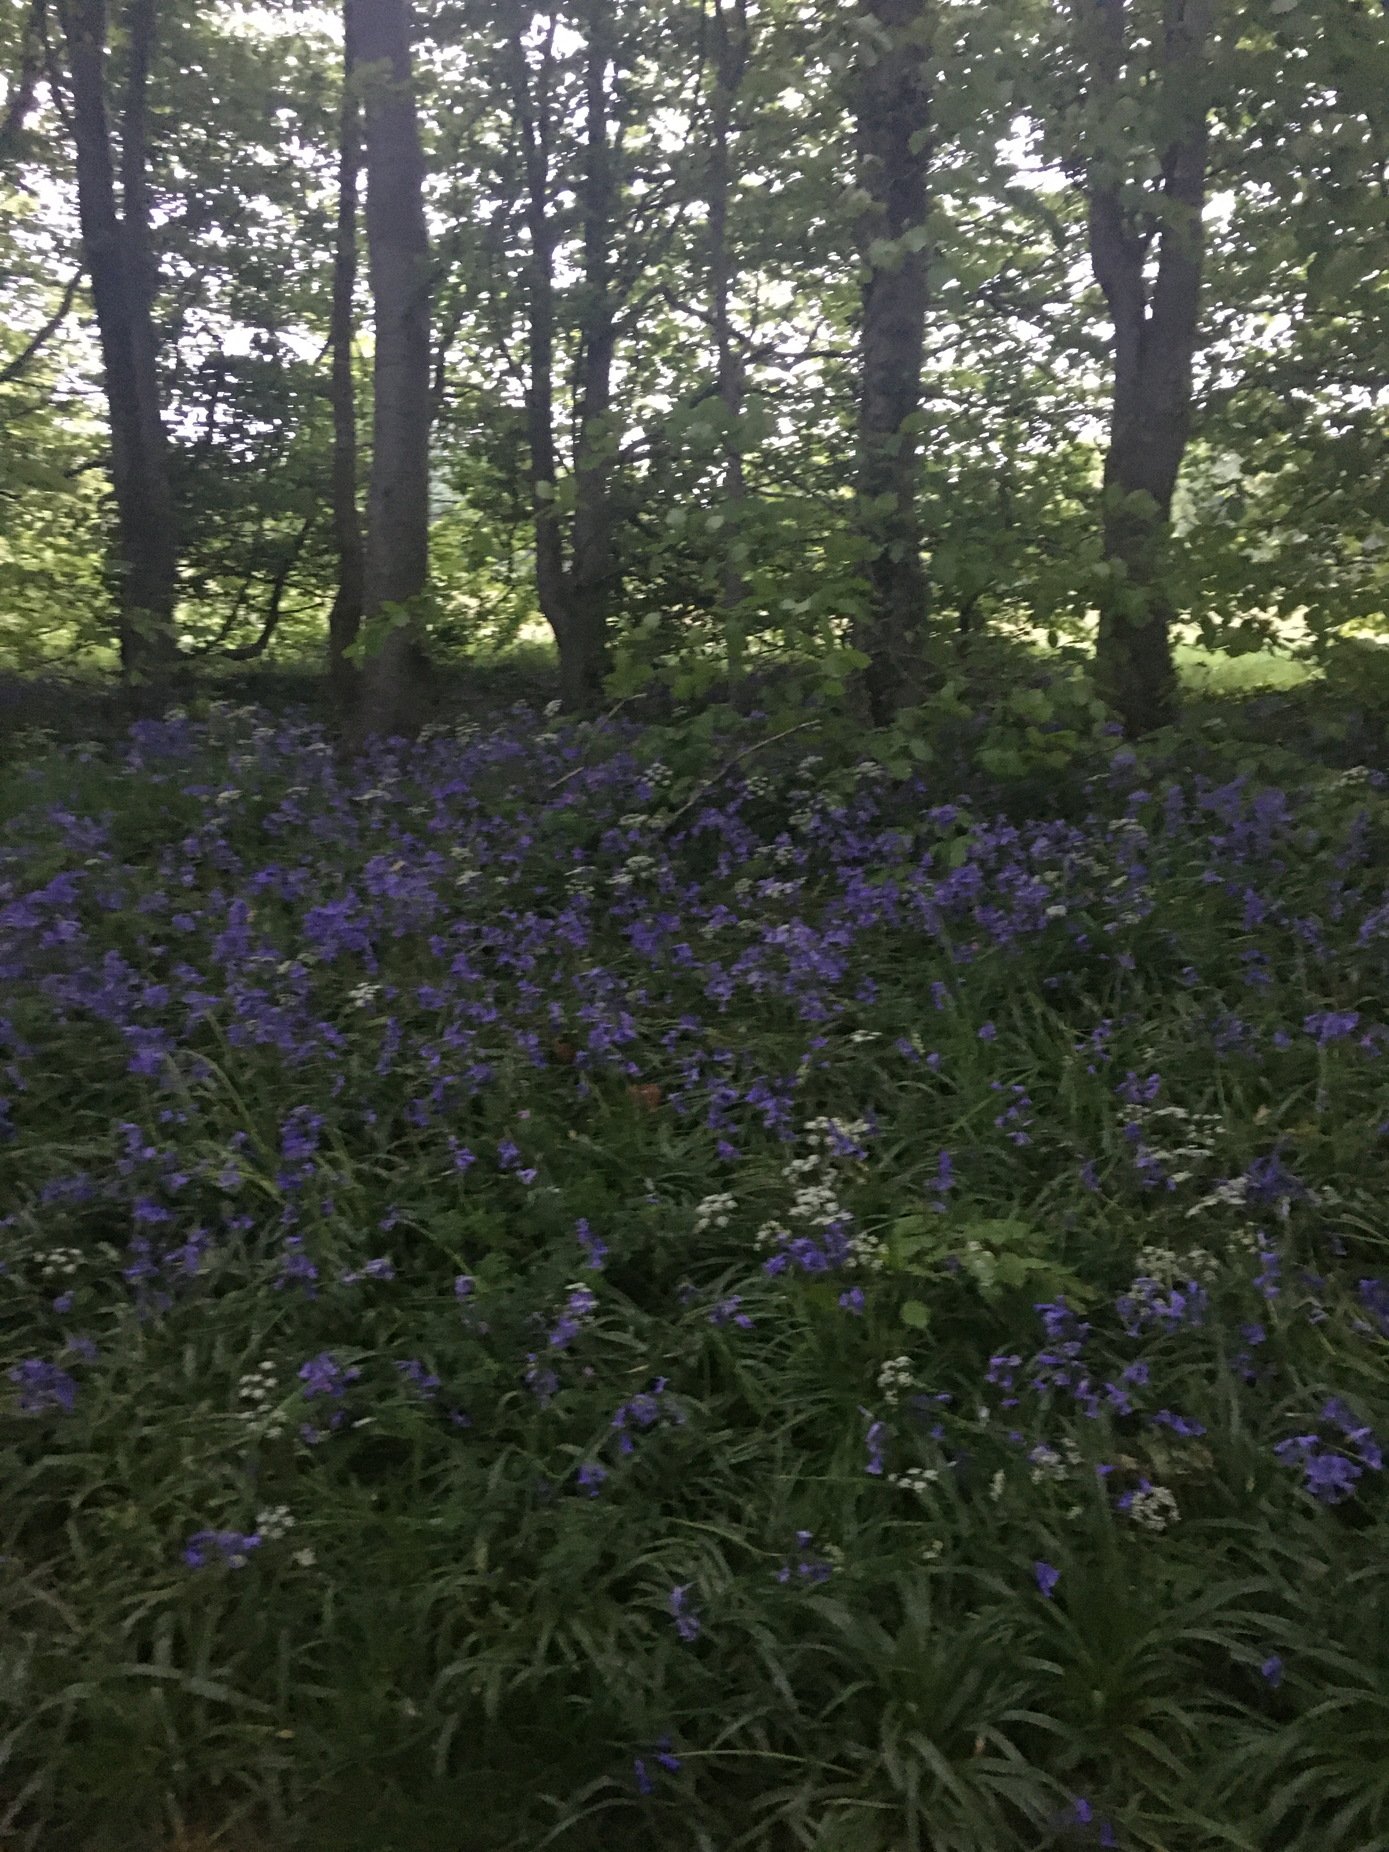
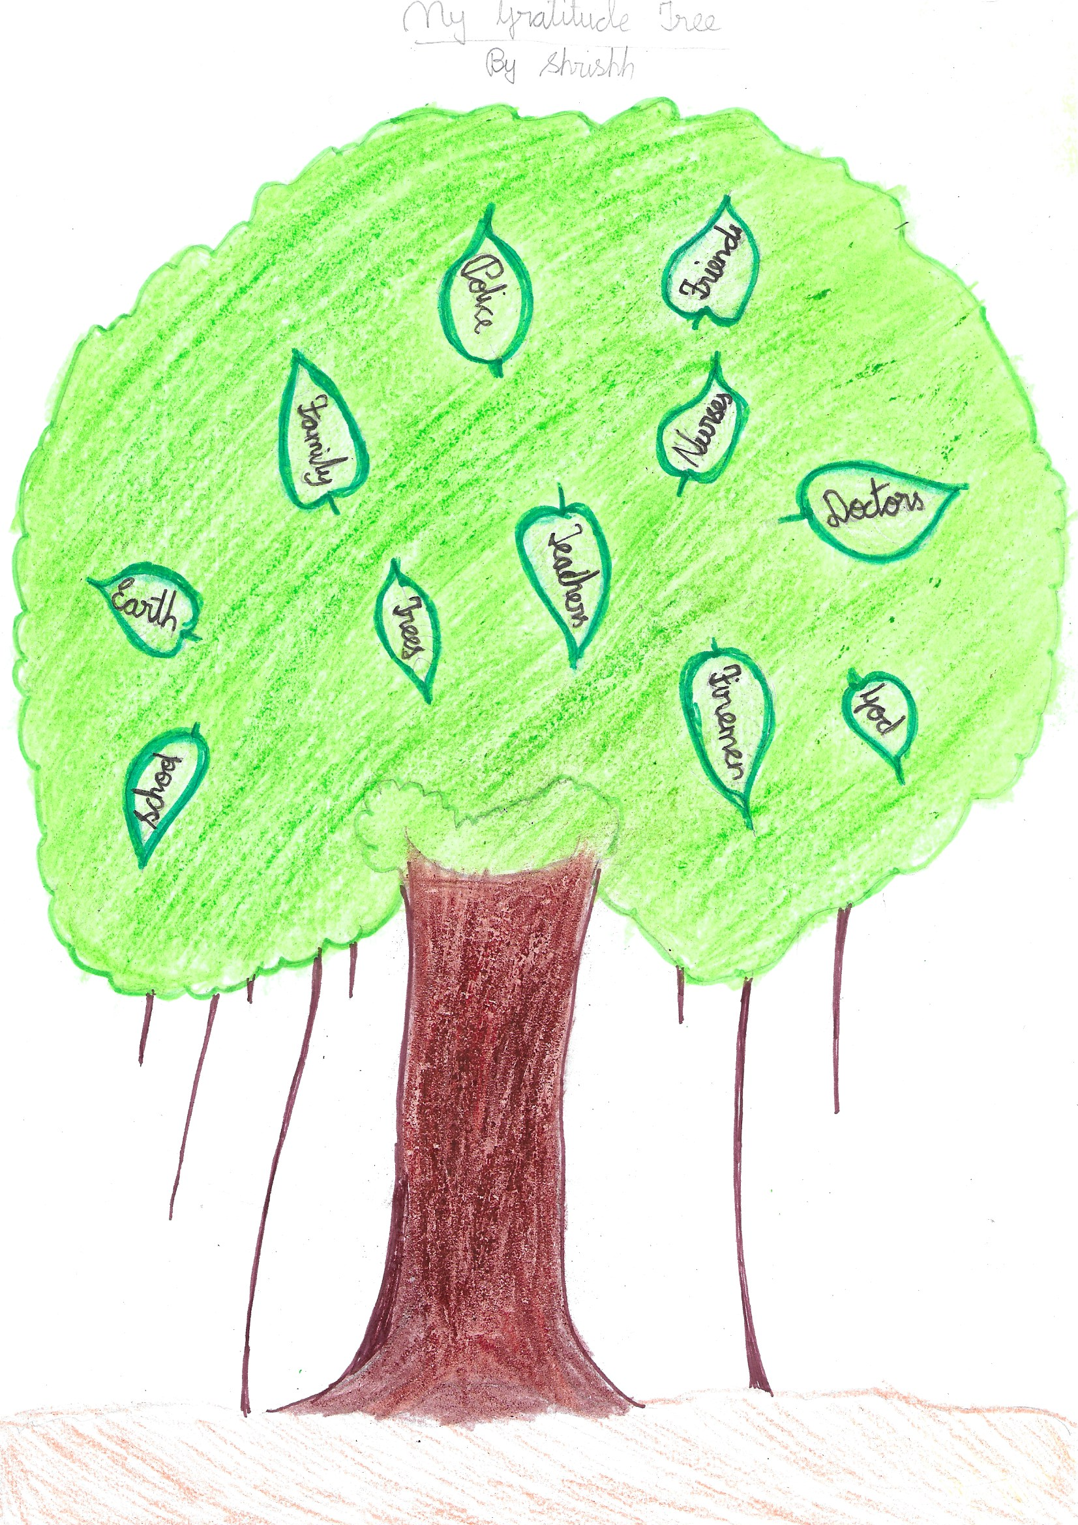
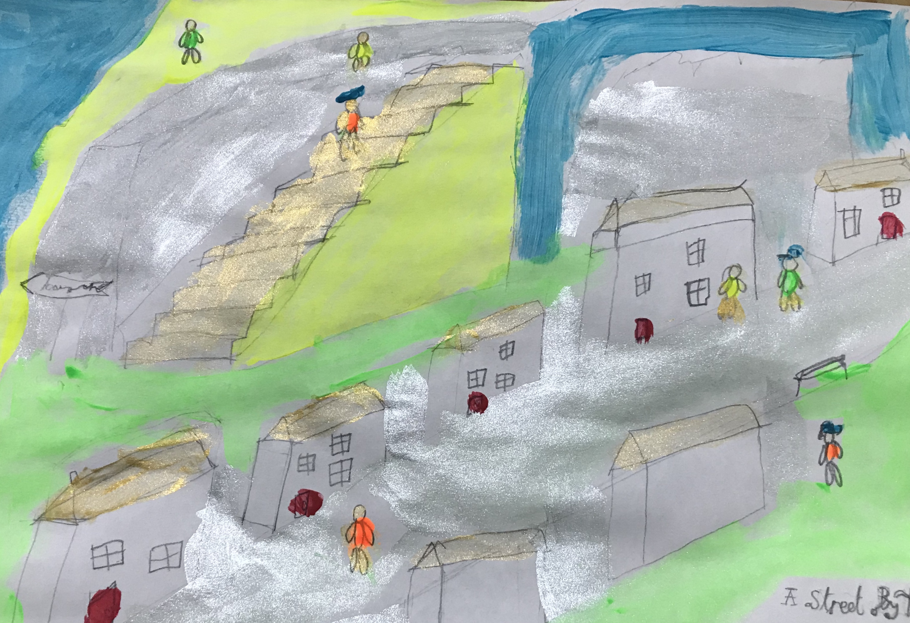
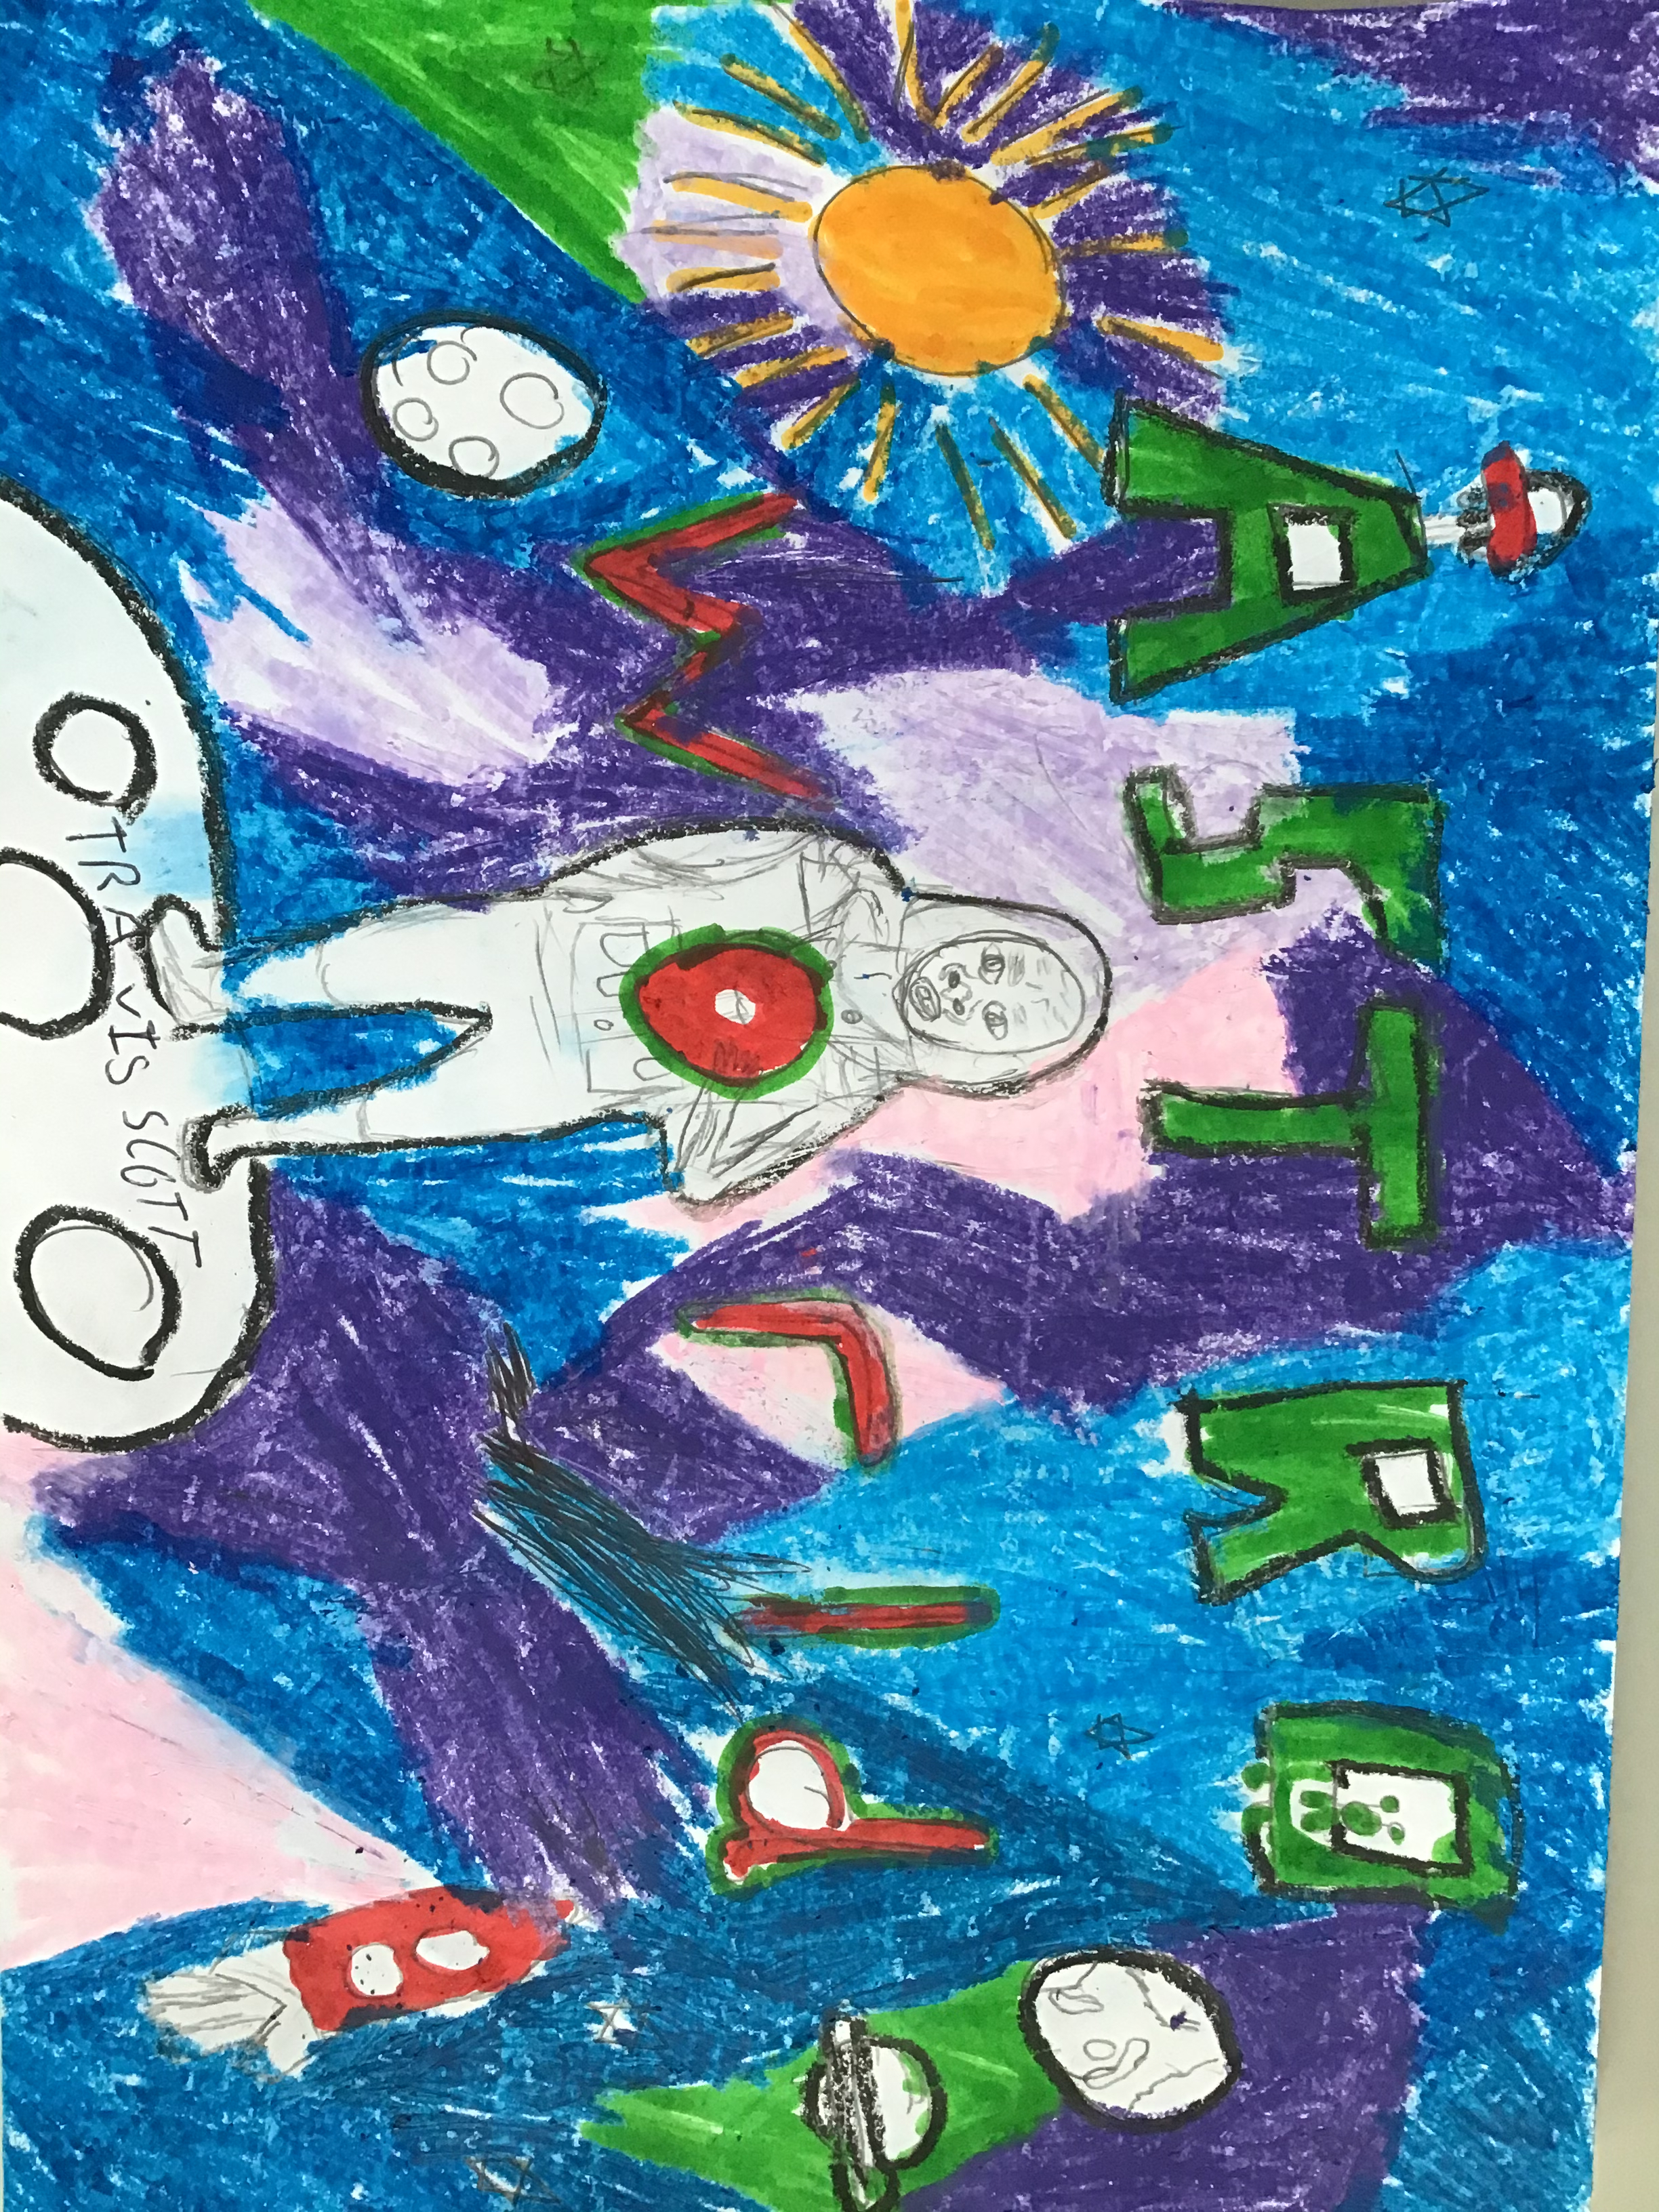
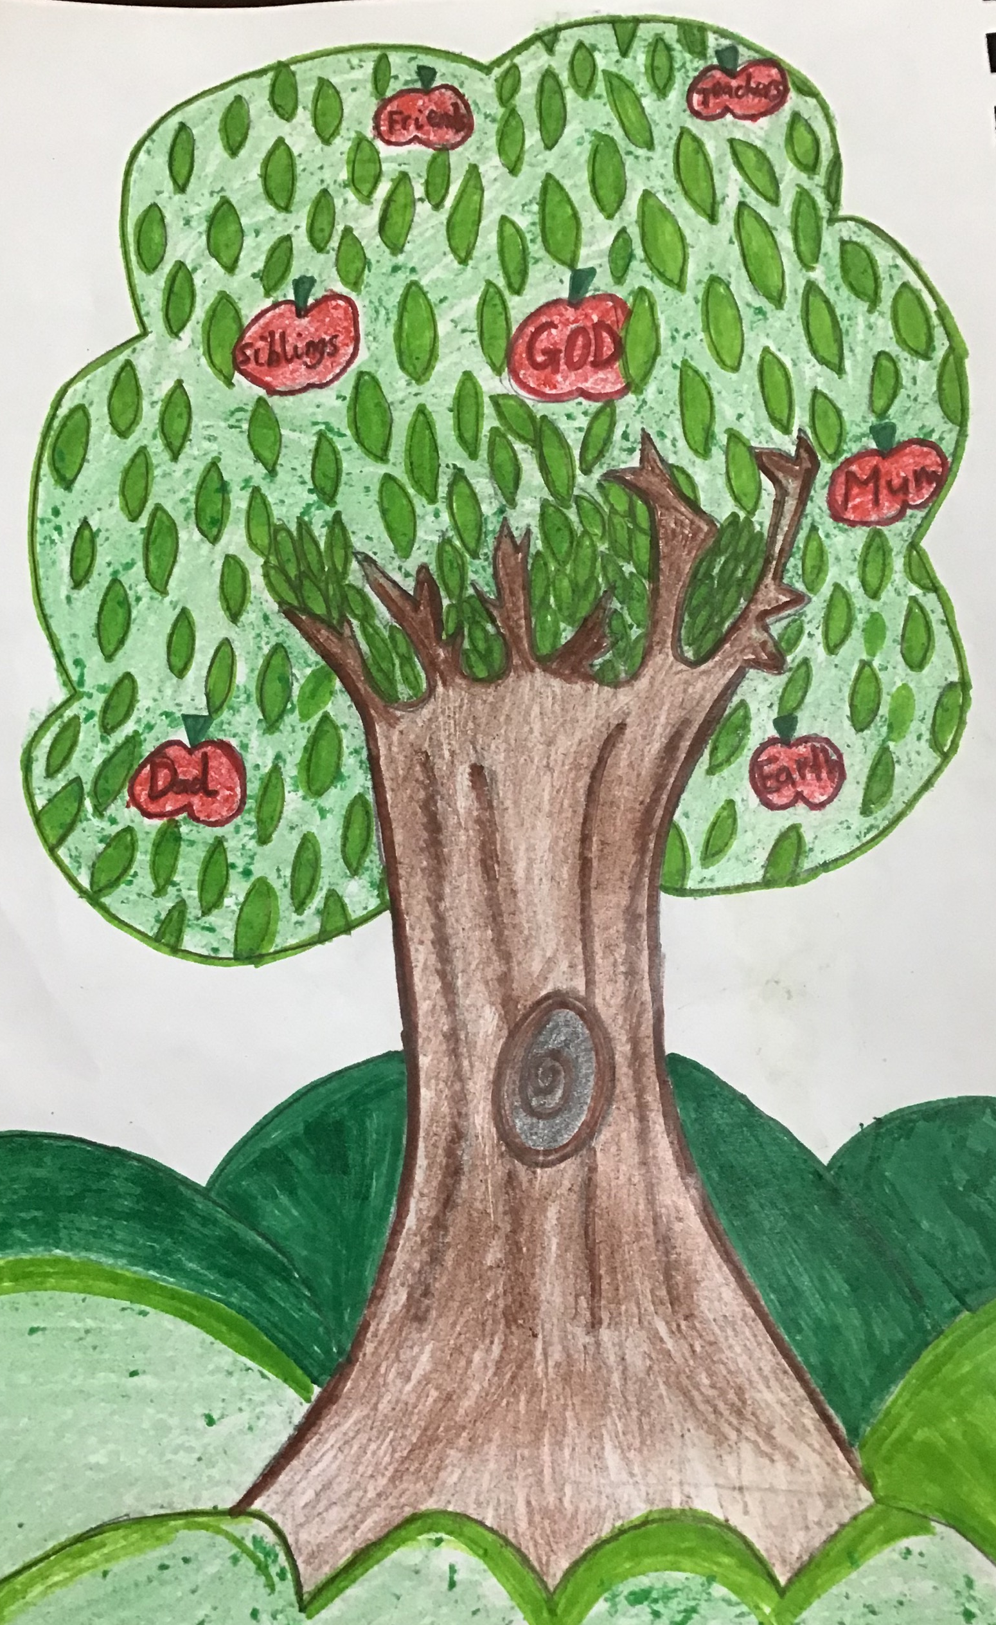
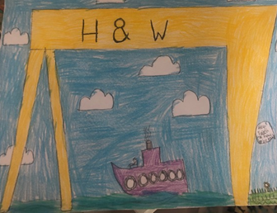
P5K - I thank you for being so creative

Slide 6
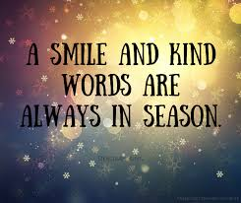
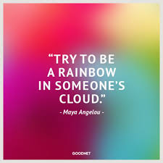
P5K – You always made me smile and where always there for each other.

Slide 7
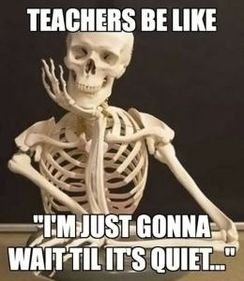
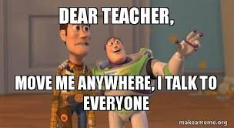
P5K - I will always remember how You just LOVED to TALK & TALK & TALK!!!

Slide 8
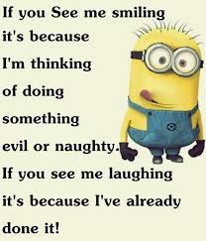
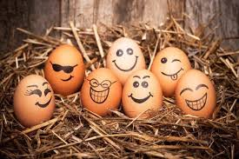
P5K you loved to laugh-for some reason, these quotes made me think of you!

Slide 9
P5K- You smashed Manga High - “Champions of St. Bride’s” - I was so proud!
You were awarded MANY Gold, Silver & Bronze

Slide 10
Well done P5K, you made it to the end of your P5 journey!
Thank you from Mrs K x

