Slide 1
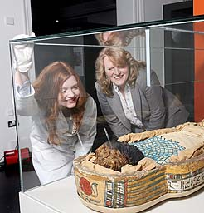
Come to Belfast!
Ulster Museum has something for everyone including Edmontosaurus dinosaur skeleton .
Meet Champion Patrick of Ifold an Irish Wolfhound and meet an Egyptian mummy!
Find out about the history of ‘The Troubles’ and see Nobel Peace Prize medals

Slide 2
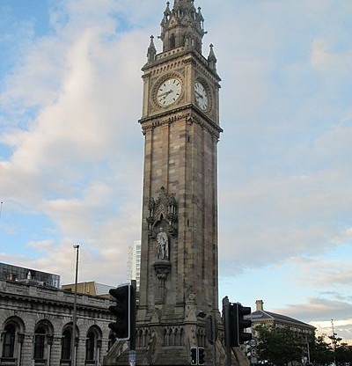
Come to Belfast
The Albert Memorial Tower is a clock tower in Queens square Belfast.
It was completed in 1869 and is one of the best known landmarks in Belfast.
To halt the worsening lean and repair damage caused by the elements and heavy passing traffic, a multimillion-pound restoration project was completed in 2002.

Slide 3
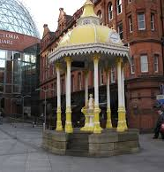
Come to Belfast
Jaffe erected the Jaffe Memorial fountain in 1874 to commemorate his father, who had funded the building of Belfast's first synagogue at Great Victoria Street.
Originally sited in Victoria Square, the fountain was surmounted by an ornamental weather vane and was later moved to the Botanic Gardens.
Now it is back in Victoria Square it is not in Botanic Gardens anymore.

Slide 4
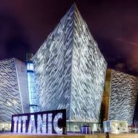
Come to Belfast!
Titanic Belfast is the world’s largest Titanic experience.
Take the Discovery Tour explaining the history of the ship.
Titanic Belfast extends over 9 interactive galleries.

Slide 5
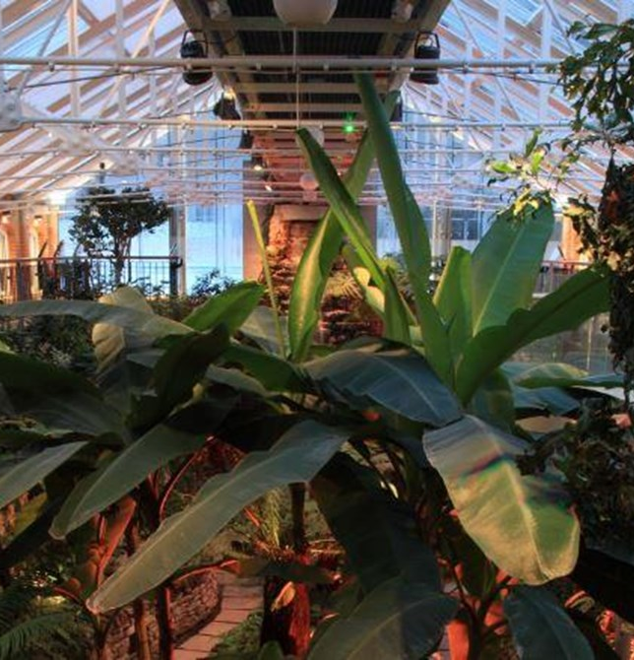
Come to Belfast
Situated beside the Ulster Museum is the beautiful Botanic Gardens.
Botanic Gardens is home to the tropical Palm House and Tropical Ravine.
The building was designed by Sir Charles Lanyon who helped design Queens University.

Slide 6
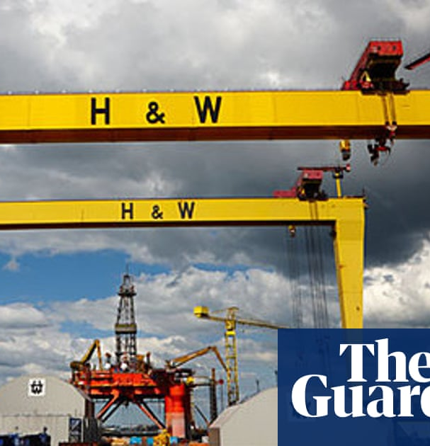
Come to Belfast
The Harland and Wolff shipyard was founded in 1862.
It was founded by Edward James Harland and Gustav Wilheim Wolff.
At its height Harland and Wolff shipyard became one of the biggest ship builders in the world.

Slide 7
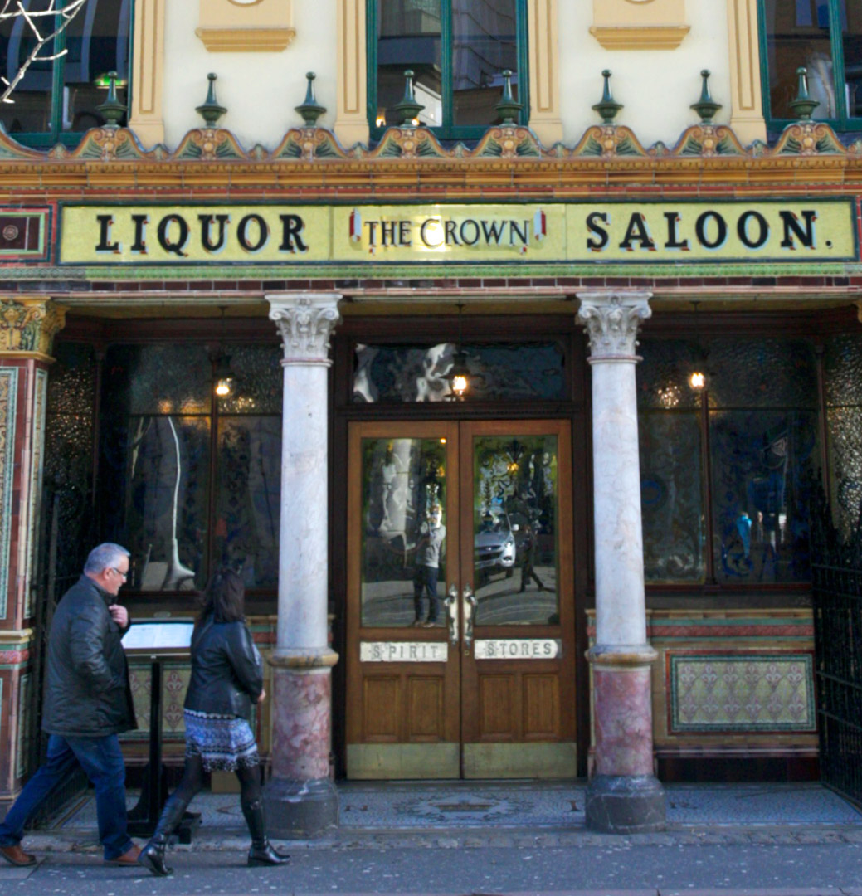
Come to Belfast
The Crown Liquor Saloon is the most famous and oldest bar in Belfast.
It is owned by the National Trust and is an outstanding example of a Victorian gin palace.
It was refurbished in 1885 by Patrick Flanagan and has elaborate tiling, stained glass and woodwork completed by Italian Craftsmen.

Slide 8
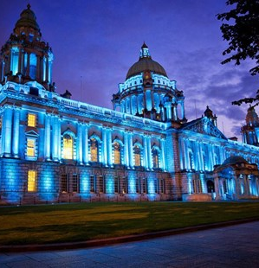
Come to Belfast
Belfast City Hall is the civic building of Belfast City Council.
Belfast was awarded city status by Queen Victoria in 1888 and plans for city hall followed.
The grounds house Northern Ireland’s main War Memorial which is The Garden Of Rememberance.

Slide 9
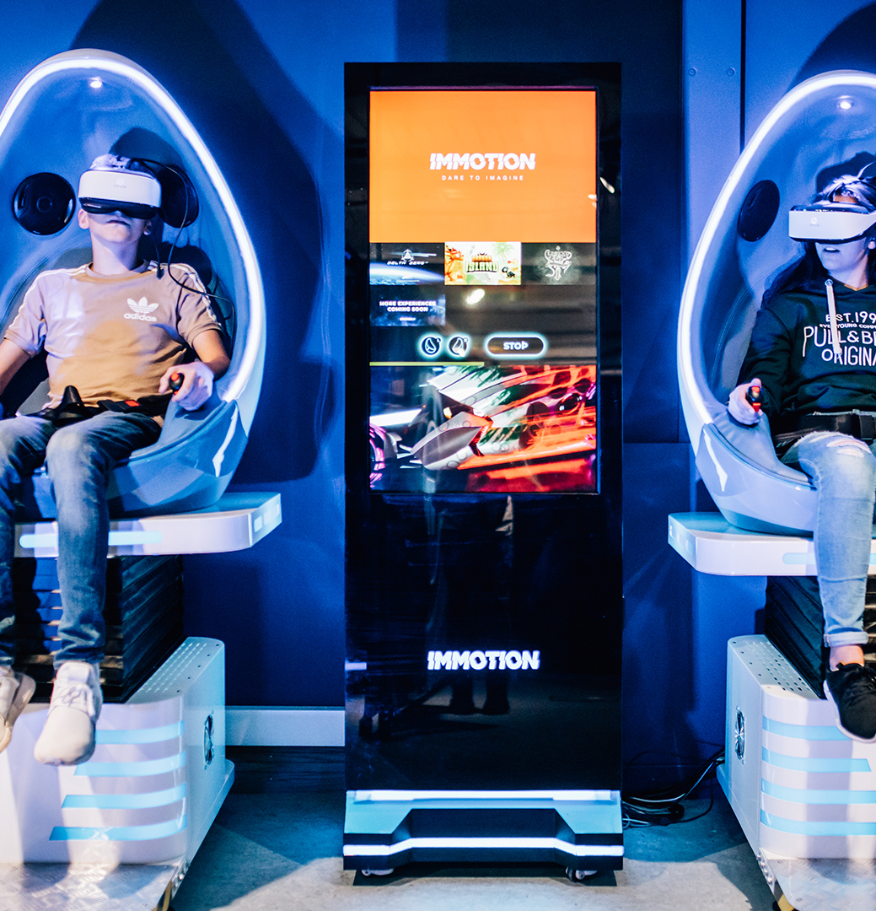
Come to Belfast
W5 is an award winning science and discovery centre housing over 250 interactive exhibits.
It is located at the Odyssey Complex.
It is a perfect family day out with 6 themed exhibition areas for all ages from Spacebase to VR Zone.

Slide 10
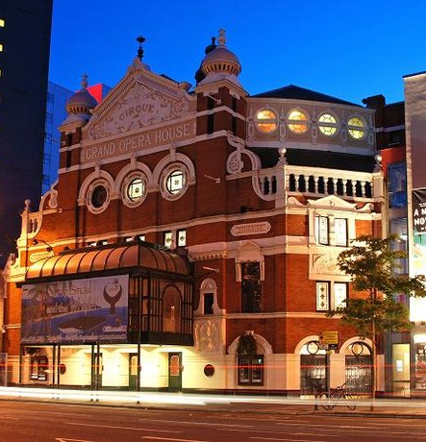
Come to Belfast
The Grand Opera House was designed by Frank Matcham and opened on 23rd December 1895.
The building has been damaged by bombs on several occasions usually when the nearby Europa Hotel was targeted.
In 1995 the running of the theatre was taken over by the Grand Opera House Trust, it is currently undergoing further renovation and was due to open later this year but is likely to be delayed because of Covid-19.

