Slide 1
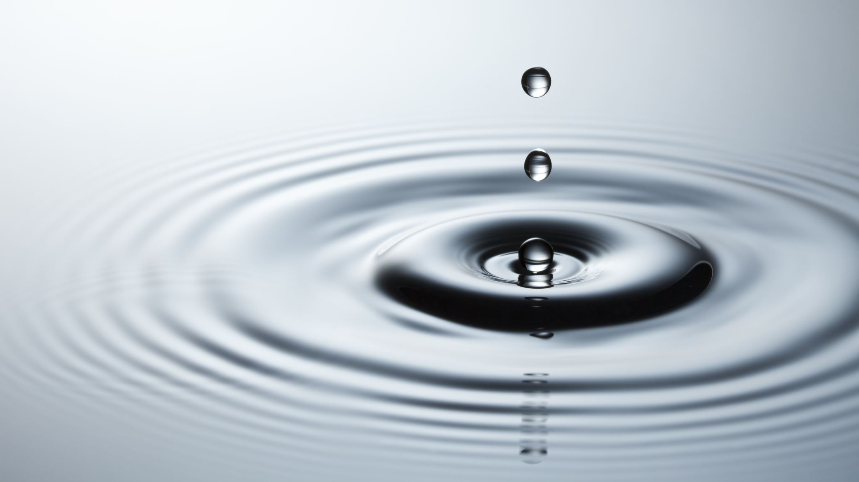
Water cycle
By Jodie Scanlon

Slide 3
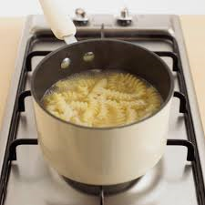
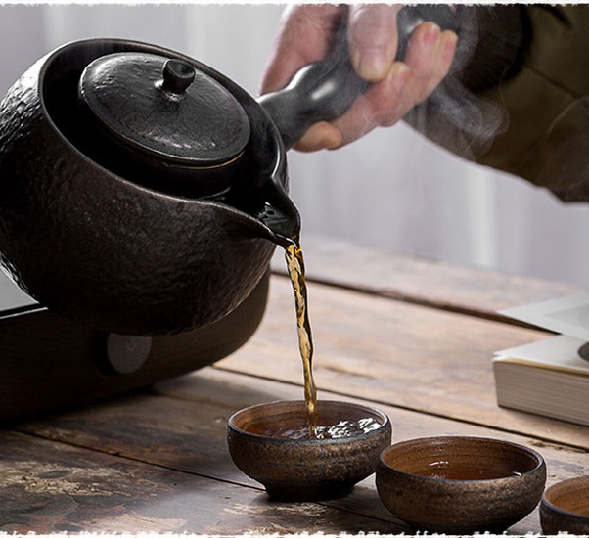
Water is used
Water is used for drinking water, make tea, boil water, wash your self and clean your self

Slide 4
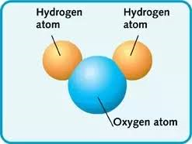
What is water made of ?
Water is made of hydrogen and oxygen gases that combines and then it makes water.

Slide 5
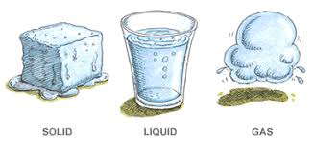
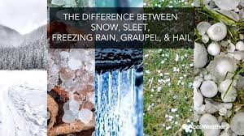
Can water turn in to different forms?
Water can change forms from a solid (ice) to a liquid (water) to a gas (water vapour). Sometimes rain can be snow, sleet and hail stones.

Slide 6
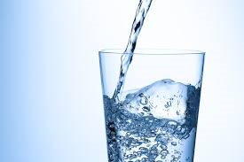
Why is water called liquid gold?
Water is called liquid gold because in some countries it is very hard to get water because you can only live for 3 or 4 days without drinking water.
75% of our body is made of water.

Slide 7
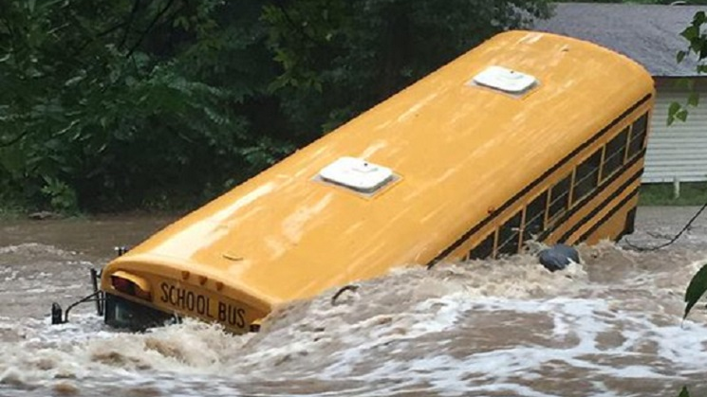
Too much water
When we have too much water they are called floods. Rainfall is usually about 2cm deep but sometimes there is more called flooding. This can be very deep covering your whole body. It can be higher than the roof of your house. Some people can not swim so these people may die in a flood. Houses could be damaged.

Slide 8
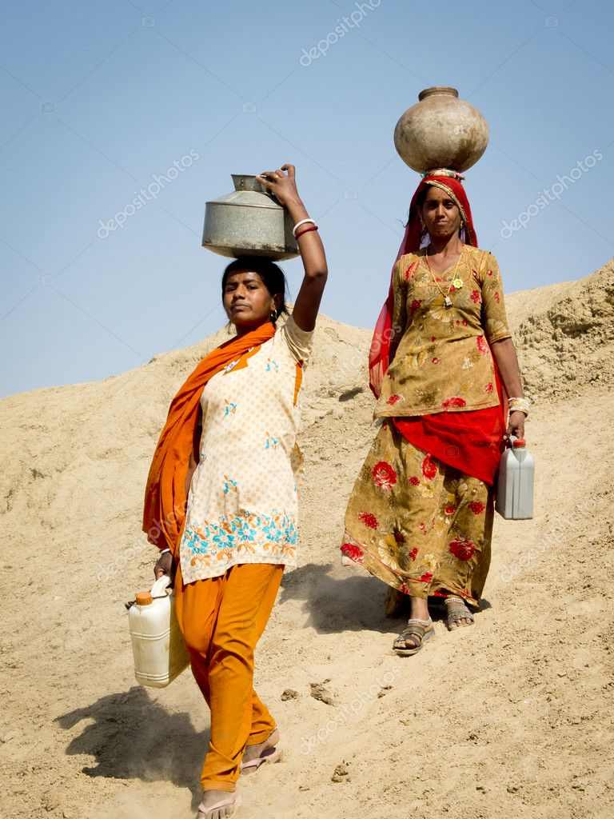
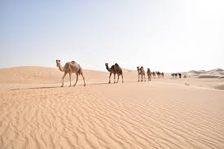
If we did not have enough water in the world
If there is no water instead of grass it will be sand and there would not be many plants.

Slide 9
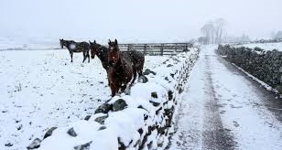
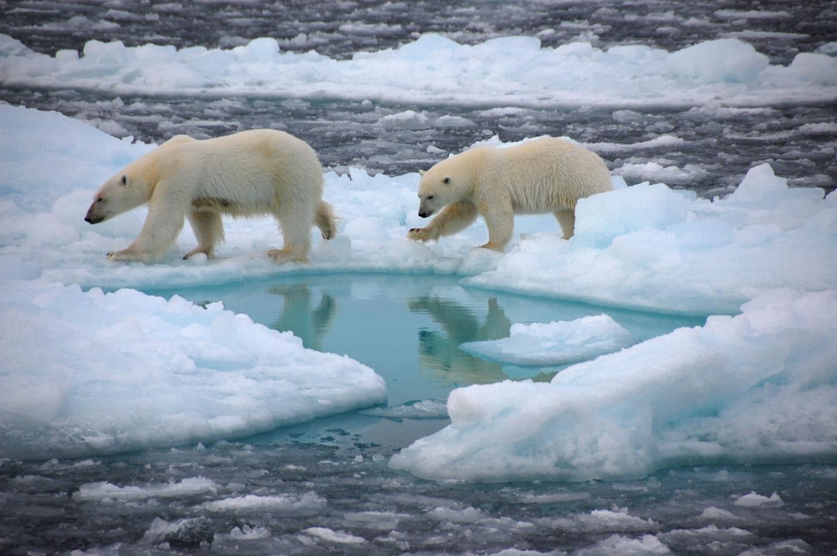
What would happen if the whole world was covered in ice?
When it is very cold ice forms everywhere especially on any form of water.

