Slide 1
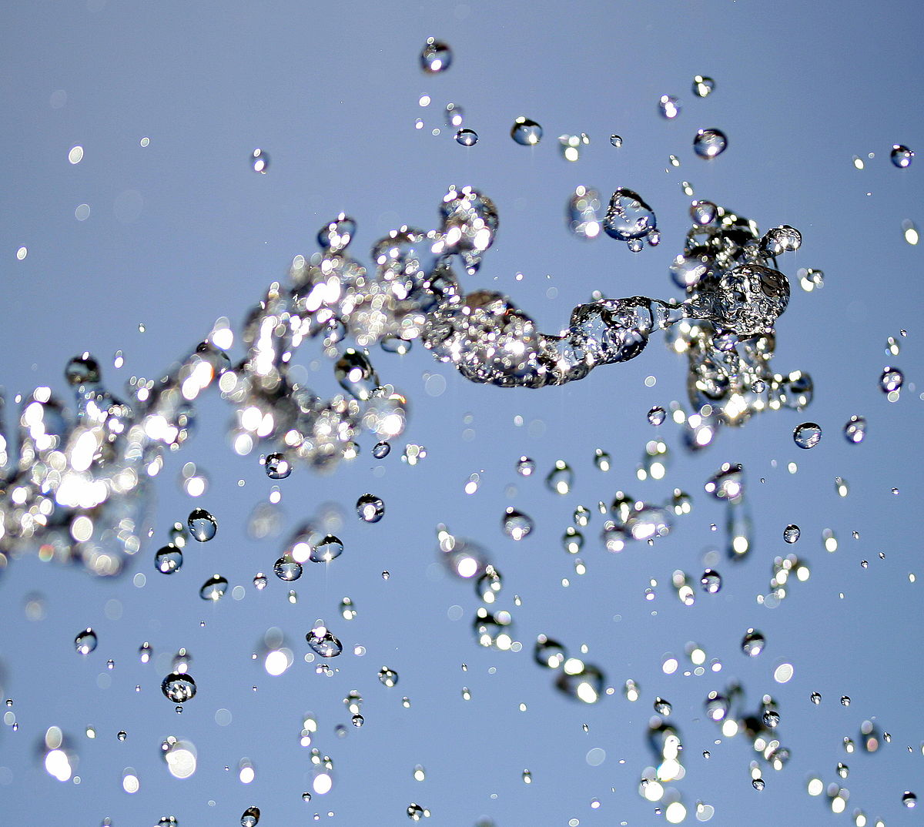
The Importance of Water
By anna
This Photo by Unknown author is licensed under CC BY-SA.

Slide 2
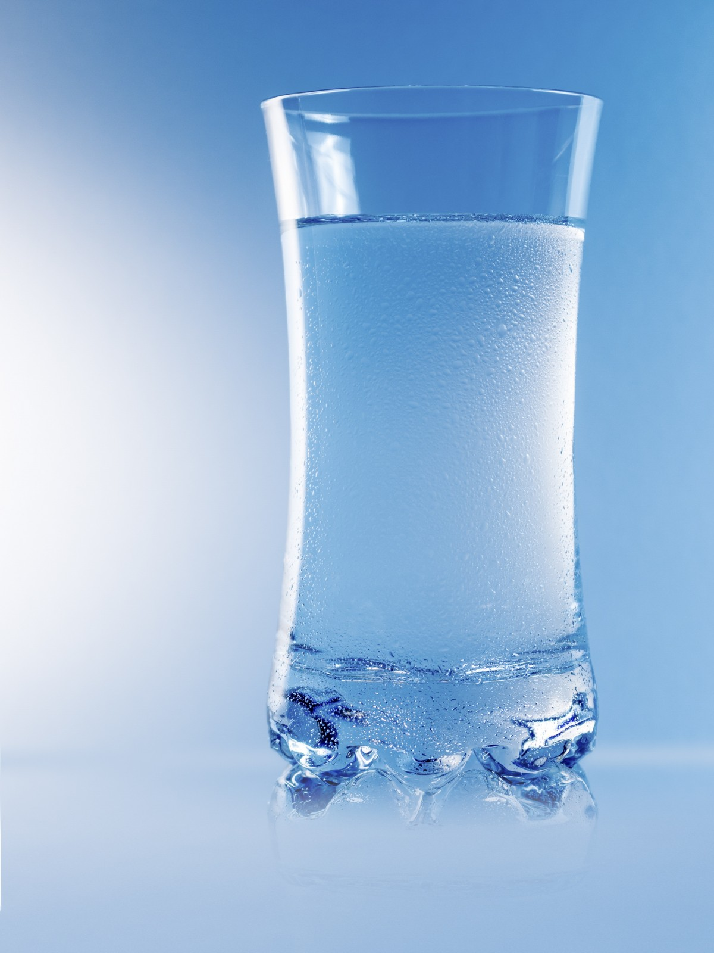
Why do we need to drink?
When we sweat we lose our water from our body so we need to drink more water
We all need fresh water to drink, bathe, washing clothes, cooking and watering the plants
Water also keeps the animal's bodies clean and cool

Slide 3
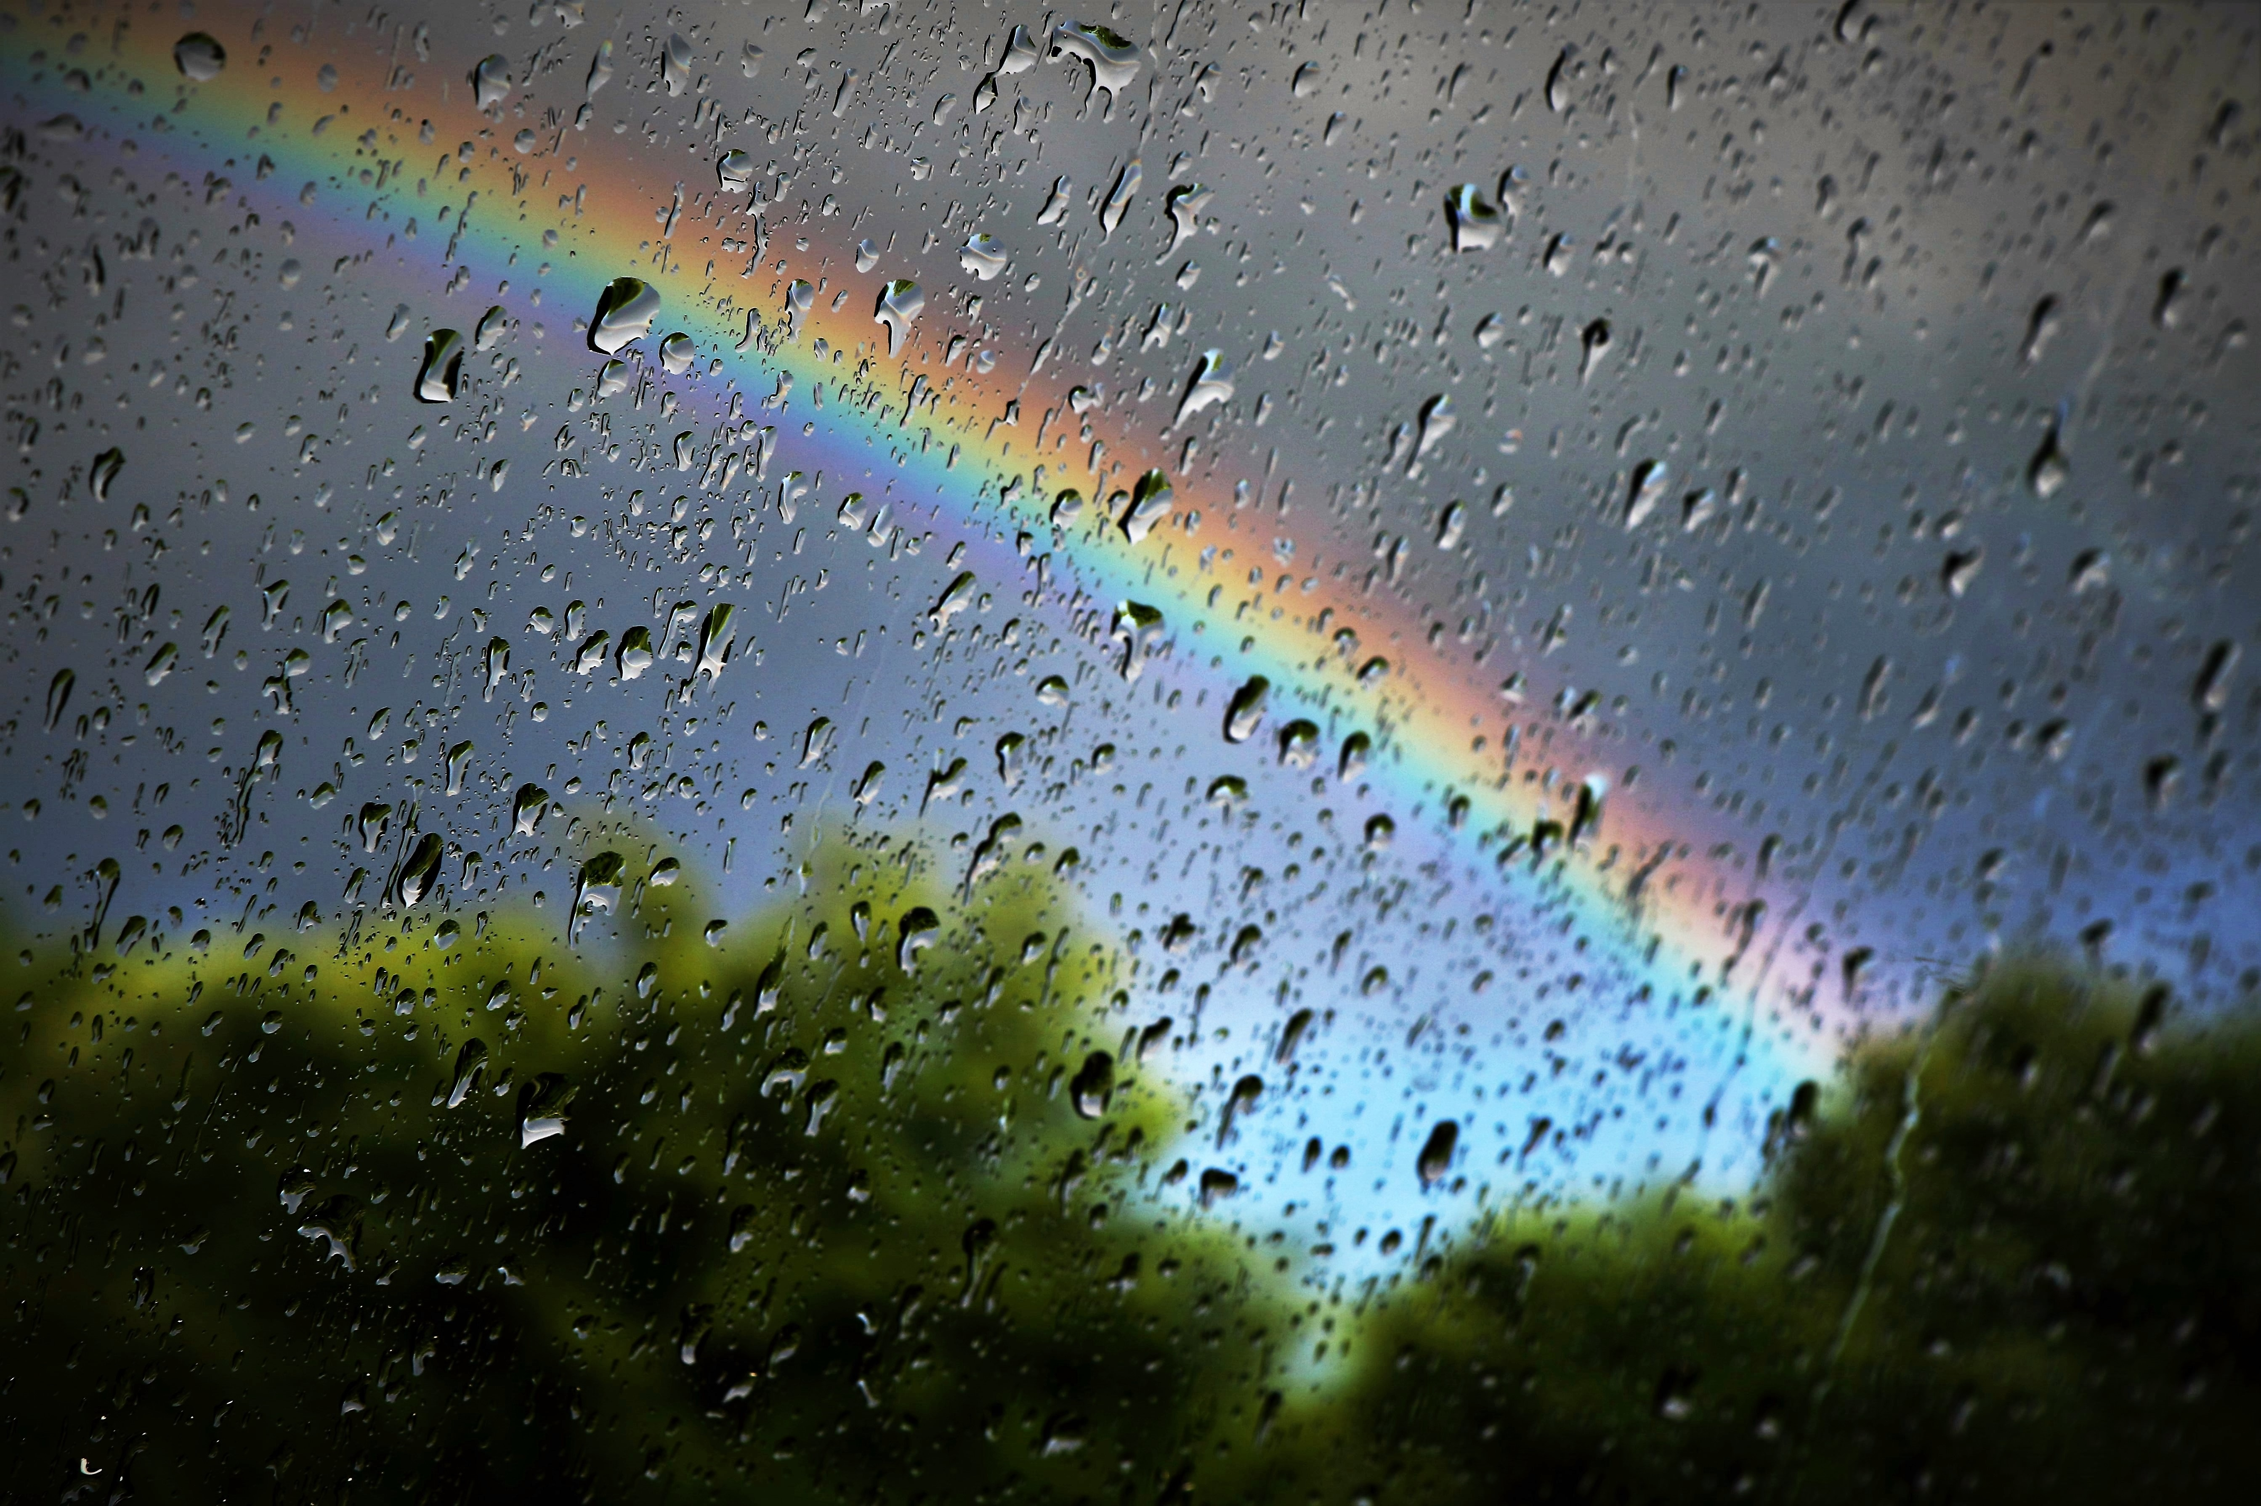
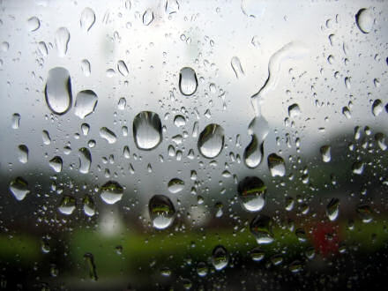
Why is rain good?
Rain is a source of fresh water
Rain brings us water so we all have more water to drink
Water falls to the ground and lands in lakes and ponds and when it flows it
Forms into small streams and big rivers
This Photo by Unknown author is licensed under CC BY-SA.

Slide 4
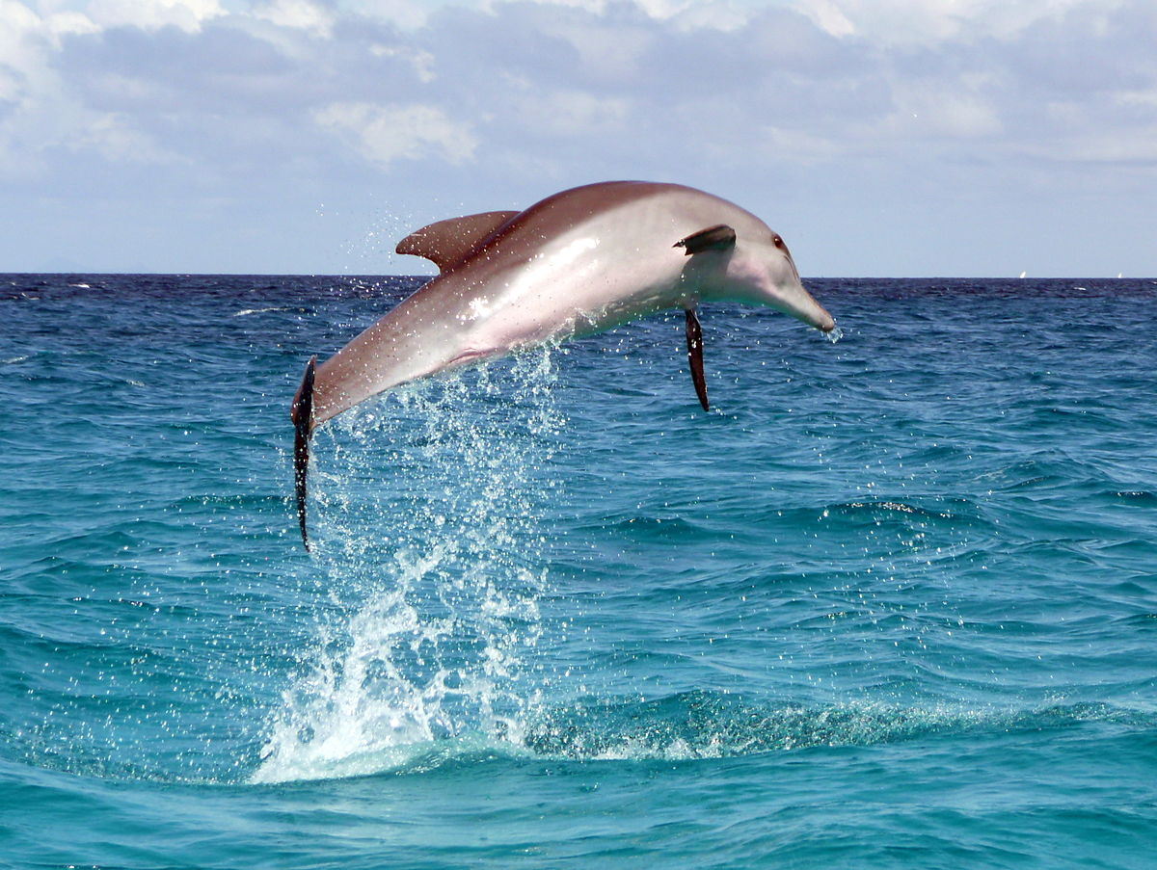
Why do we need to save water?
Some animals live in water it is their home but if we keep putting trash and rubbish into the sea
The animals can die or they will get sick
Water should be purifed before we drink it
This Photo by Unknown author is licensed under CC BY-SA.

Slide 5
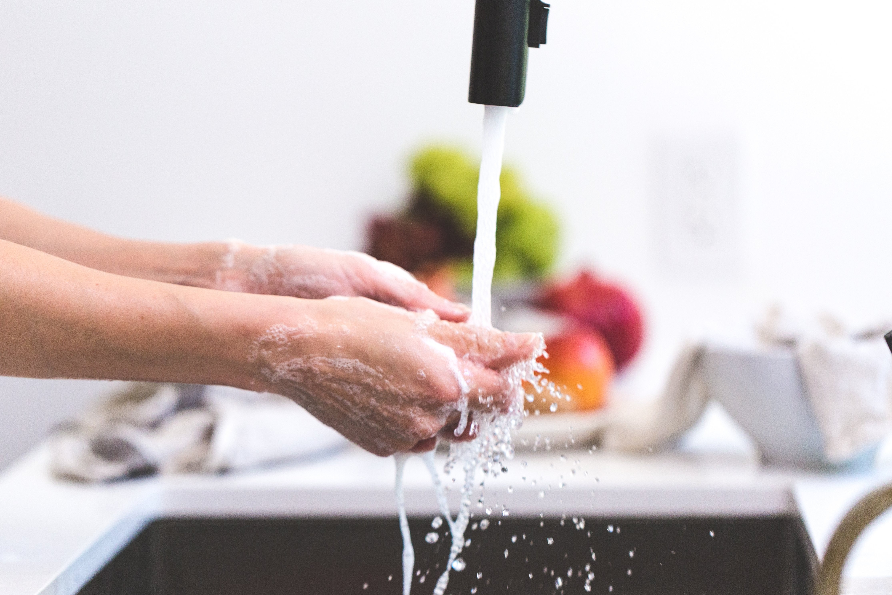
Do we have lots of water?
Yes we do we have manmade sources like dams and canals
We all have lots of water so we can drink water, cook with water, have a shower and especially for washing our hands!

Slide 6
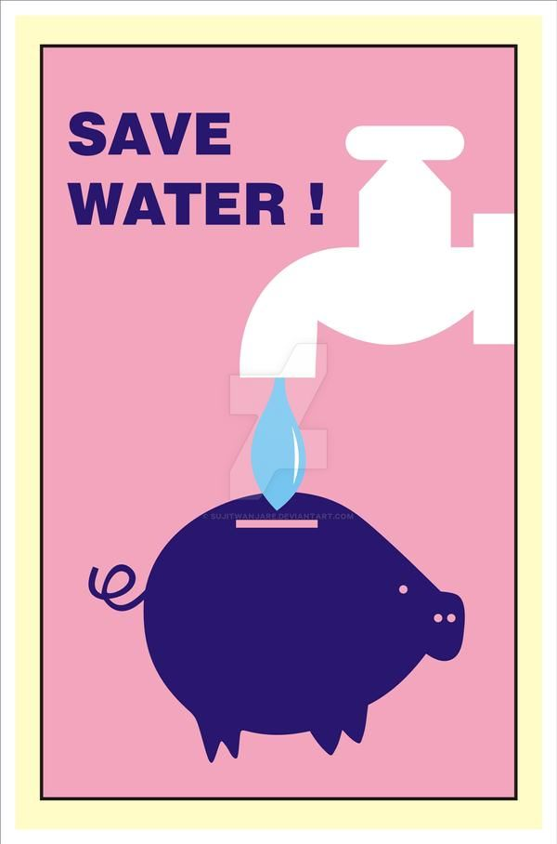
The end
So don't forget to drinks lots of water and wash your hands often!
And save water when you can-it is precious
This Photo by Unknown author is licensed under CC BY-NC-ND.

