Slide 1
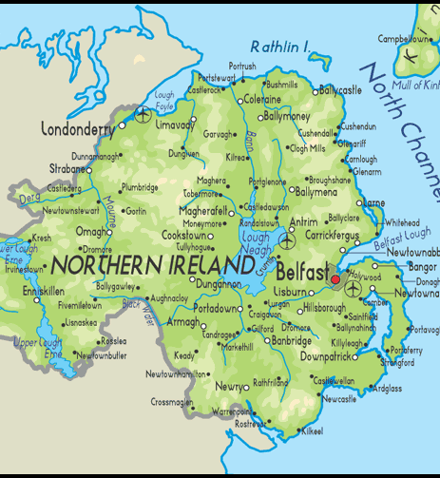
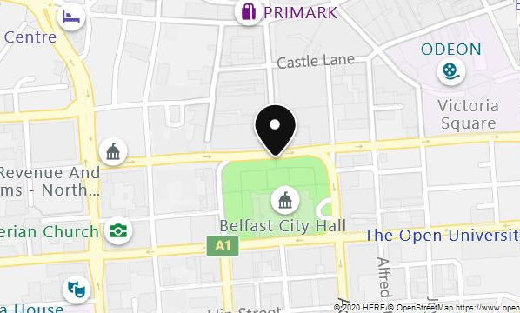
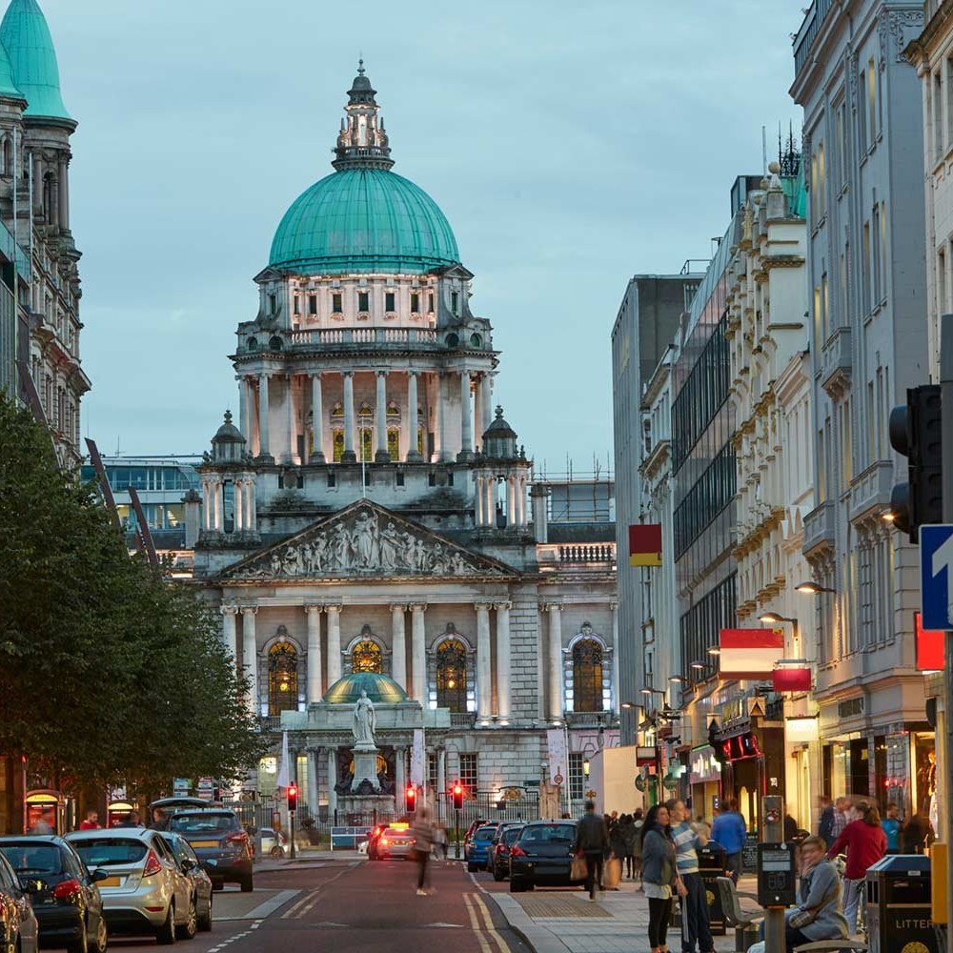
Welcome to Belfast

Slide 2
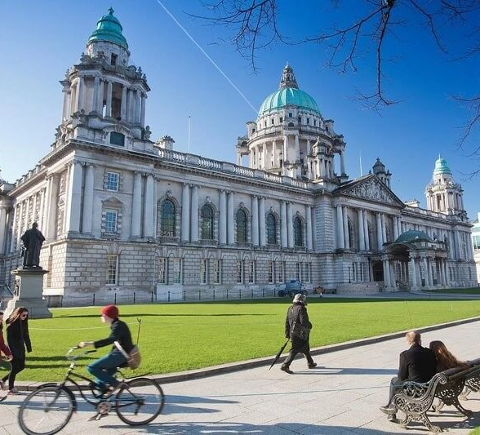
Belfast City Hall Belfast City Hall is Belfast City council's Civic building . It is located in Donegall Square, In the heart of Belfast City enter. It first opened its doors on 1 August 1906.

Slide 3
About history of City Hall
In 1888 Queen Victoria granted Belfast the status of the City and it was agreed that a grand and magnificent Building was required to reflect this new status. City hall opend its doors on the first of August 1906,at a time of unprecedented prosperity and industrial might for the city.
Belfast City Hall is famous building in North Ireland.
Spring and Summer people go there to play and busy season.
In the Christmas and they have shoping,food and toys too many go there to shoping and eat delicious food.
I remember my dad brought a hot dog for me in last year's christmas fair at City Hall. It is unforgettable.

Slide 4
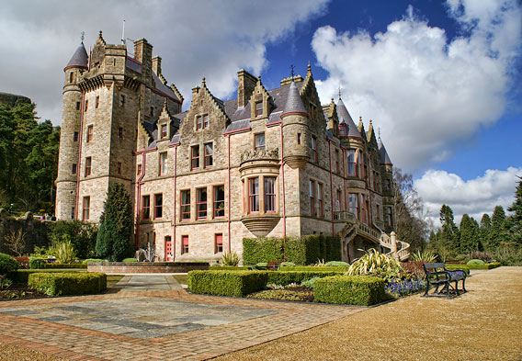
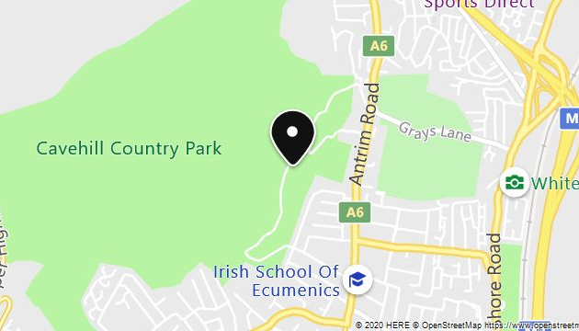
Belfast Castle location
Belfast Castle is located 400 feet(121.92 meters) above sea level on Cave hill overlooking Belfast, Country Antrim, North Ireland.

Slide 5
Belfast Castle history Sitting in a prominent position in Cave Hill country park, we have spectacular views out across the lough and the City. The first Belfast Castle was built by the Normans in Belfast City center in the late 12th century. A second castle, made of stone and timber, was later constructed by sir Arthur Chichester, Baron of Belfast , on the same site in 1611.

Slide 6
Facilities
Belfast Castle is open to the public daily with a visitors center, antique shop, restaurant and a playground . Visitors can see many rooms in the Castle .
I was there with my parents last summer, There was a restaurant and a bar there. People take wedding picture in the castle.

Slide 7
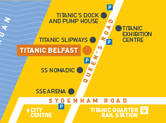
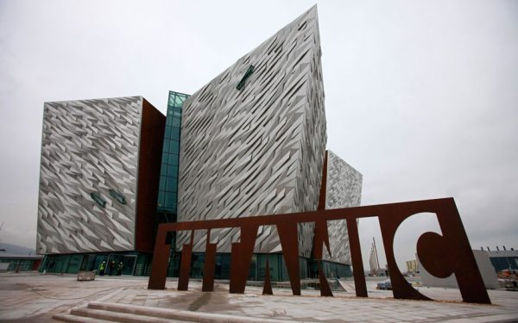
Titanic Belfast
Location
Located just a short 5-10 min car journey from George best Belfast city airport, and around, a 3min drive from Belfast International Airport, Titanic Belfast is easily accessible visa all major routes.
Opening time
Jan-Mar 10am-5pm
Apr-May 9am-6pm
Jun-Aug 8:30am-7pm
Sep 8:30am-6pm
Oct-Dec 10am-5pm

Slide 8
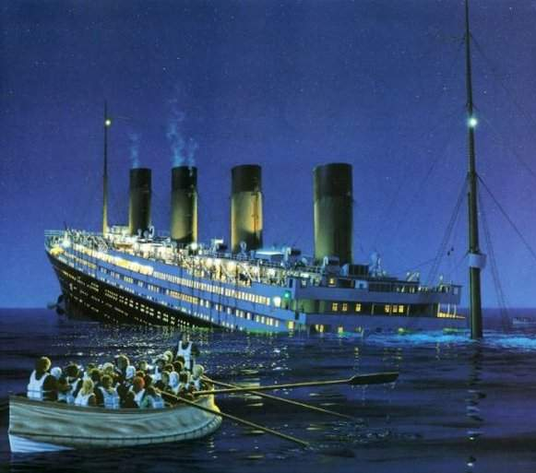
History of Titanic

Slide 9
Titanic Belfast is a visitor attraction opened in 2012, a monument to Belfast's maritime heritage on the site of the former Harland & Wolff shipyard in the City's Titanic Quarter where the RMS Titanic was built.It tells the stories of the Titanic, which hit an iceberg and sank during her sister ship RMS Olympic and HMHS Britannic. The building contains more than floor space, most of which is occupied by a facilities plus the addition of Hickson's point destination bar in March 2018.
The Titanic Belfast Museum is look like a boat and sliver diamond. The Museum show people about Titanic boat building time and size, why the boat sank, because the Titanic boat was hit by a ice berg so the boat sink .
A love story film was made about Titanic. It tells the story of people who could have been on the Titanic when it sank.

