Slide 1
WELCOME TO BELFAST
All about Belfast
By Karol Kowalski

Slide 2
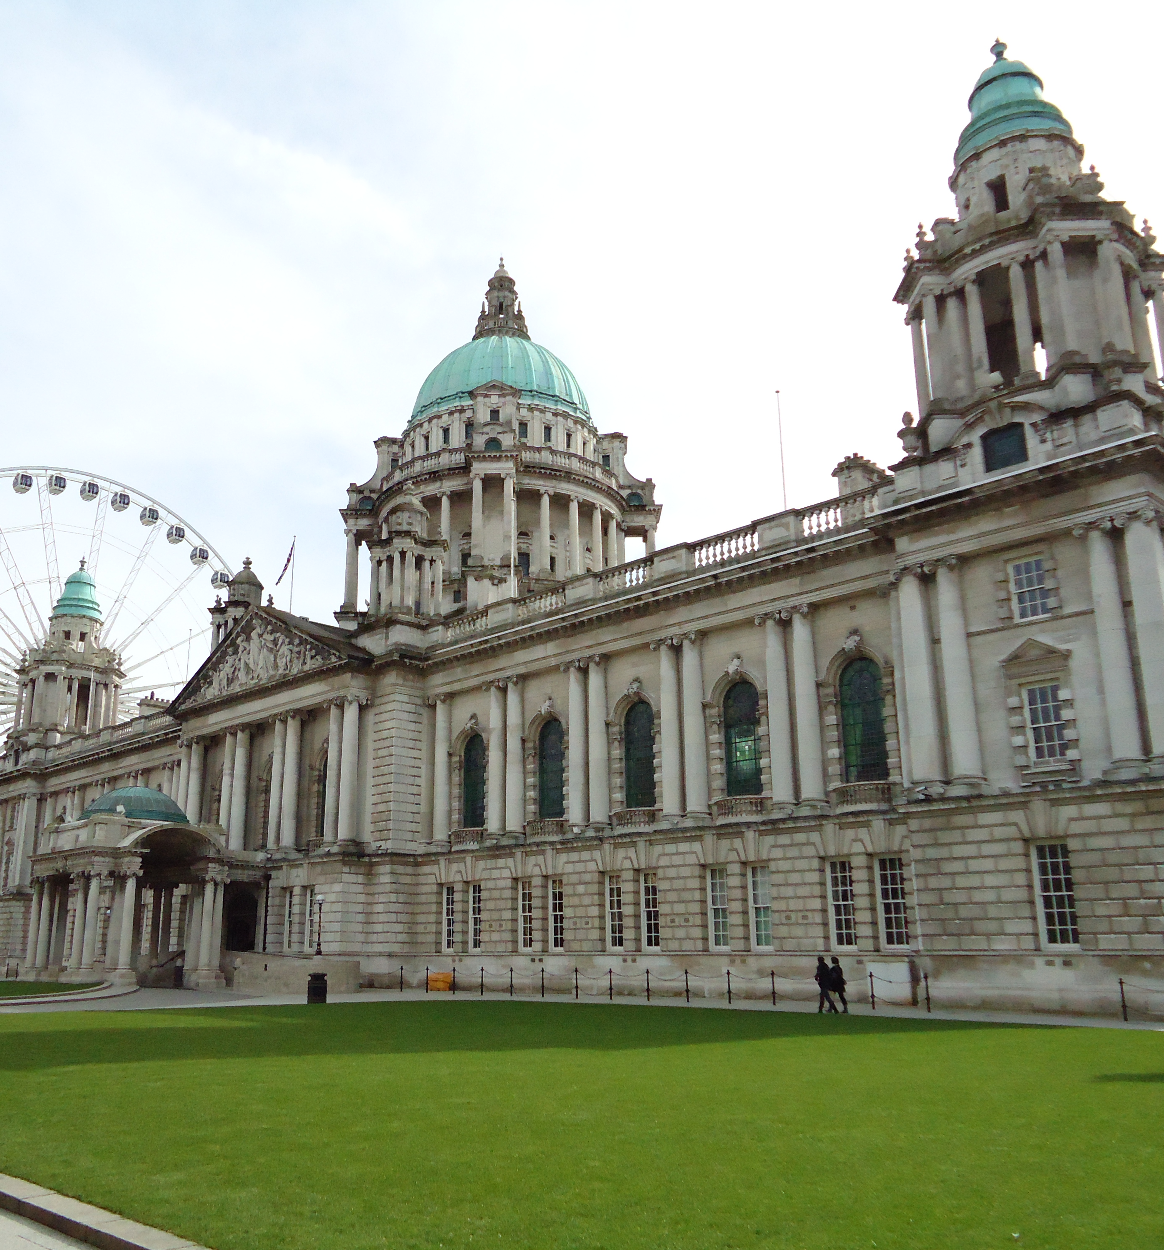
Belfast
Capital and largest city of Northern Ireland. Greater Belfast is divided between two counties Antrim and Down, but Belfast it self belongs entirely to Antrim.
The city is located at the mouth of the Lagan River to Belfast Lough. Settlements developed around the Normandy castle, built in 1177. In the Middle Ages it was a small settlement remaining in the shadow of the neighboring Carrickfergus.

Slide 3
Sights and tourist attractions
Cathedral : Anglican and Catholic
Belfast Castle
Town hall (1906)
Headquarters of Queens University (1849)
Numerous buildings from the Victorian and Edwardian era
Belfast Titanic Museum

Slide 4
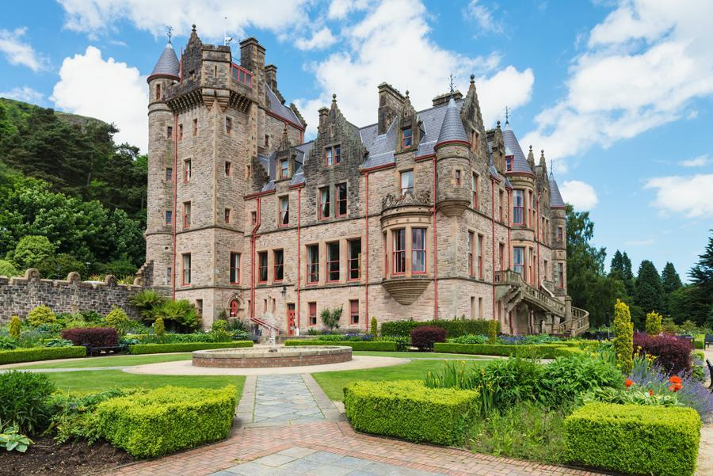
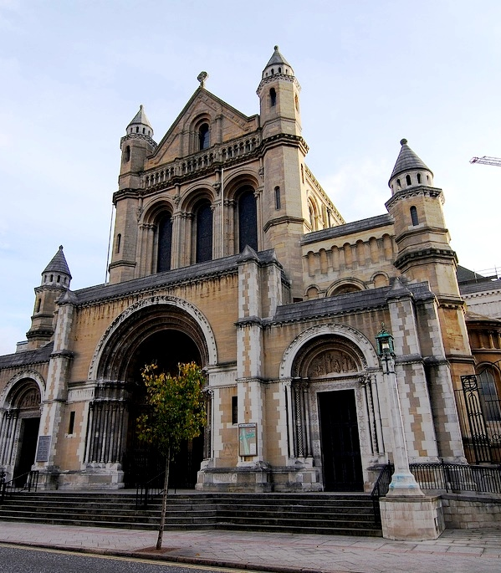
Cathedral Church St.Anne & Belfast Castle

Slide 5
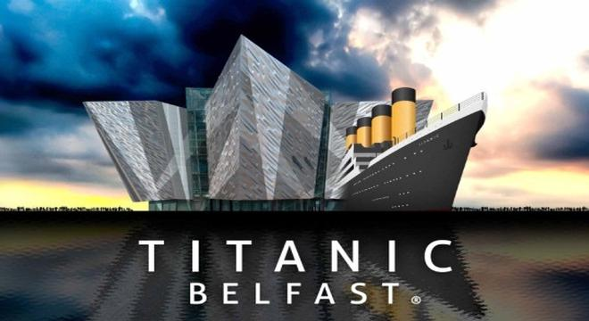
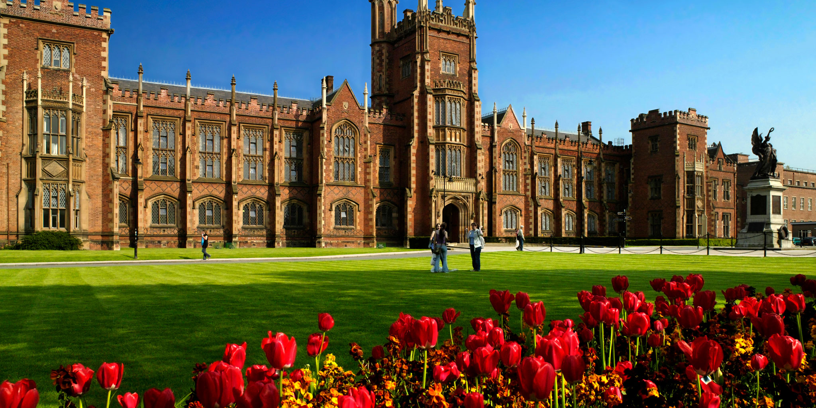
Titanic Quarter & Queens University

Slide 6
Places worth recommending and watching …
Titanic Quarter
The Big Fish
St. George’s Market
Ulster Museum & Botanic Gardens
Ulster Folk and Transport Museum
Victoria Park
Cave Hill Country Park

Slide 7
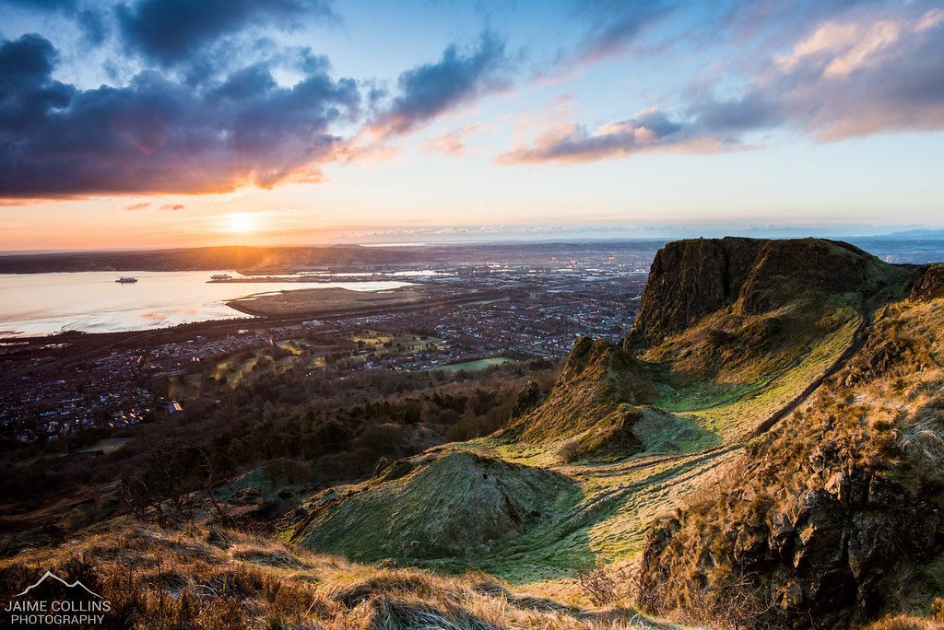
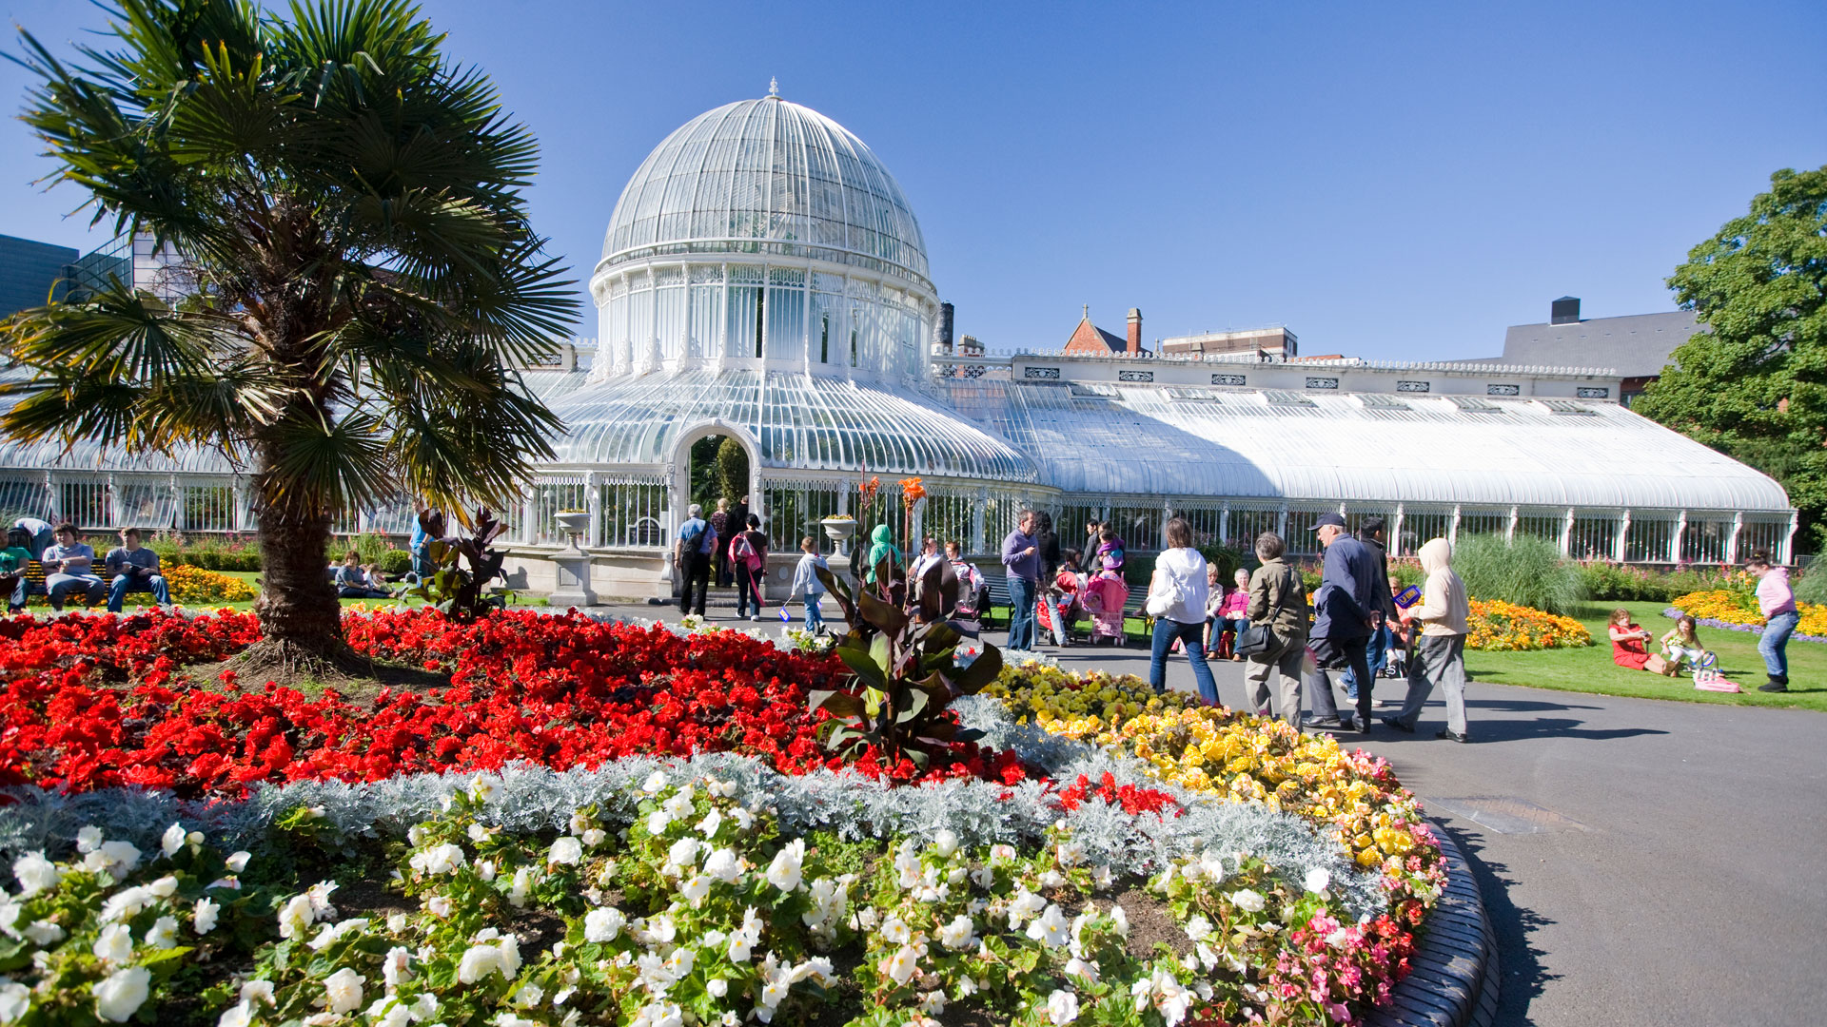
Cave Hill Park & Botanic Gardens

Slide 8
Thank You For Visiting.
Belfast is a City well suited for tourists has many restaurants, and hotels where you can spend your free time with friends and family.

