Slide 1
Visiting Belfast
By Matthew Ferris

Slide 2
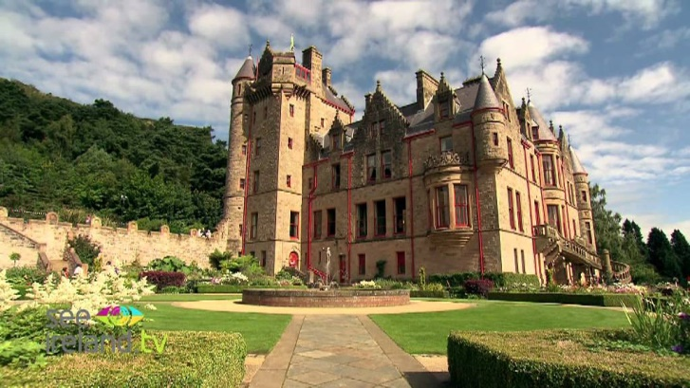
Famous Landmarks Belfast Castle
Belfast Castle
Belfast Castle is located in the Cave Hill area of north Belfast.
It was built in the 1860s. It’s very old and is one of the city's most famous landmarks.
There is a visitor information area in the castle.
The Castle grounds has a brilliant Adventure Playground for kids.
There are brilliant walking trails with great views of Belfast – the author climbed to the top on Sunday 10th of May!

Slide 3
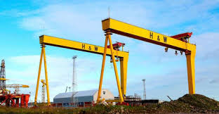
Harland and Wolff Cranes
Harland and Wolff became one of the world's great shipbuilders.
They constructed over 70 ships for the White Star Line.
The Titanic was the most famous ship constructed at the company.
The two giant, yellow cranes’ names are Samson and Goliath.
They hold the world record for the biggest free-standing cranes in the world and the authors Granda & Great-Granda have been on the top of them!

Slide 4
Titanic Building
This amazing building is the same height as the actual Titanic ship.
The shape of the building is the same shape as the front of the actual ship!
You can find out everything you need to know about the Titanic ship and the great disaster when it hit an iceberg and sunk in 1912.
Explore the shipyard, walk the decks, travel to the depths of the ocean and uncover the true legend of the Titanic in the city where it was made.
It has a shop and café and you can get lots of goodies.

Slide 5
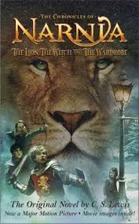
What Belfast is famous for
Belfast is famous for lots and lots of reasons.
It is the capital city of Northern Ireland.
George Best, one the best football players in the world, was born in Belfast.
The successful Ulster Rugby team train at the Kingspan stadium in Belfast.
The Titanic ship which struck an iceberg and sunk in 1912 was built in Belfast.
CS Lewis who wrote about the magical world of Narnia was born in Belfast.

Slide 6
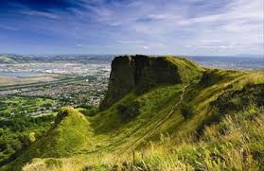
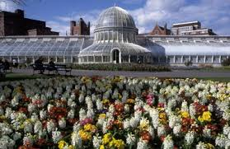
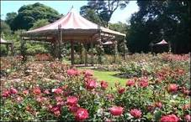
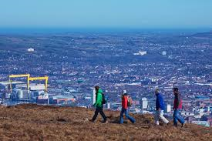
Great Views and Green Spaces
Relax and Enjoy these parks, mountains and amazing views:
Cave Hill Country Park
Botanic Gardens
Sir Thomas and Lady Dixon Park
Ormeau Park
Lagan Meadows
Black Mountain
Grounds of Stormont
Parks have playgrounds for kids and park benches and picnic tables so bring a packed lunch!

Slide 7
Places of Historical Interest Ulster Museum
Ulster Museum is a fantastic museum open throughout the year, and it’s free!
Find out what mummies looked like and how big dinosaurs were.
You can see real treasure and art work.
You can learn about the history of Belfast and Northern Ireland.
There are fun activities for kids of all ages - arts and crafts and play with toys that children had through history.
There is a café that sells hot food and delicious treats!

Slide 8
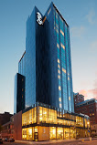
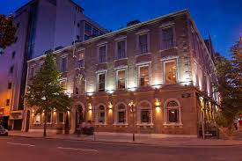
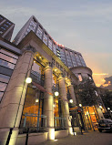
Places to Stay in Belfast
Belfast has great places to stay.
You could book a hotel, Bed and Breakfast or you can rent an apartment.
Check www.tripadvisor.co.uk for prices, information and customer reviews.

Slide 9
Fine Dining & the Cathedral Quarter
Belfast has a lot of famous eating locations including the Michelin starred Ox as well as Deanes if posh food will stop your tummy rumbling!
The Cathedral Quarter in the heart of the city also has brilliant restaurants such as Hadskis, Muddlers Club, Buba & Coppi which are great for the whole family with foods from all around the world.
The Cathedral Quarter covers Royal Avenue to York St & Dunbar link and is easy to find – just look for the big cathedral with a spike!

Slide 10
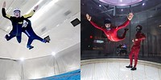
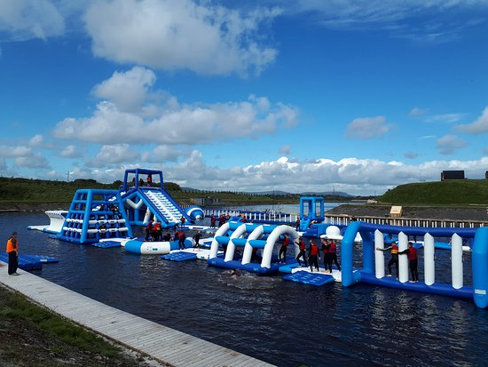
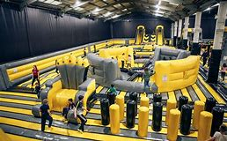
Fun Action Places to Visit for Kids
W5-Fantastic fun and discovery for all kids.
We are Vertigo – Ninja Park, indoor inflatable park, indoor ski-ing and climbing and even indoor sky diving!
Let’s Go Hydro is Ireland’s largest aqua park be prepared to get wet!!!

