Slide 1
Visit Belfast!
By Emily Irvine

Slide 2
Information about Belfast
Belfast is the capital of Northern Ireland and the River Lagan flows through the city.
The district of Belfast has an area of 44 square miles.
The population is estimated at 630,632.
Belfast is the second largest city on Ireland and the 15th largest city in the UK.

Slide 3
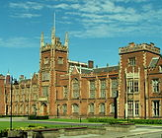
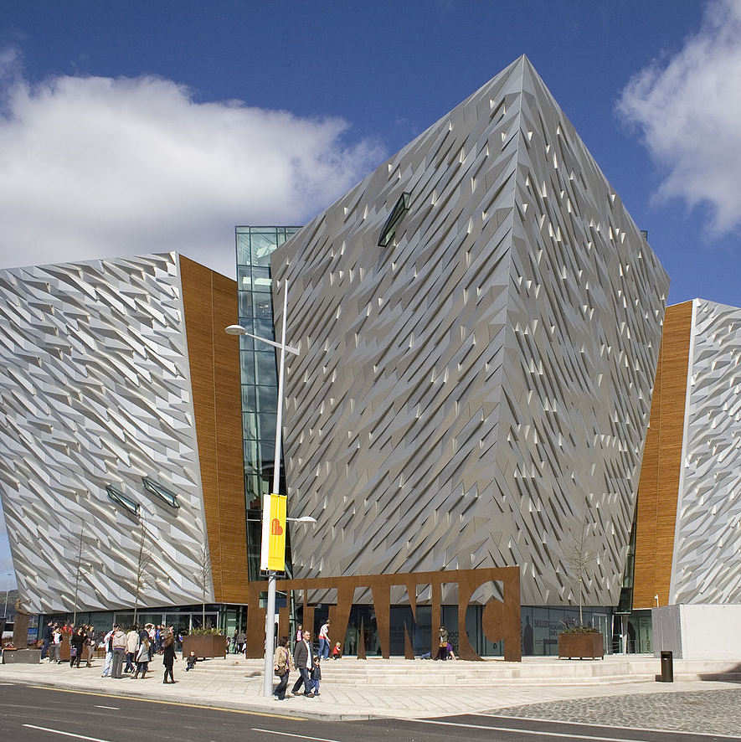
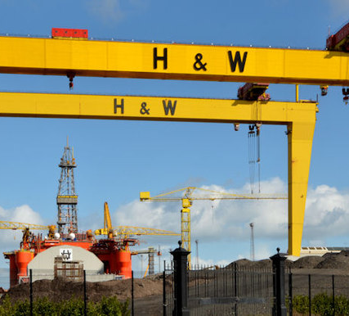
Belfast landmarks
There are lots of beautiful land marks and buildings in Belfast.
One of these is the building of Queens University. The front is often seen on bank notes and the buildings are specially designed.
Another important landmark is the two ship building cranes called Samson and Goliath. If you see them you know you are in Belfast.
Titanic is a visitor attraction on the site of the former Harland and Wolf shipyard where the Titanic was built.
This Photo by Unknown Author is licensed under CC BY-SA
This Photo by Unknown Author is licensed under CC BY-SA
This Photo by Unknown Author is licensed under CC BY-SA

Slide 4
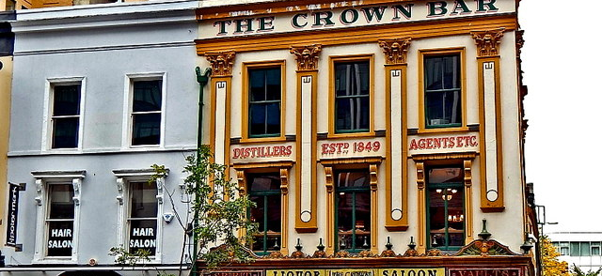
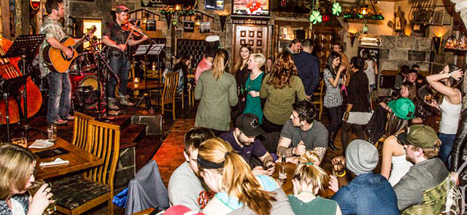
What is Belfast famous for?
The friendliness from Irish people is famous all around the world.
Belfast people are kind to other visitors and great fun.
There are lots of great places to eat and drink.
This Photo by Unknown Author is licensed under CC BY-SA
This Photo by Unknown Author is licensed under CC BY-NC-ND

Slide 5
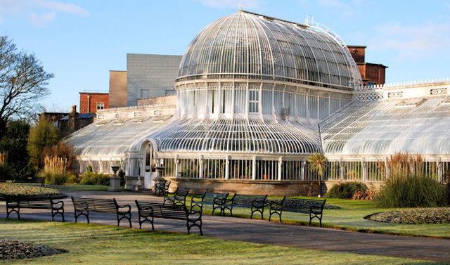
Parks around Belfast
Belfast has over forty public parks.
One of the most popular parks is Botanic Gardens.
It was built in the 1830s and has a Tropical Ravine, the palm house and rose gardens.
Another park is Sir Thomas and Lady Dixon park which brings thousands of vistors each year to its International Rose Garden.
This Photo by Unknown Author is licensed under CC BY-SA

Slide 6
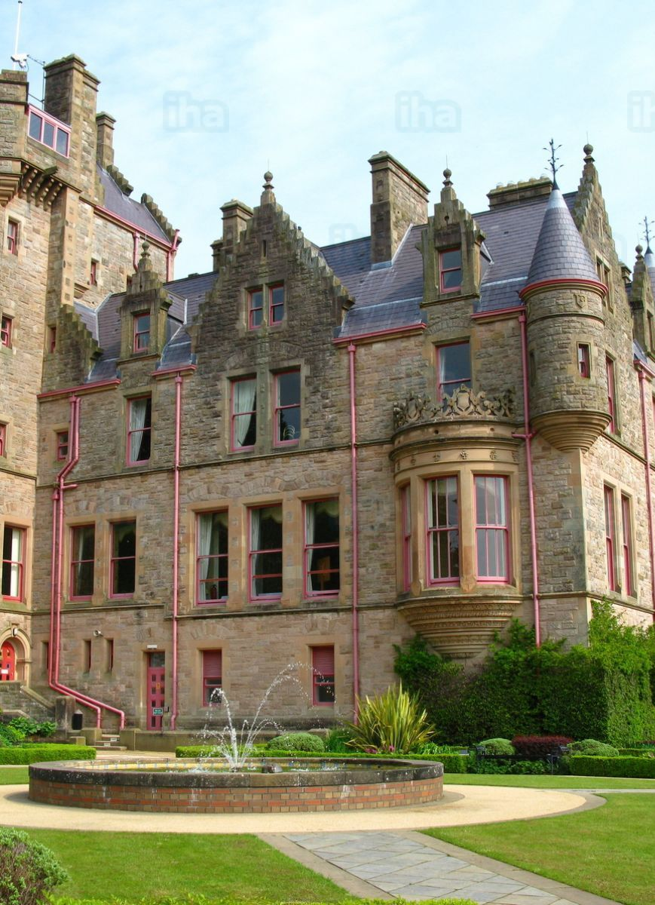
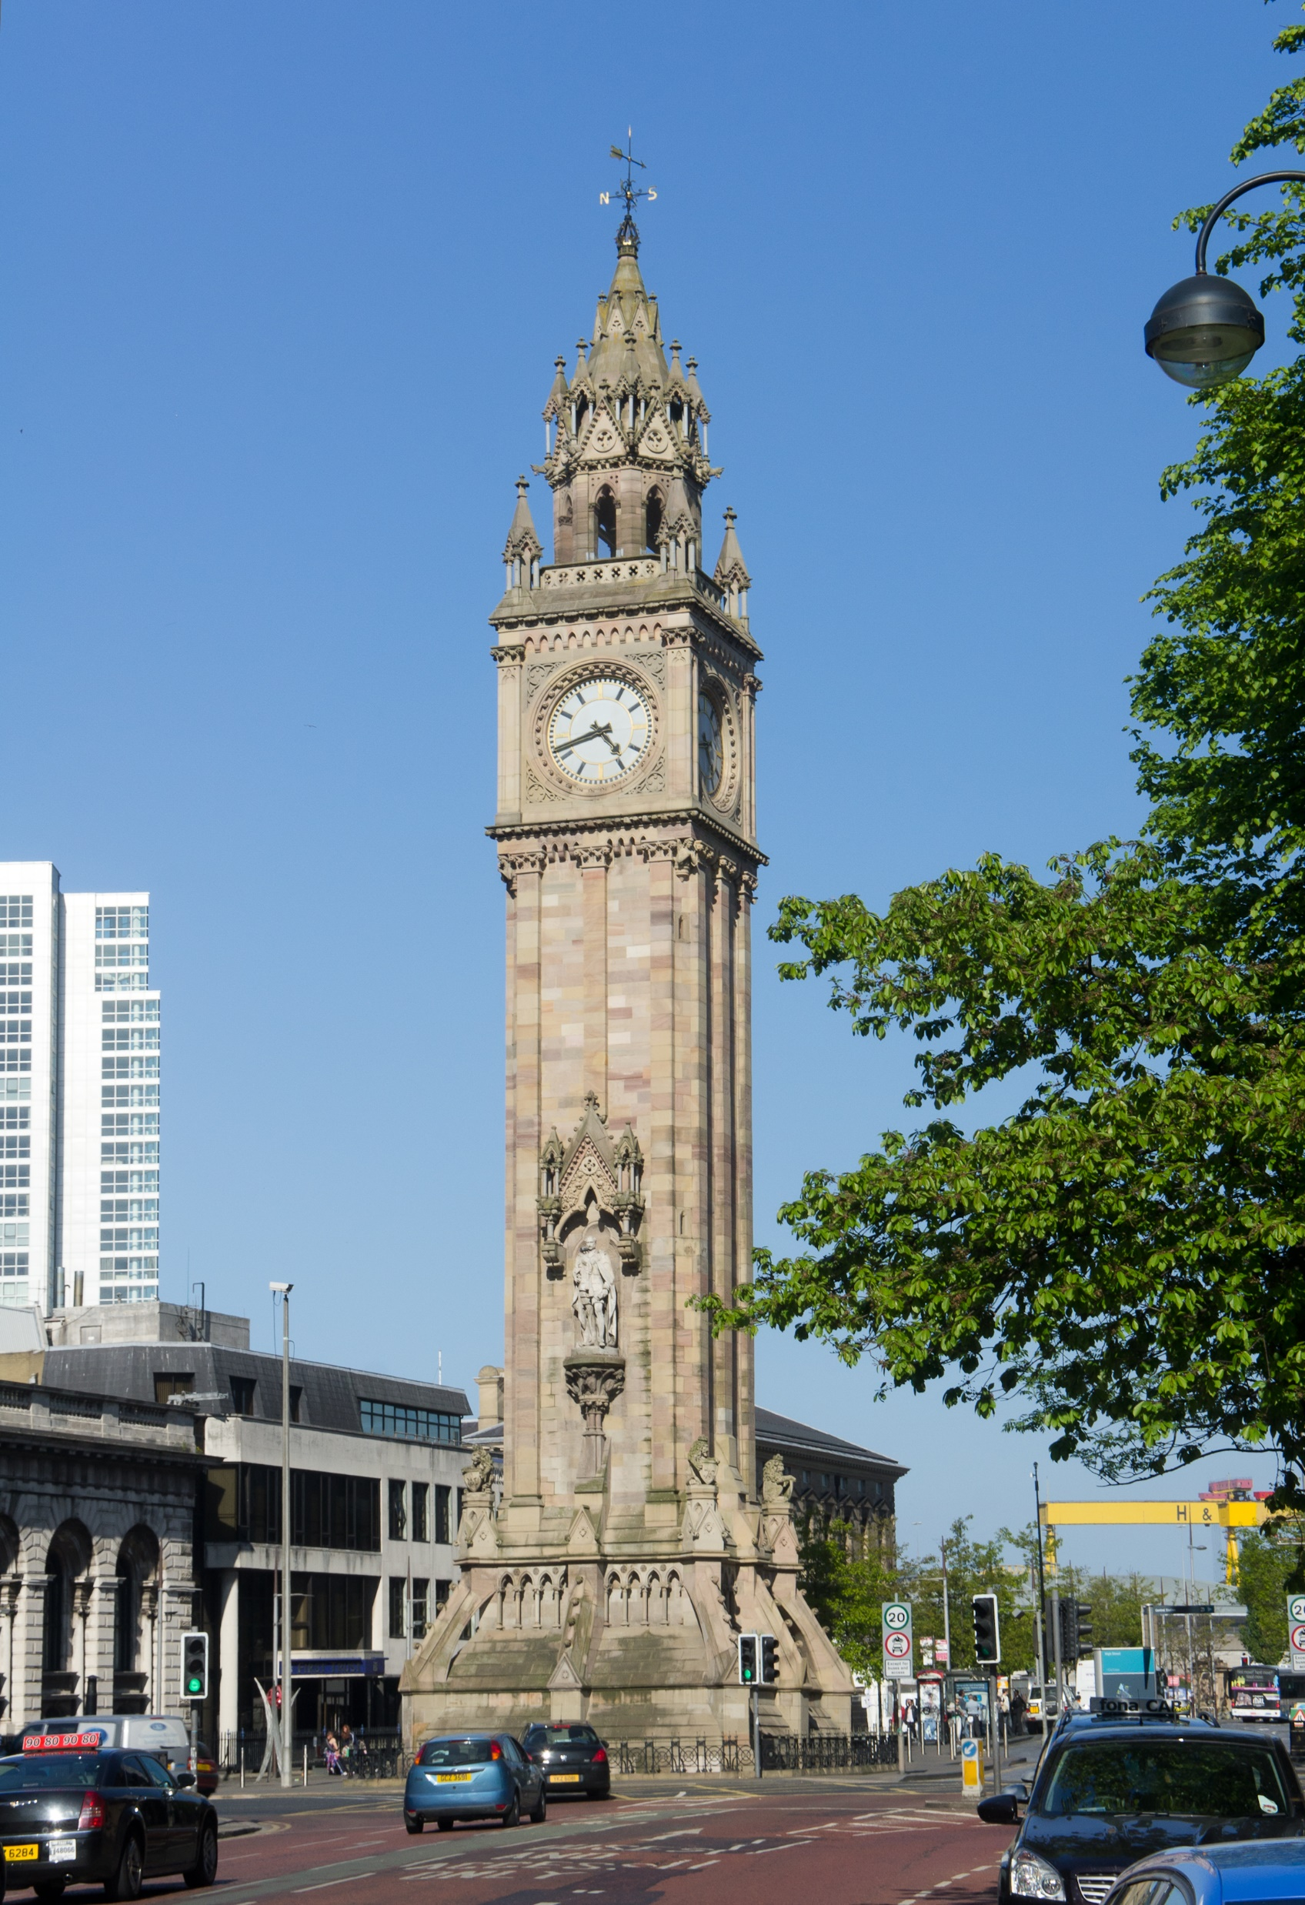
Places of historical interest
Belfast Castle is set on the slopes of Cavehill country park 120 meters above sea level. It has beautiful views of Belfast because it is up so high.
The Albert Memorial Clock is a clock tower situated at Queens Square and was completed in 1869 and is one of the best known landmarks of Belfast.
This Photo by Unknown Author is licensed under CC BY-SA-NC
own Author is licensed under CC BY-SA

Slide 7
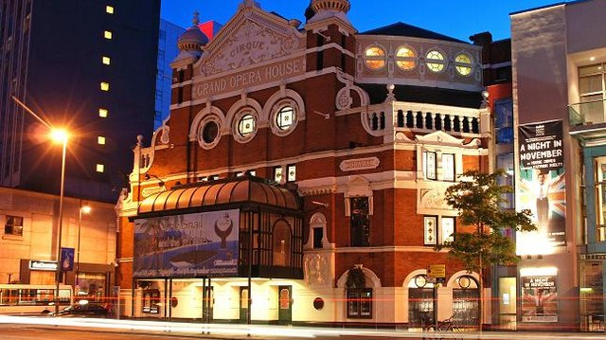
Places of cultural interest
Belfast has many places where you can enjoy dancing, great music, theatre, art and many more.
Some of these places include Grand Opera house, The Water Front Hall and the Mac.
Belfast also hosts culture night Belfast which is a celebration of the amazing talent that our city boasts.
This Photo by Unknown Author is licensed under CC BY-SA

Slide 8
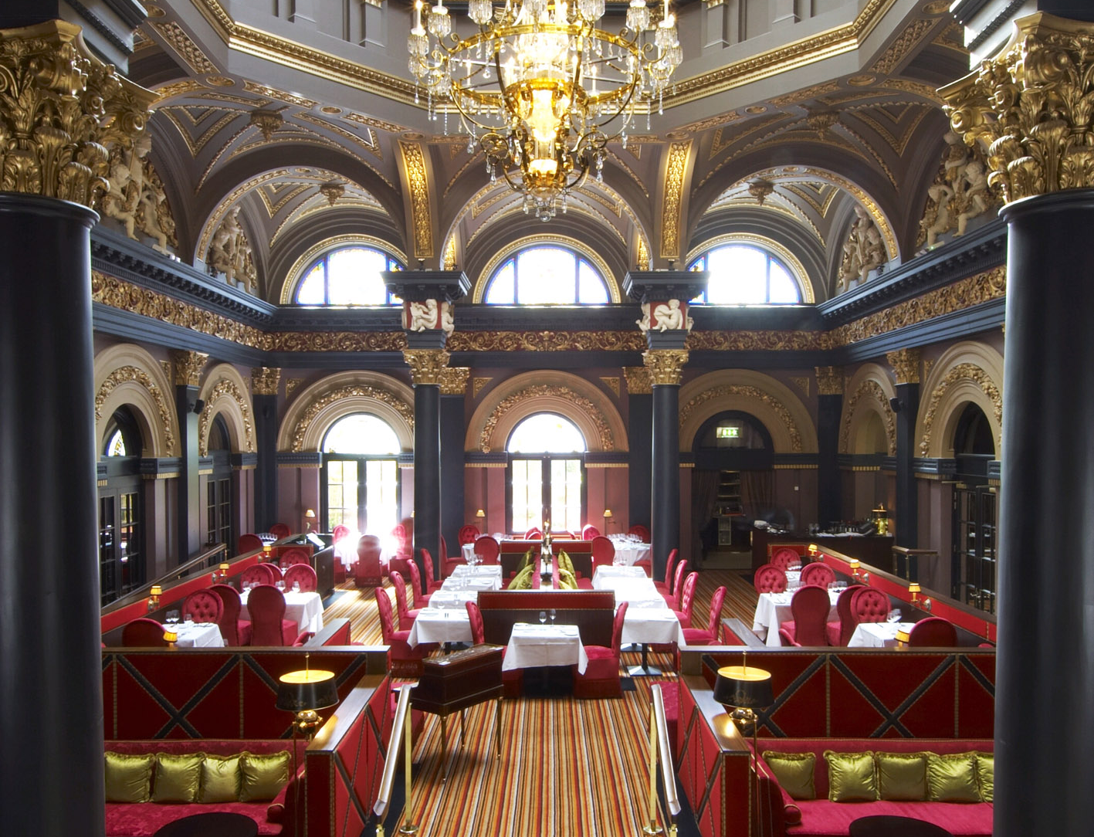
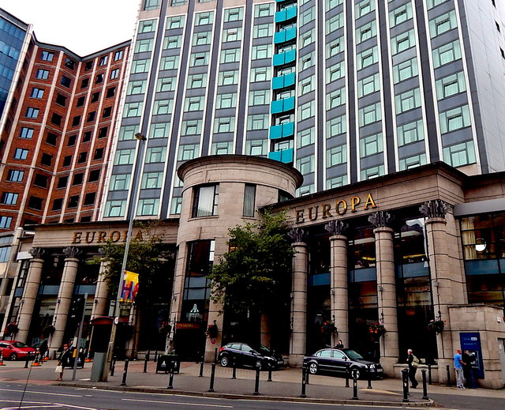
Where Tourists can stay
Tourists can stay in hotels, bed and breakfasts or hostels in Belfast.
Belfast’s Cathedral Quarter is the best place to stay if you want to be within walking distance of all that Belfast has to offer.
Belfast is a popular place to stay and there is a wide selection of places to choose from.
This Photo by Unknown Author is licensed under CC BY-SA
This Photo by Unknown Author is licensed under CC BY-SA

Slide 9
Thank you
And you got to remember to visit Belfast soon!!!

