Slide 1
Belfast the city to visit
By Dara eberendu

Slide 2
Whatever your interests there is a place to visit in Belfast

Slide 3
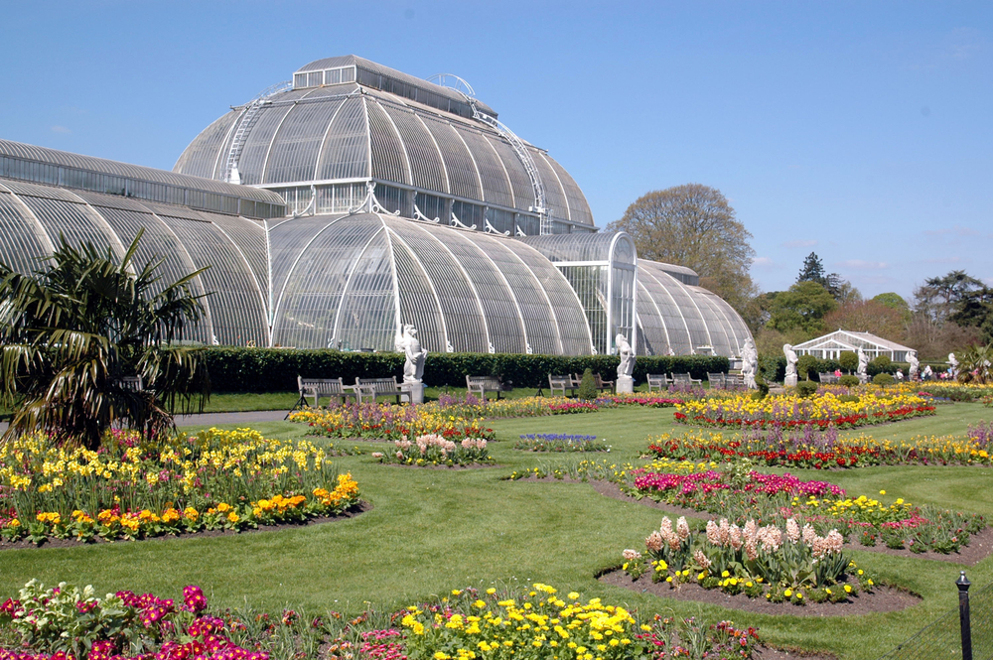
Landmarks of belfast
Botanic Gardens is a public garden in Belfast, Northern Ireland. Occupying 28 acres of south Belfast, the gardens are popular with office workers, students and tourists. They are located on Stranmillis Road in Queen's Quarter, with Queen's University nearby. The Ulster Museum is located at the main entrance.
Titanic is a visitor attraction opened in 2012, a monument to Belfast's maritime heritage on t Belfast he site of the former Harland & Wolff shipyard in the city's Titanic Quarter where the RMS Titanic was built.
Belfast City Hall is the civic building of Belfast City Council located in Donegall Square, Belfast, Northern Ireland. It faces North and effectively divides the commercial and business areas of the city centre. It is a Grade A listed building.
Belfast Castle is set on the slopes of Cave hill Country Park, Belfast, Northern Ireland, in a prominent position 400 feet above sea level. Its location provides unobstructed views of the city of Belfast and Belfast Lough

Slide 4
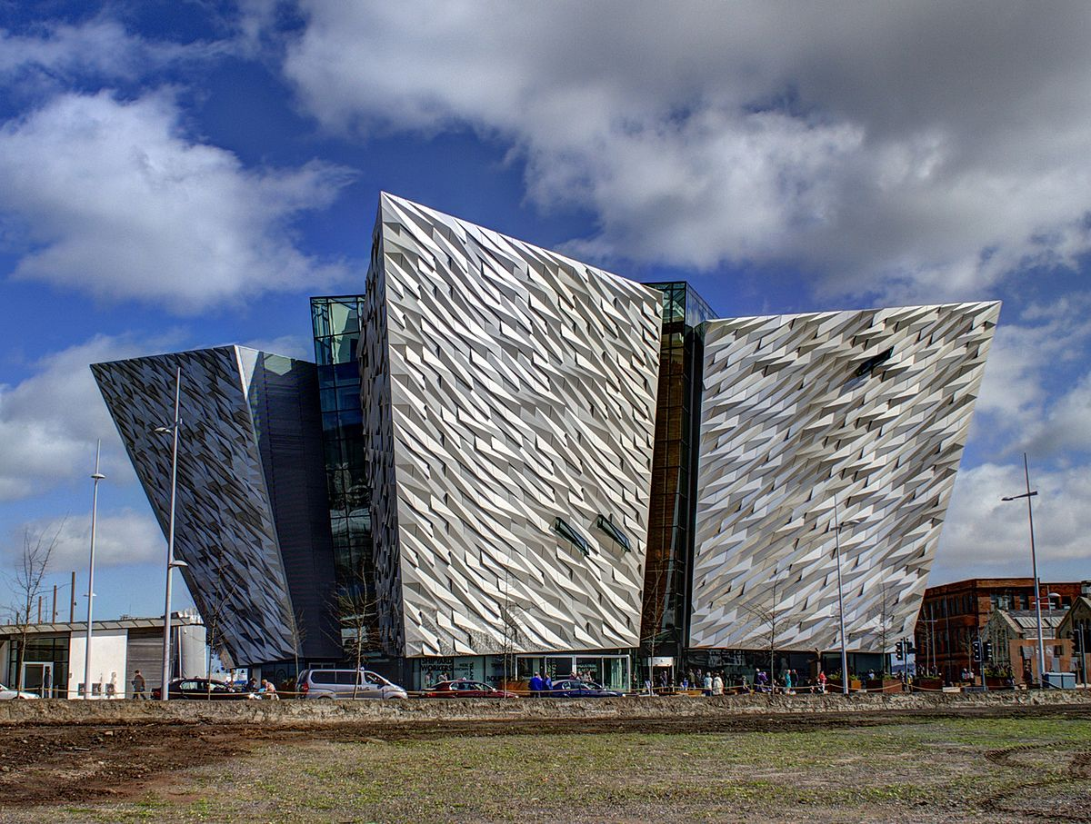
What belfast is famous for, The titanic!
.
The Titanic struck an iceberg and sunk in 1912. This Ships legacy is recalled in the renovated dockyards' Titanic Belfast is Northern Ireland’s capital. It was the birthplace of the RMS Titanic, which famously quarter, which includes the Titanic Belfast, an aluminium-clad museum reminiscent of a ship’s hull, as well as shipbuilder Harland & Wolff’s Drawing Offices and the Titanic Slipways, which now host open-air concerts.

Slide 5
Greenery
Botanic Gardens was established in 1828 by the Belfast Botanic and Horticultural Society, in response to public interest in horticulture and botany. Originally known as the Belfast Botanic Garden, the site contained exotic tree species and impressive plant collections from the southern hemisphere, many of which can still be seen in the park. Today, the park is popular with residents, students and visitors and is an important venue for concerts, festivals and other events. It is home to the Palm House and the Tropical Ravine.
Top Reasons To Visit
An early example of a glasshouse made from curved iron and glass
The Palm House's tropical plants and birds of paradise
The Tropical Ravine's oldest seed plants
Walking routes
Green Flag Award winner - recognises UK's best open spaces

Slide 6
HISTORIC PLACES
1. Crumlin Road Gaol. 4.7. Historic Site.
Belfast Castle. 3.7. Castle.
Parliament Buildings. 4.5. Government Building.
4. Falls Road. 4.2. Historic Site.
5. Mount Stewart. 4.3. Historic Site.
6. Shankill Road. 3.9. ...
7. Carrickfergus Castle. 4.3. ...
Cathedral Quarter. 4.5. Neighbourhood

Slide 7
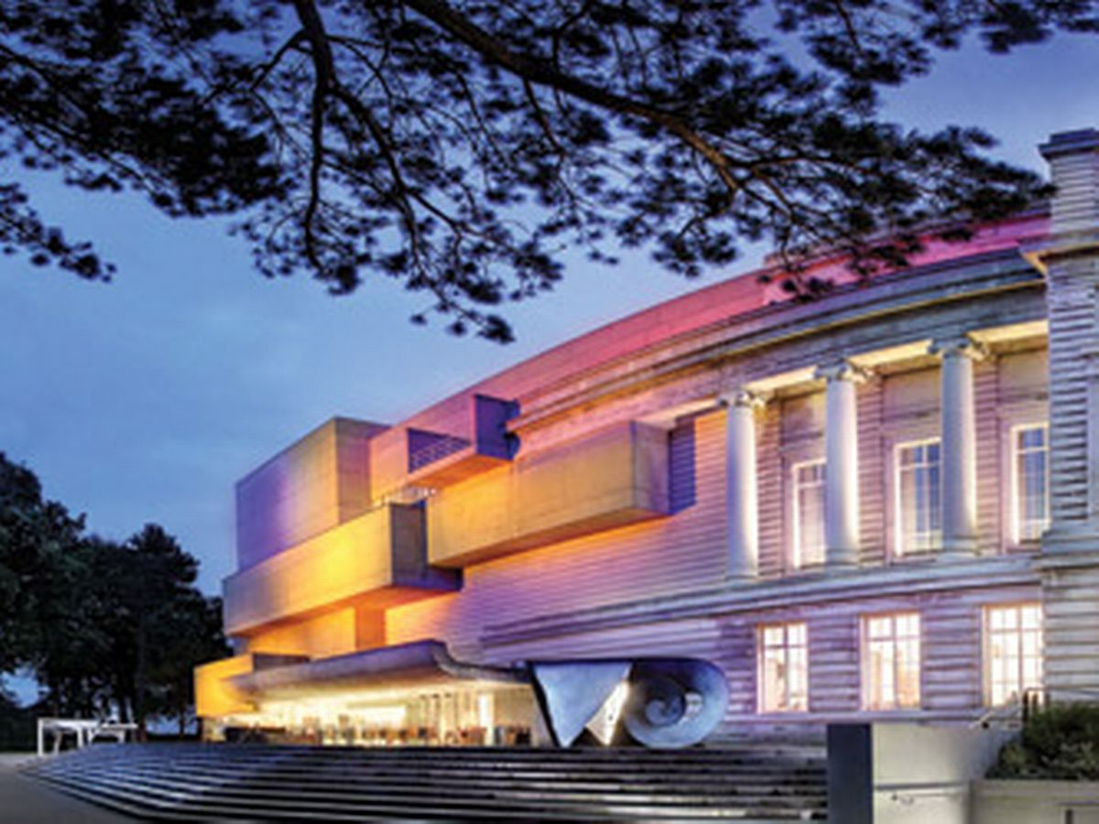
cultural places
2 ST GEORGE'S MARKET. For an authentic taste of Belfast life, make your way to the renovated St George's Market. ...
3 BLACK TAXI TOUR. One of the best ways to see Belfast's famous wall art is to sign up for a Black Taxi Tour. ...
4 ULSTER MUSEUM. ...
6 BELFAST CITY HALL. ...
7 CRUMLIN ROAD GAOL. ...
9 CAVE HILL COUNTRY PARK.

Slide 8
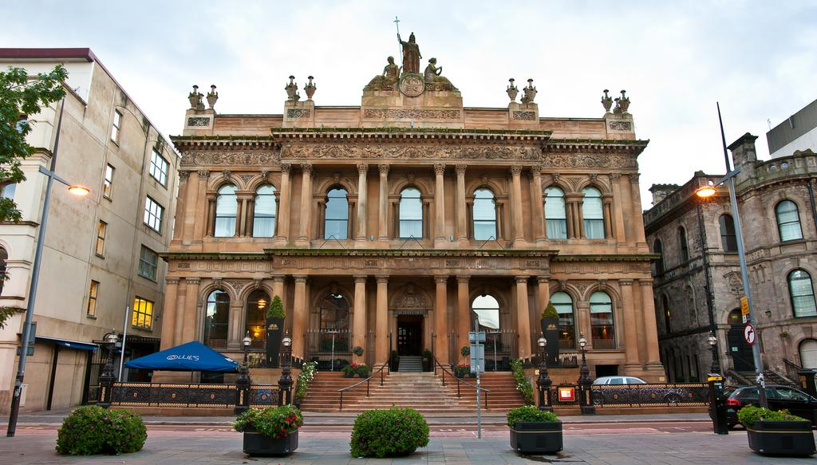
Hotels
The merchant hotel Belfast is one of the best hotels in belfast with its spa, fitness centre and suites.

Slide 9
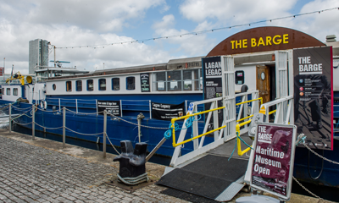
Restaurants: hohans
Stunning views of the river Lagan and the bridges of Belfast make this converted barge moored in front of Waterfront Hall one of the most impressive locations to eat in the city centre of Northern Ireland’s capital, especially in summer when the sides of the dining room are opened to the fine weather.
‘Irish produce to create Irish dishes’ is the mantra of a kitchen headed up by chef Calvin Holohan, whose grandmother Sheila founded the restaurant. Expect a menu with plenty of native salmon, venison, watercress, shellfish, lamb, beef, pork, cheese – and of course Irish potatoes. Seasonal and ethically sourced ingredients are also important here, though Northern Irish cooking isn’t presented as a piece of heritage but a subtly updated, contemporary cuisine.
Prawns might come with a napa slaw, chilli jam and garlic mayo, while pan-fried sea bass is accompanied by herb-crushed potatoes, kale, chorizo, brown shrimp and lemon butter. Seared scallops and pork belly with roast cauliflower purée, spinach, capers and balsamic is a more classical combination, or else there is steak and chips (dry-aged sirloin), chicken breast with fondant potato, savoy cabbage, wild mushroom and tarragon jus, plus veggie options such as blue cheese and red onion tart.
Desserts have the refreshing simplicity of the best homemade cooking: baked plums with chocolate mousse, sticky toffee pudding with toffee sauce or cheese and crackers.
Sundays see a roast with all the trimmings served for both lunch and dinner, smoked cod for the non meat-eaters and boxty for the veggies. A children’s menu, meanwhile, has sausages, mash, gravy, homemade soup and crusty bread or a cheeseburger and chips.
The wine list is as snappy as the ever-changing menu, with 20 whites and reds from lesser-known producers ticking off all the main grape varieties from around the world. Otherwise there are Irish beers and ciders, premium soft drinks and, of course, Irish whiskies.

Slide 10
BELFAST THE CITY TO VISIT

