Slide 1
All about Belfast
By Chloe Nicholas

Slide 2
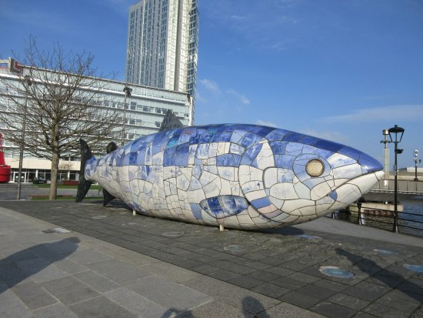
The big fish
This is the big fish, it is one of the best attractions in Belfast.
It was made in 1999.
It’s a printed ceramic mosaic statue and is 10 metres long.
The ceramic tiles describe different scenes from the cities history.

Slide 3
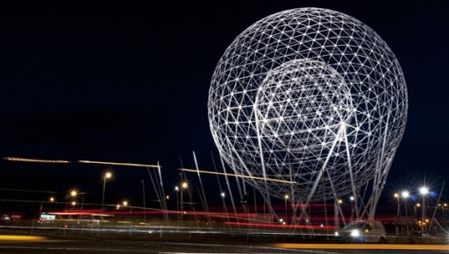
The Rise sculpture
It was constructed in 2011.
It is the biggest public art sculpture in Belfast.
There are two globes which symbolise the rising of the sun and hope for the future.
It is 37 meters high and 30 metres wide.

Slide 4
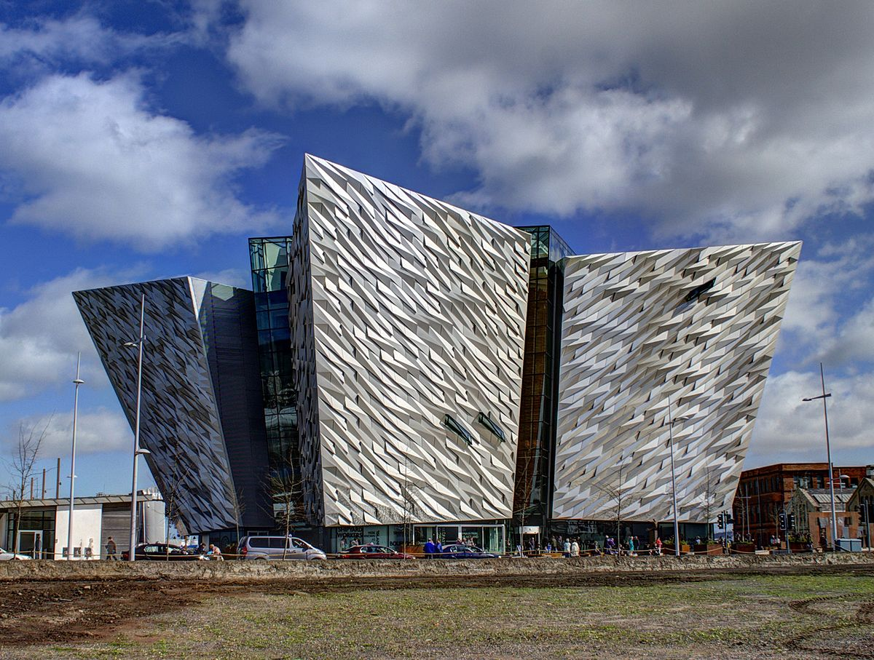
Titanic
The Titanic museum opened in 2012
Self guide experience which has over 9 interactive galleries.
It is the worlds largest titanic visitors experience located at the place the titanic was made and launched.
The Shape of the building was supposed to be the shape of a ship.

Slide 5
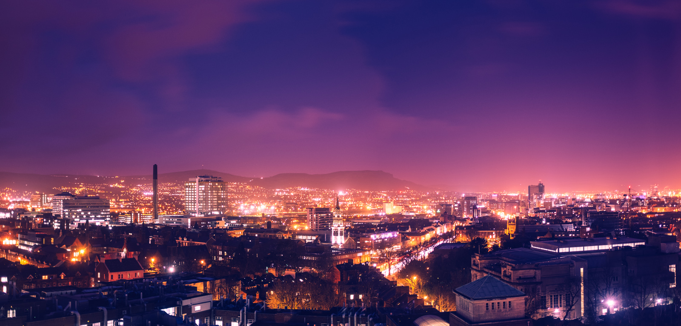
Belfast is the Capital of Northern Ireland.
It is the birthplace of the Titanic, which famously struck a iceburg in 1912.
There are two airports the George Best Belfast city airport and the Belfast international airport.
There is a population of 340,220 in the city and over one million people in the Belfast region.

Slide 6
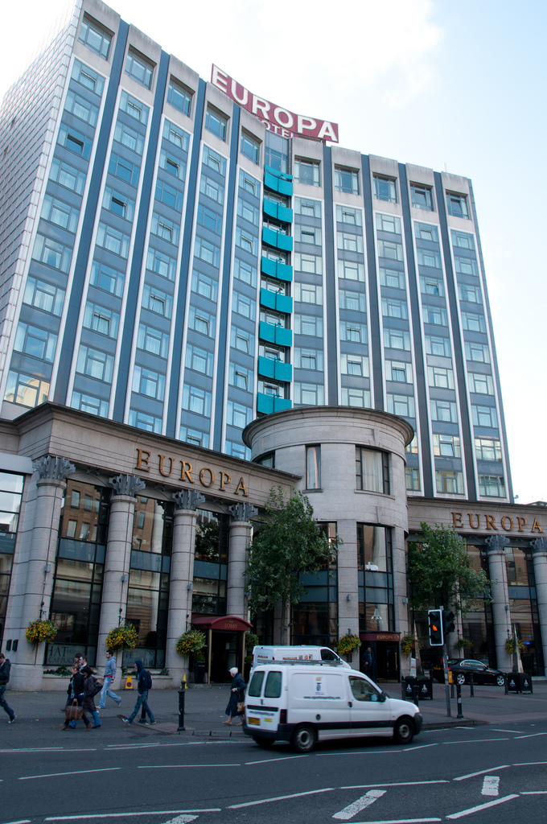
Places to stay
The Europa hotel
Holiday inn
The Fitzwilliam hotel
The Stormont hotel
Tara Lodge

Slide 7
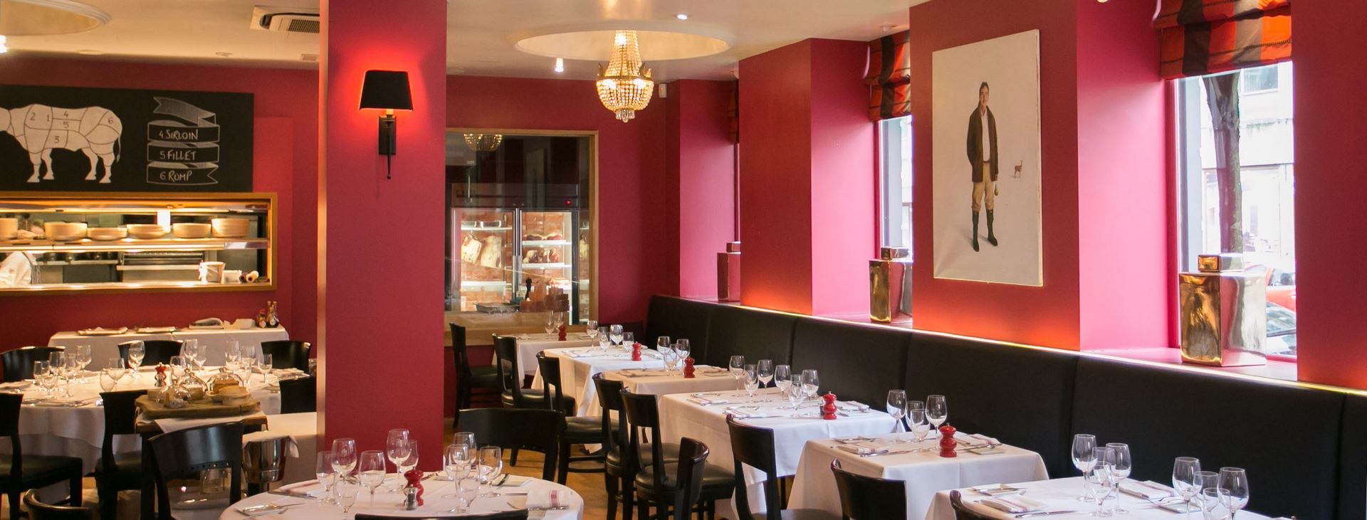
Restaurants
Nu Delhi
Tate of spice
Darcy’s Belfast
YuGo
The welcome restaurant
Oliver’s restaurant

Slide 8
THE END!

