Slide 1
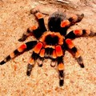
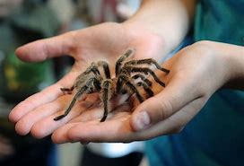
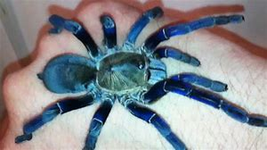
CORMAC GRAHAM’S Spider Report on
TARANTULAS

Slide 2
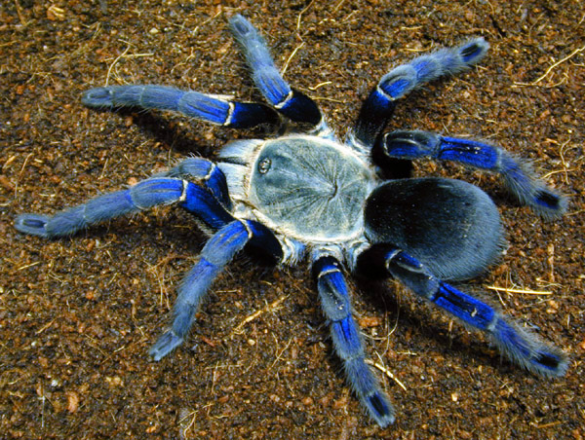
What are Tarantulas
Tarantulas (Theraphosidae) are among the largest spiders in the world. They are a member of the primitive group of spiders known as Mygalomorphae. Although many people consider tarantulas to be hairy and scary, it may surprise you to know that some people love them so much that they keep them as pets.

Slide 3
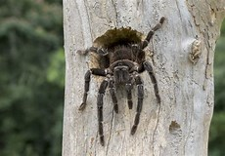
Habitat
Tarantulas live primarily in the tropical, subtropical, and desert areas of the world, with the majority found in South America. In the United States, tarantulas are found in southwestern states. Despite their fearsome appearance, tarantulas are not threatening to humans

Slide 4
What they eat !
Tarantulas are opportunistic carnivores, meaning that in the wild they can be observed eating a variety of different animals. They aren’t picky, and if they’re hungry, they’ll happily devour any creature that they come across.
Smaller tarantulas, especially dwarf species, primarily feed on insects such as crickets, roaches, beetles, caterpillars, grasshoppers, cicadas, and other spiders. These smaller species do take on larger prey, but doing so could pose a threat, so it isn’t very common

Slide 5
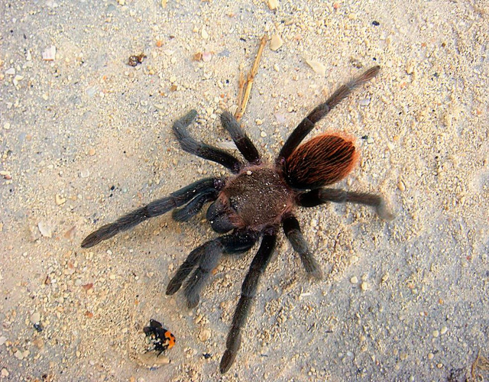
Red-Rump Tarantulas
Red-Rump Tarantulas are 4 or 5 inches across (including their legs) but some females can get as large as 6 inches. The males are smaller than the females. Sometimes the female spiders eat their boyfriends -- yikes!
When they are young, the spiderlings are brown. Once they are adults the males and females get red hairs on their abdomen (which is why they are called "red-rump" tarantulas). They look quite similar but the males are a little bit brighter red and the females are a bit larger.
Red-Rump Tarantulas sleep in their burrows during the day and then, at night, come out to hunt. They pounce on their prey and quickly pierce them with venomous fangs like ice-picks. They inject digestive juices into their prey that (quite quickly) turns them into a sort of soup that the spider slurps up.
When feeling threatened, the Red-Rump Tarantula rears up, raising its front legs to show off their threatening fangs. If this doesn't scare off an enemy, the next line of defense the tarantula uses is to flick itchy little hairs at the enemy using their legs. These hairs are called "urticating hairs" and grow on the tarantula's abdomen. It's very similar to what a porcupine does with its quills. The urticating hairs have a hook at the end that itches and irritates the skin and possibly eyes of the enemy. Over time, these hairs can even work themselves deeper into soft flesh.
One of the most fascinating things about red-rump tarantulas is that they live for so long -- a female can live for nearly 20 years. The male's life-span is closer to 5 years (if he doesn't get eaten by one of the females before then!)

Slide 6
Known facts about tarantulas
Tarantulas comprise a group of large and often ″hairy″ spiders belonging to the family Theraphosidae. Currently, about 1,000 species have been identified. The term tarantula is usually used to describe members of the family Theraphosidae, although many other members of the same infraorder are commonly referred to as "tarantulas" or "false tarantula. Tarantulas comprise a group of large and often ″hairy″ spiders belonging to the family Theraphosidae. Currently, about 1,000 species have been identified. The term tarantula is usually used to describe members of the family Theraphosidae, although many other members of the same infraorder are commonly referred to as "tarantulas" or "false tarantula

Slide 7
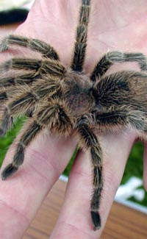
FUN FACTS
Spiders are arachnids, not insects.
Other members of the arachnid family include scorpions, mites, ticks and harvestmen.
Spiders have 8 legs while insects have 6.
Spiders are found on every continent of the world except Antarctica.
Most spiders make silk which they use to create spider webs and capture prey.
Most spiders are harmless to humans but a few spider species, such as the black widow, can bite humans and inject venom. Deaths from spider bites are rare however.
An abnormal fear of spiders is called ‘arachnophobia’.
Tarantulas are large and often hairy spiders, the biggest species have been known to kill mice, lizards and birds.
Most tarantula species pose no threat to humans.
The largest specie of tarantula is the Goliath Birdeater.
Giant Huntsman spiders have leg-spans of around 30cm (12 in).

