Slide 1
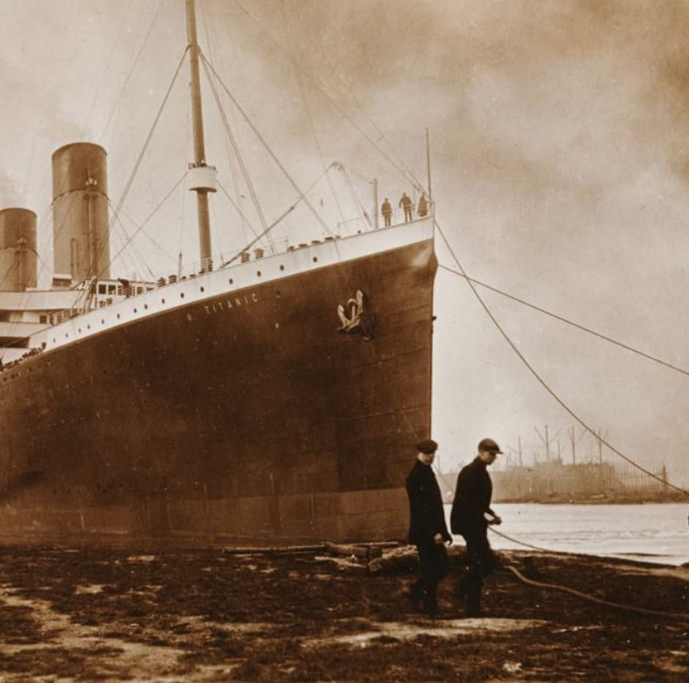
Titanic
By Edward

Slide 2
The making of it.
Built in Belfast Ireland, the Titanic took approximately 3 years to complete. Construction began in 1909, and the ship was completed in 1912, the same year as her maiden voyage.
At nearly 900 feet in length and weighing over 46,000 tons, the Titanic was the largest ship at sea in 1912. The luxury passenger ship began her tragic maiden voyage to New York from the UK on April 10, 1912. On April 14 of the same year, the Titanic struck an iceberg and sank within 3 hours of the accident. Of the 2,223 people aboard the ship, 1,517 were lost. The RMS Carpathia, replying to a distress call from the Titanic, rescued 706 passengers and crew. While some artifacts have been recovered, the Titanic still lies at the bottom of the Atlantic Ocean.

Slide 3

When it set sail and sank.
In April 1912, there were about 300 icebergs in the North Atlantic shipping lanes, the most seen in the route between Europe and North America in 50 years.
The abundance of icebergs that year would also be something the Titanic's experienced captain, Edward Smith, would not have predicted. He'd been sailing the North Atlantic for 26 years and had not reduced the Titanic's speed despite receiving warnings of bergs ahead of his ship.
The iceberg punctured five of 16 supposedly watertight compartments designed to hold water in case of a breach to the hull.
Investigations at the time blamed Captain Smith for going too fast in dangerous waters, initial inspections that had been done too quickly, insufficient room in the lifeboats for all passengers, and a nearby ship's failure to help.

Slide 4
When it was found
Seventy-three years after it sunk to the North Atlantic ocean floor, a joint U.S.-French expedition locates the wreck of the RMS Titanic. The sunken liner was about 400 miles east of Newfoundland in the North Atlantic, some 13,000 feet below the surface.
The Titanic is now routinely explored, and several thousand artifacts have been recovered. Ballard—who was celebrated as a hero after the discovery—has led several more high-profile search expeditions, including of the RMSLusitania and the USS Yorktown.

Slide 5
The visitor centre opening
Titanic Belfast is a visitor attraction opened in 2012, a monument to Belfast's maritime heritage on the site of the former Harland & Wolff shipyard in the city's Titanic Quarter where the RMS Titanic was built. It tells the stories of the Titanic, which hit an iceberg and sank during her maiden voyage in 1912, and her sister ships RMS Olympic and HMHS Britannic. The building contains more than 12,000 square metres (130,000 sq ft) of floor space, most of which is occupied by a series of galleries, private function rooms and community facilities, plus the addition of Hickson’s Point destination bar in March 2018.

