Slide 1

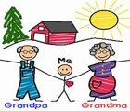

Wednesday 27th January 2021
Today we think about our school as ...
...a Community of Love.​
Today we think of our grandparents.
Today we think how they are important teachers who show us:​
* how to live, laugh & love
* how to be caring
* how to share
* how to be the best we can be

Slide 2
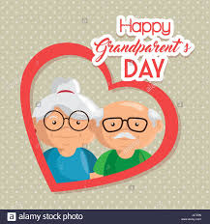

P6K Task for Grandparents Day
" P6K Celebrate the presence of
our grandparents in our lives"
1 Draw a detailed picture of your grandparent(s)​
2 Surround your picture with a range of interesting adjectives describing your grandparent.​
Eg. amazing, loving, funny, kind, thoughtful, old, witty, wise​

Slide 3
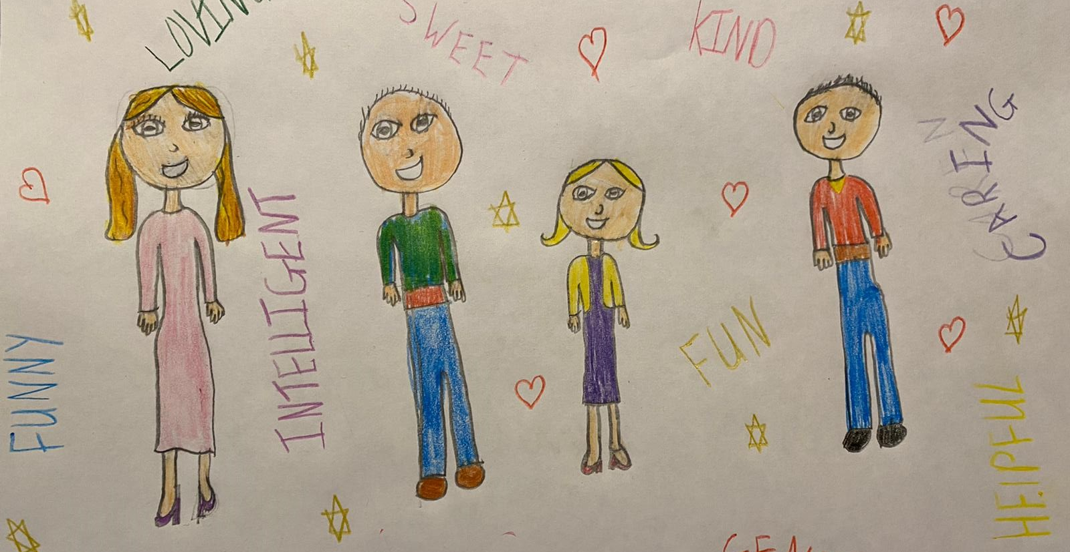
Holly’s
Grandparents

Slide 4
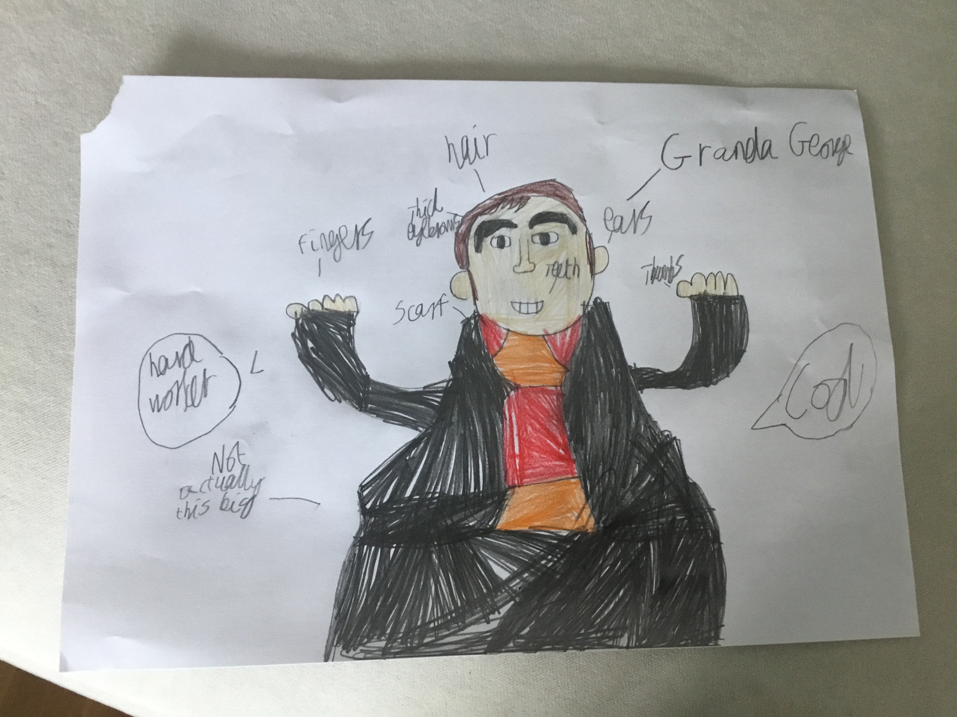
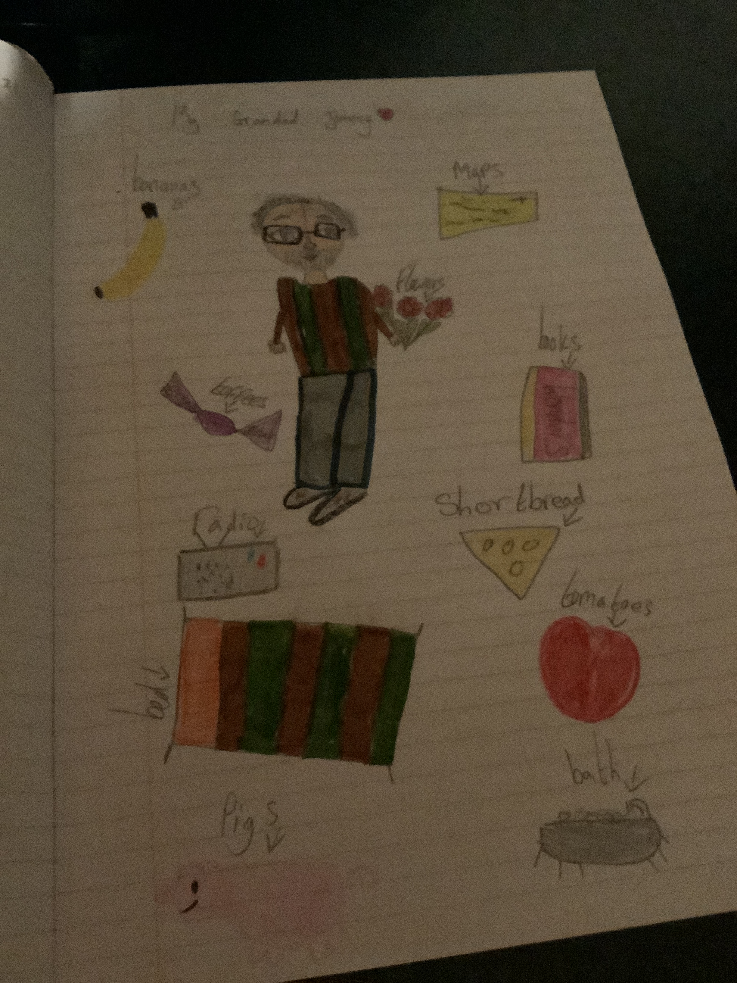
Oliver’s
Granda George
Lucy’s
Grandad Jimmy

Slide 5
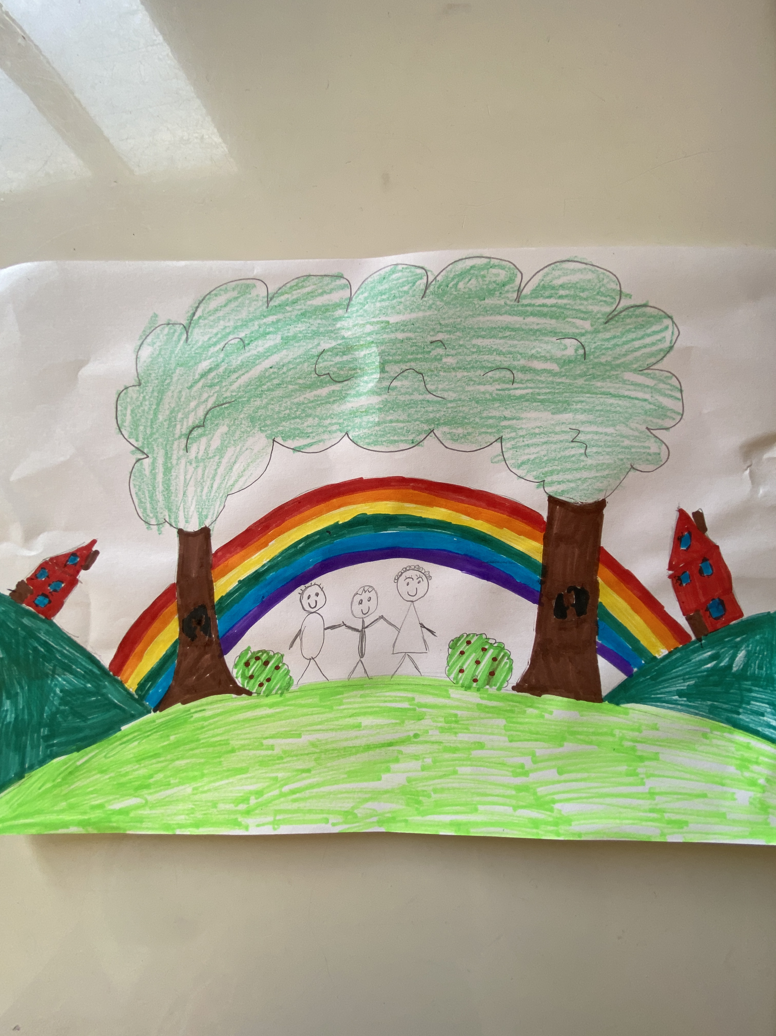
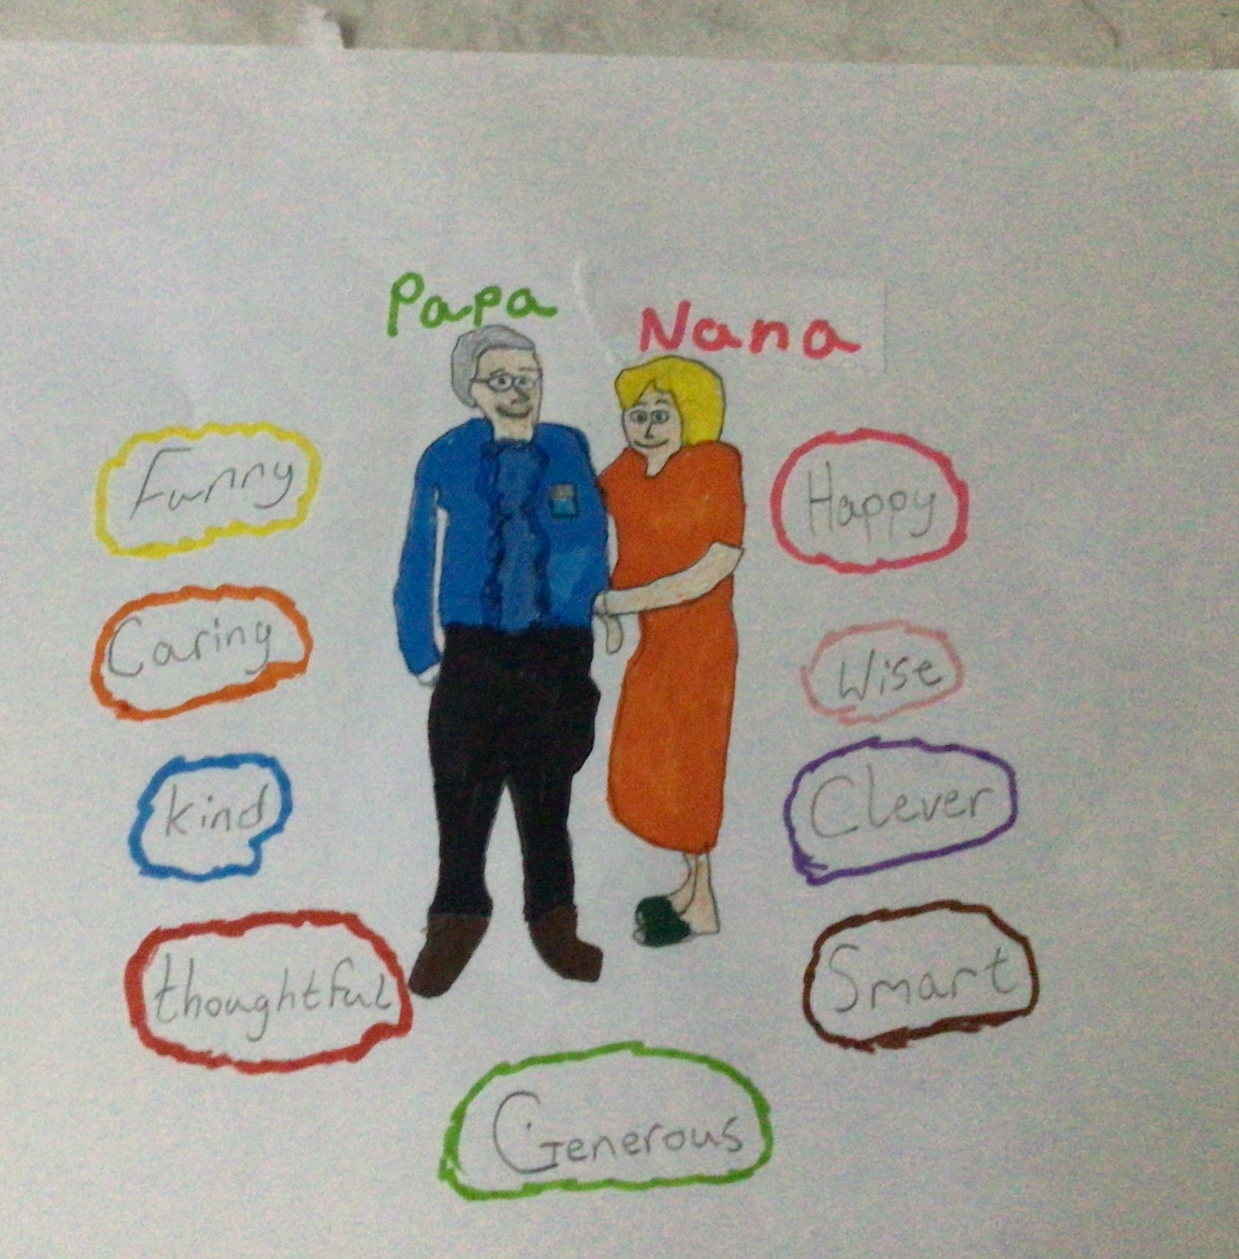
Papa & Nana
By Sean
My Grandparents
By Edmund

Slide 6
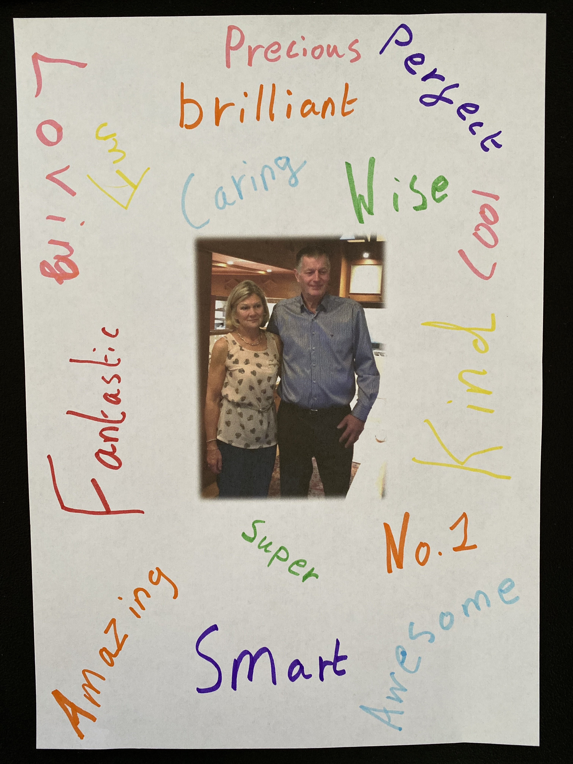
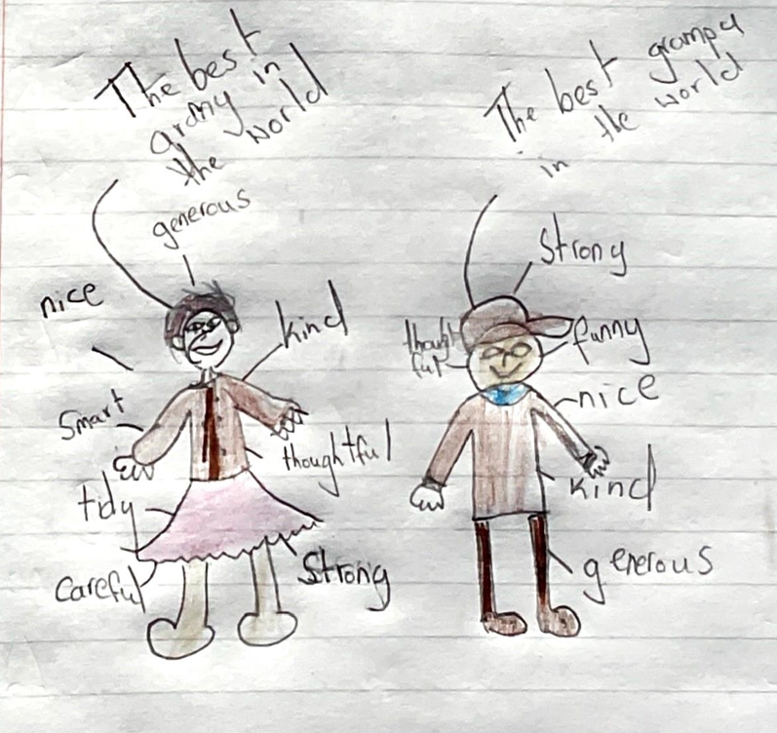
The best
granny & grampa
By Zak
My Grandparents
By Oliver V.

Slide 7
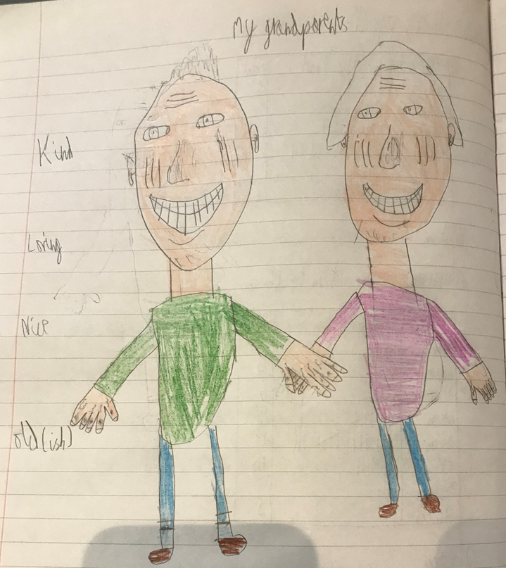
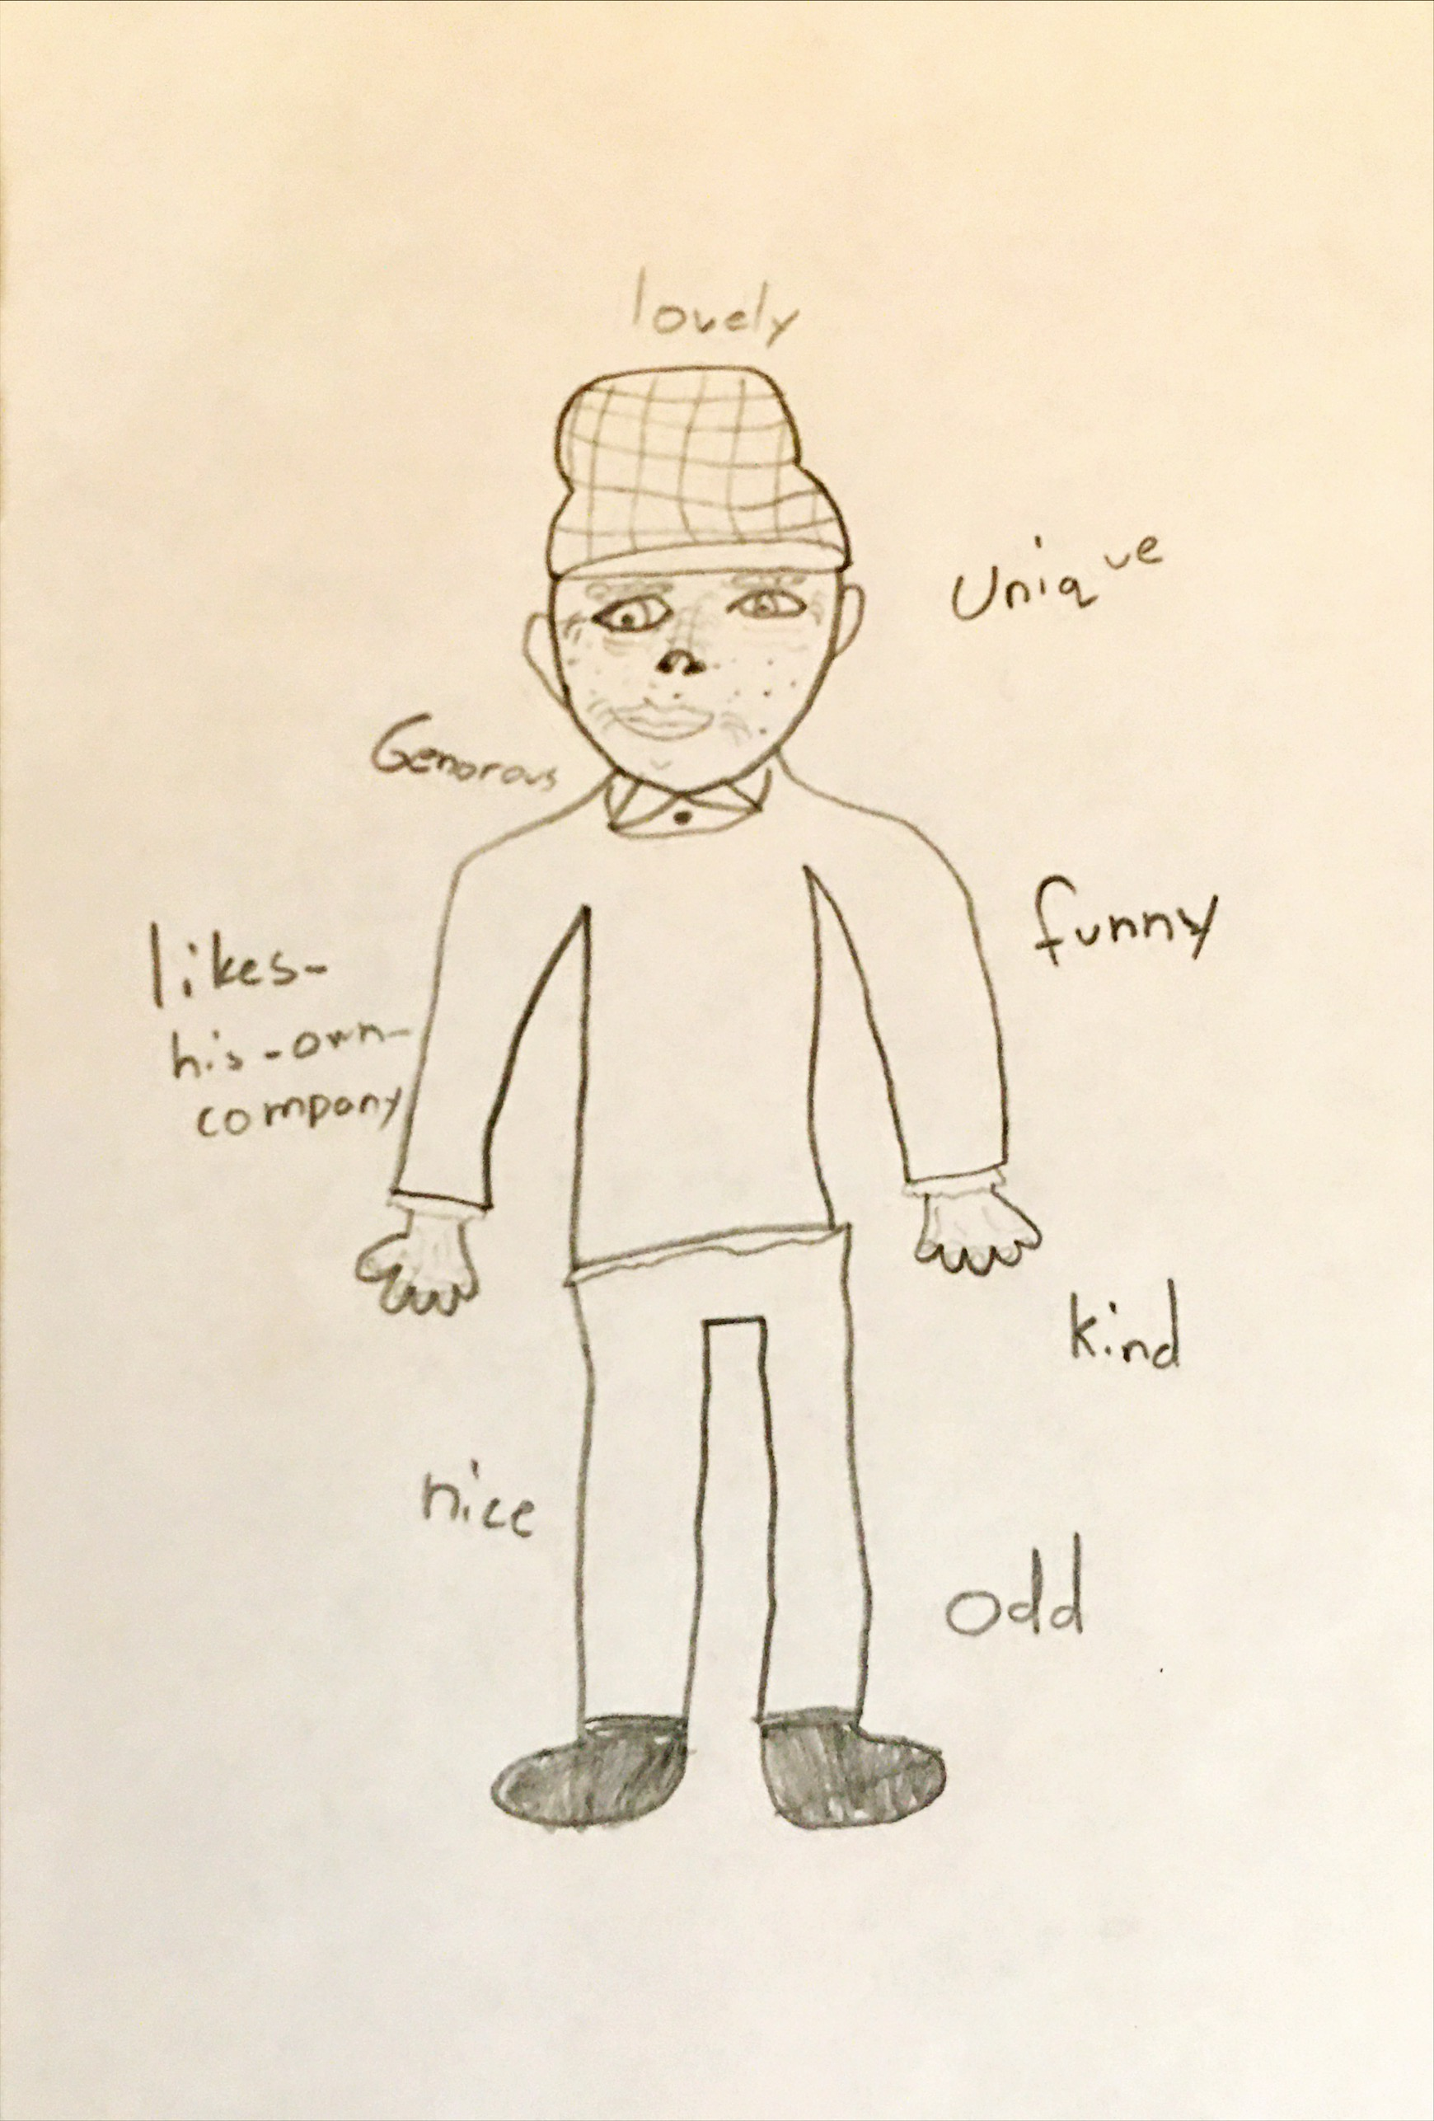
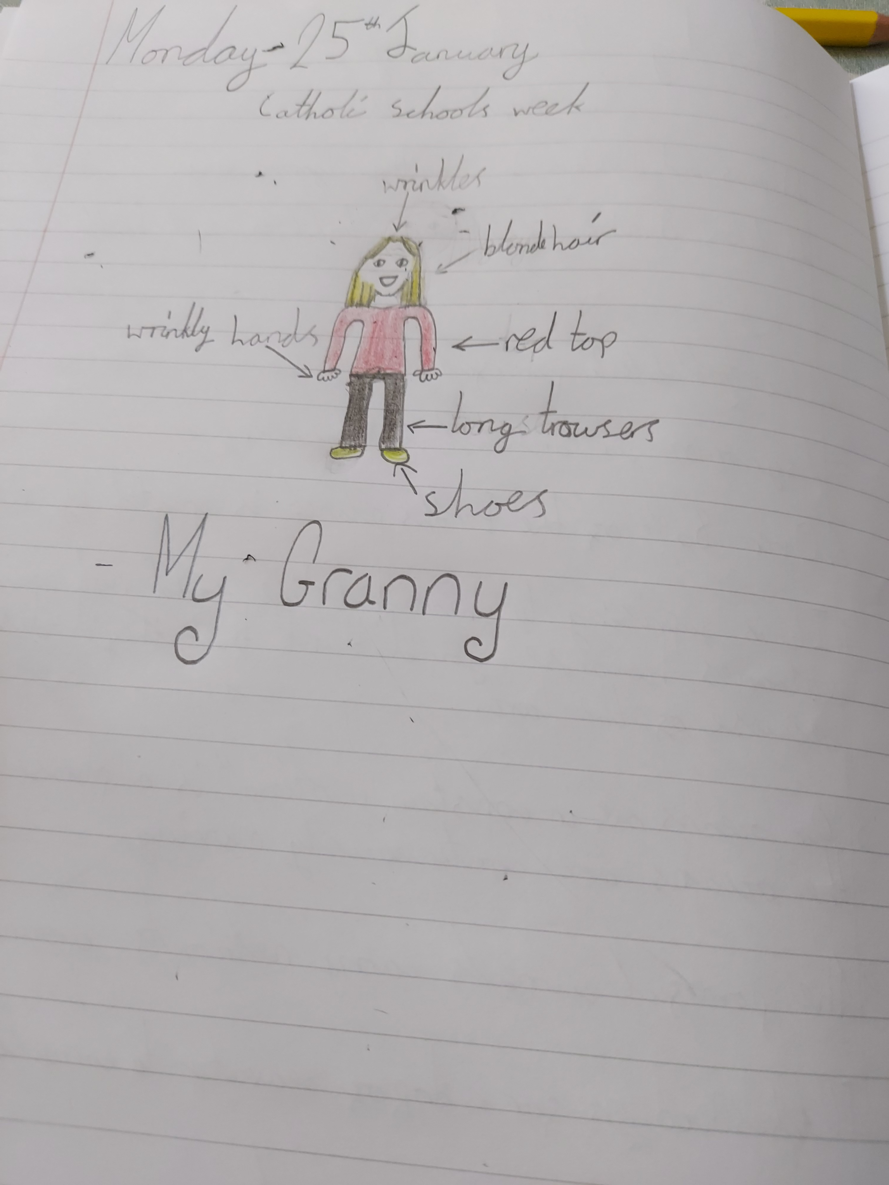
My
Grandparents
My Grandad
My Granny
By Tom
By Molly
By Thomas

Slide 8
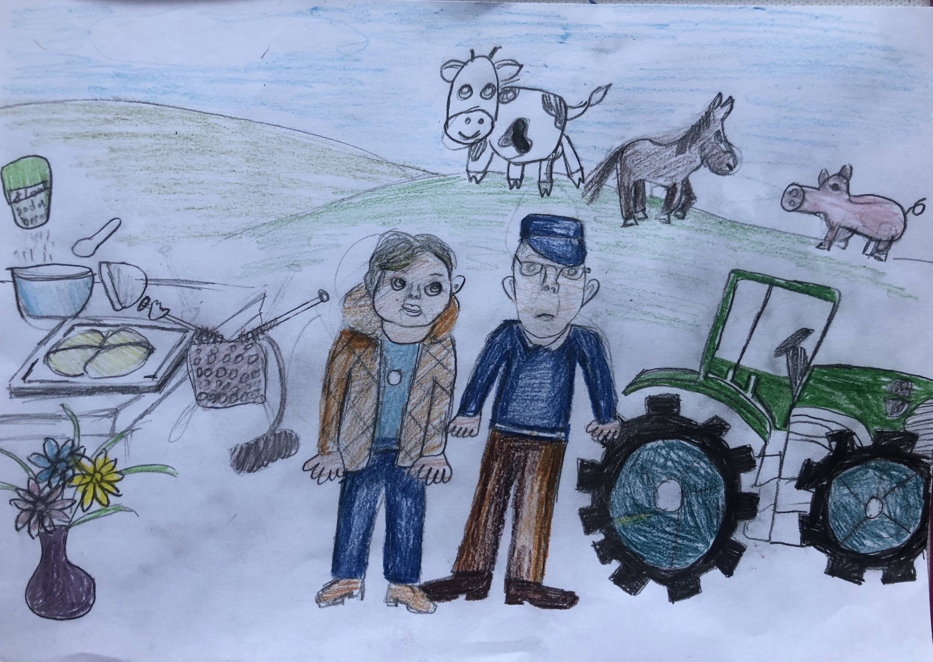

My Grandparents
By
Beatrice

Slide 9
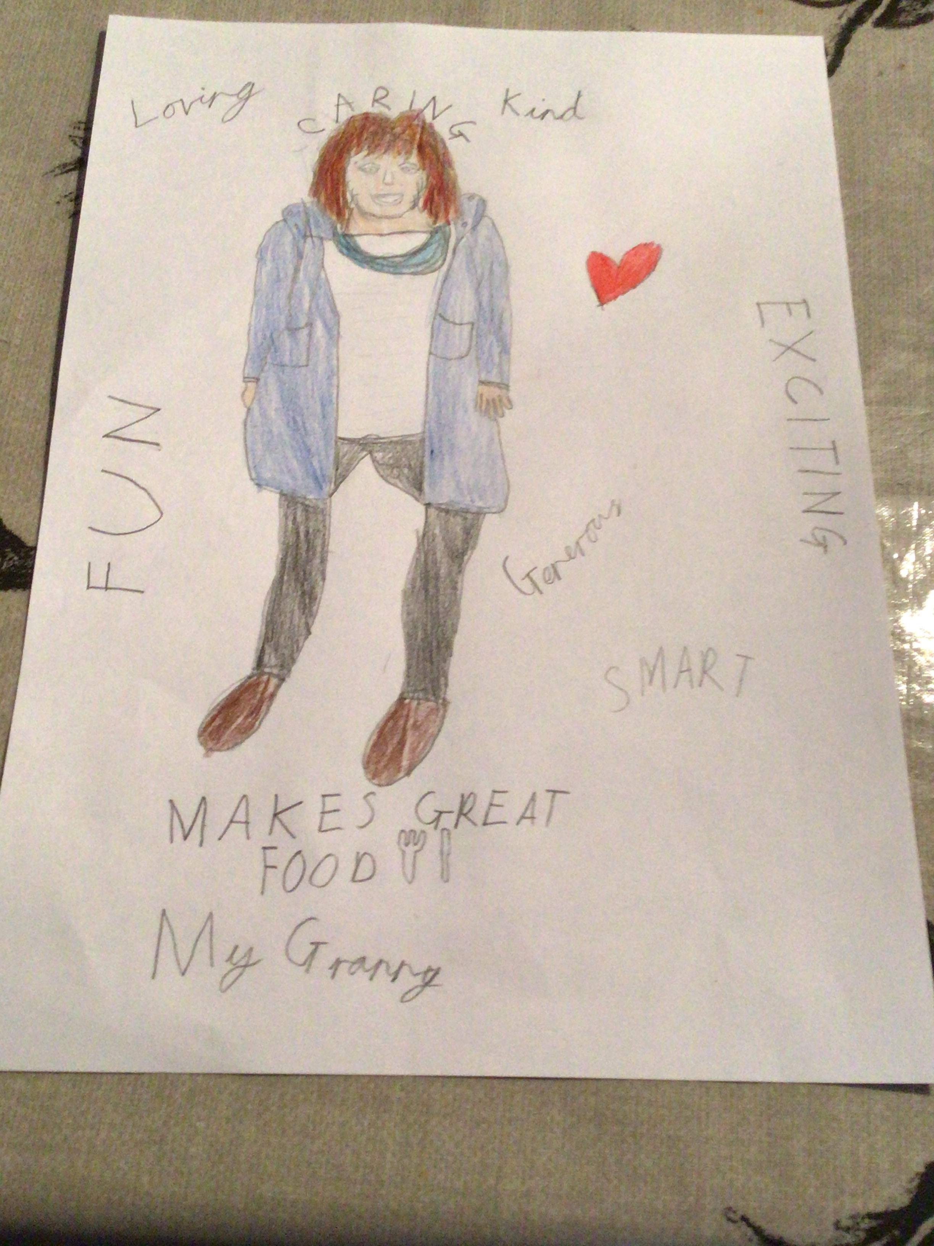
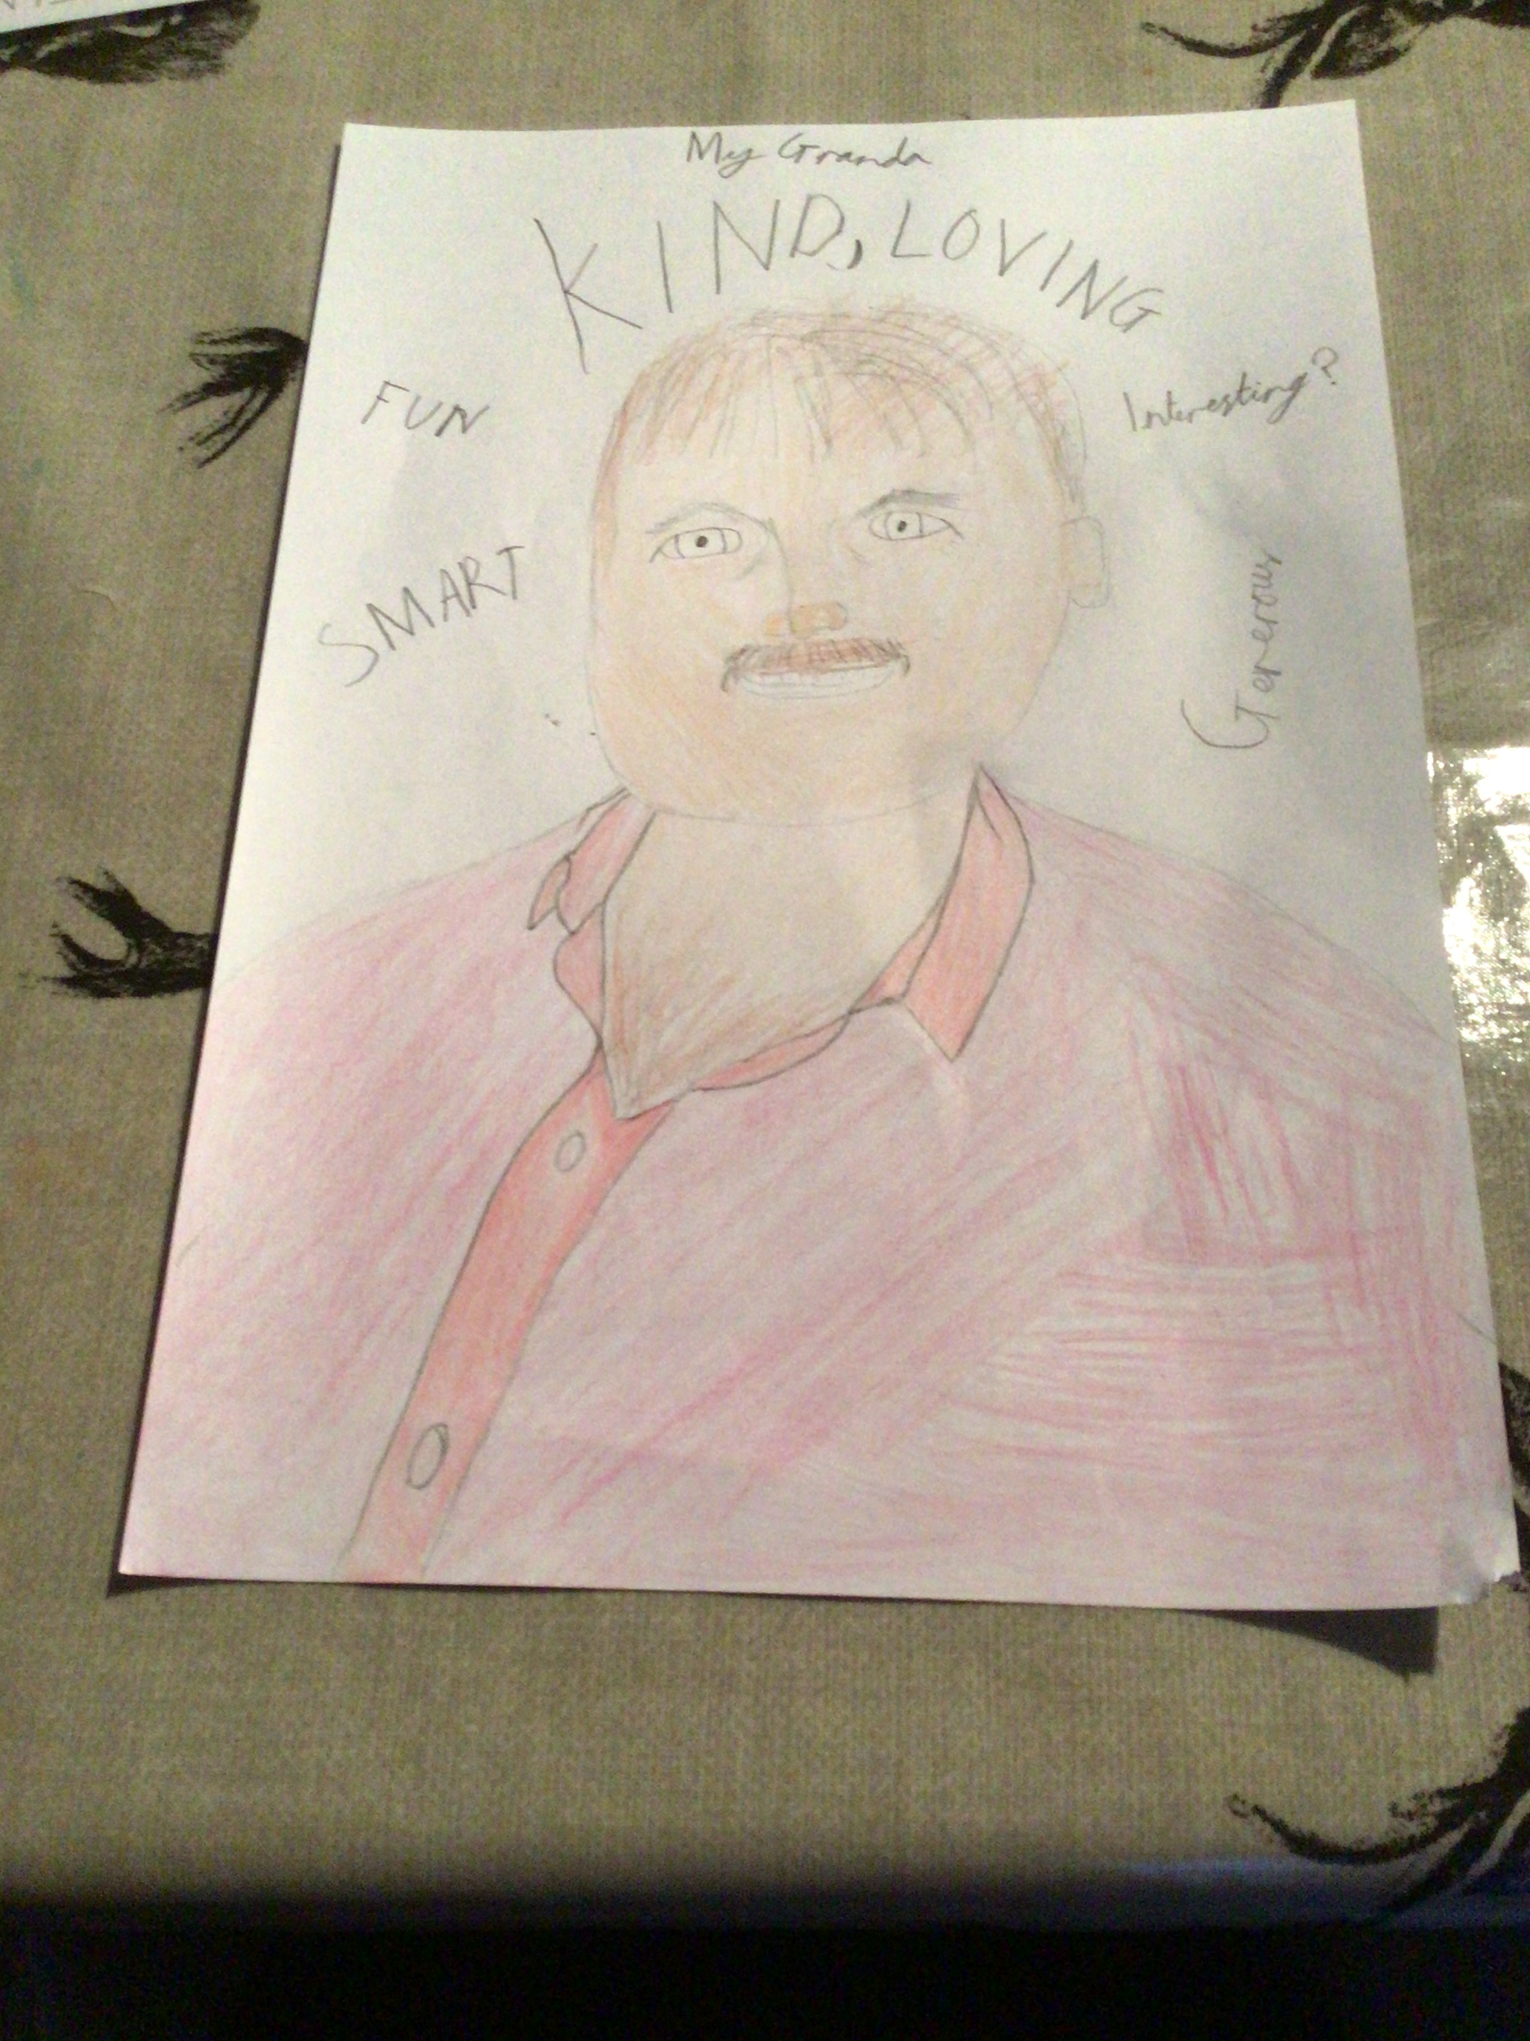
My Grandparents
By Aidan

Slide 10
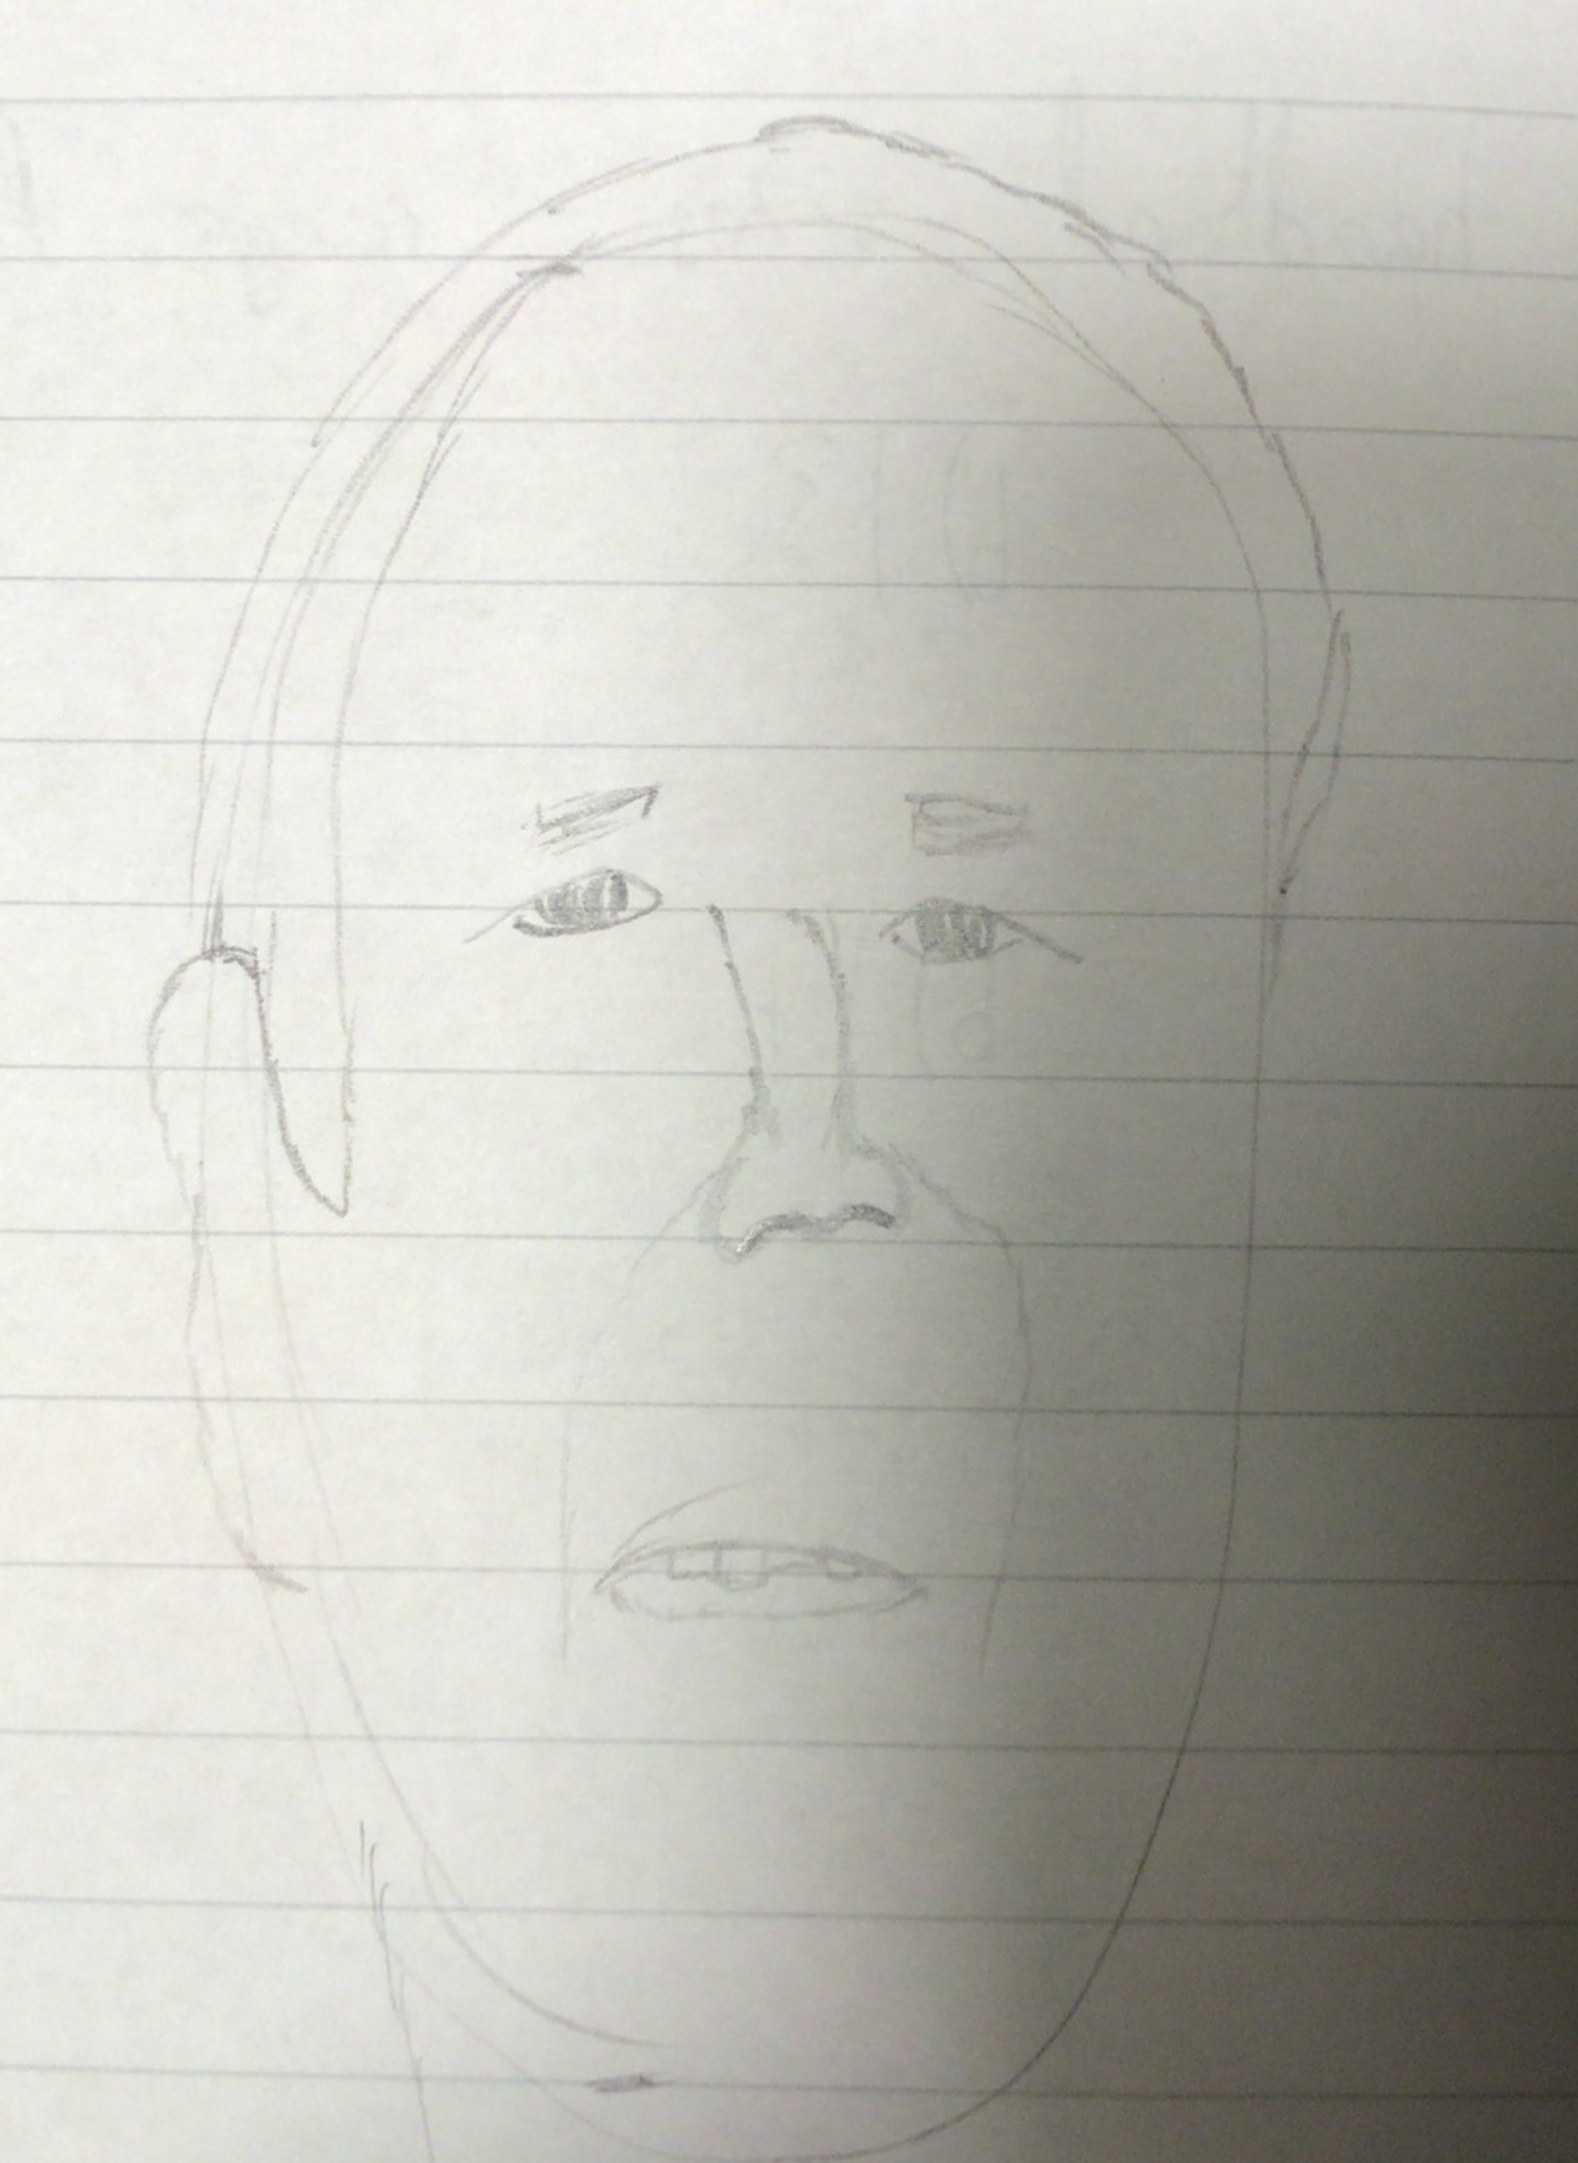
My Grandmother
By Lara
My Grandad
By Aoife T.

Slide 11
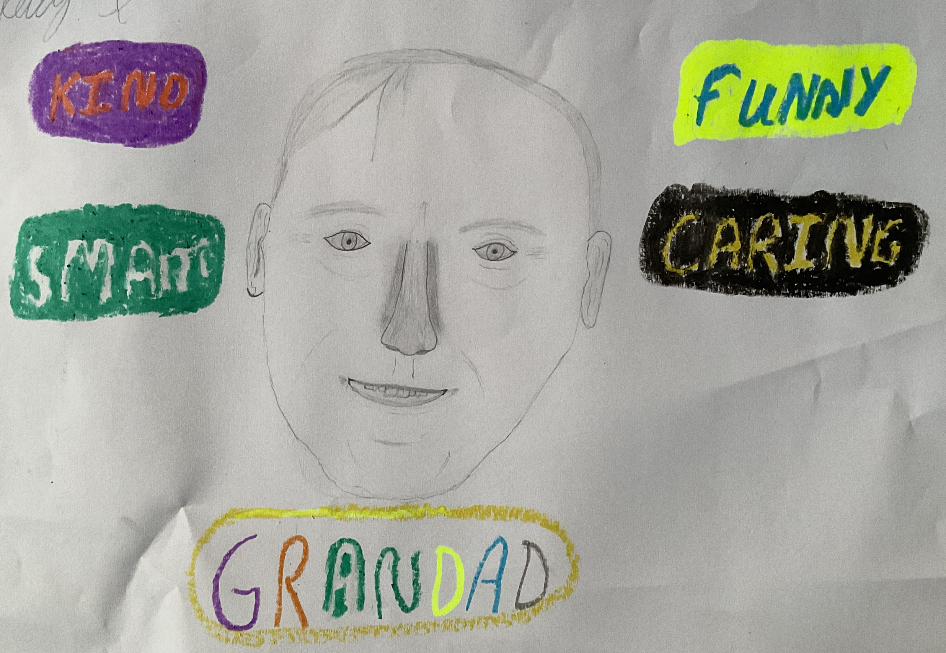
My Grandad
By Kitty

Slide 12
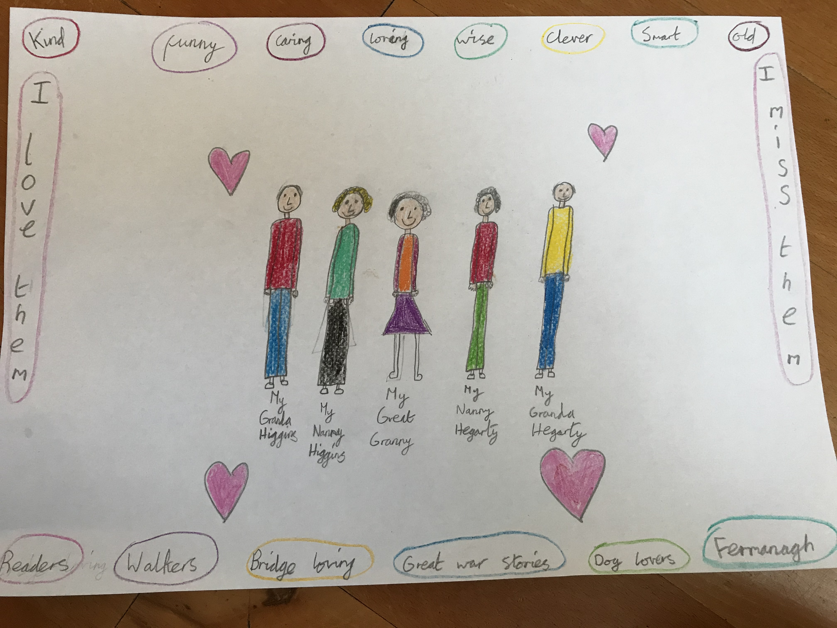
My Grandparents By Aoife H

Slide 13
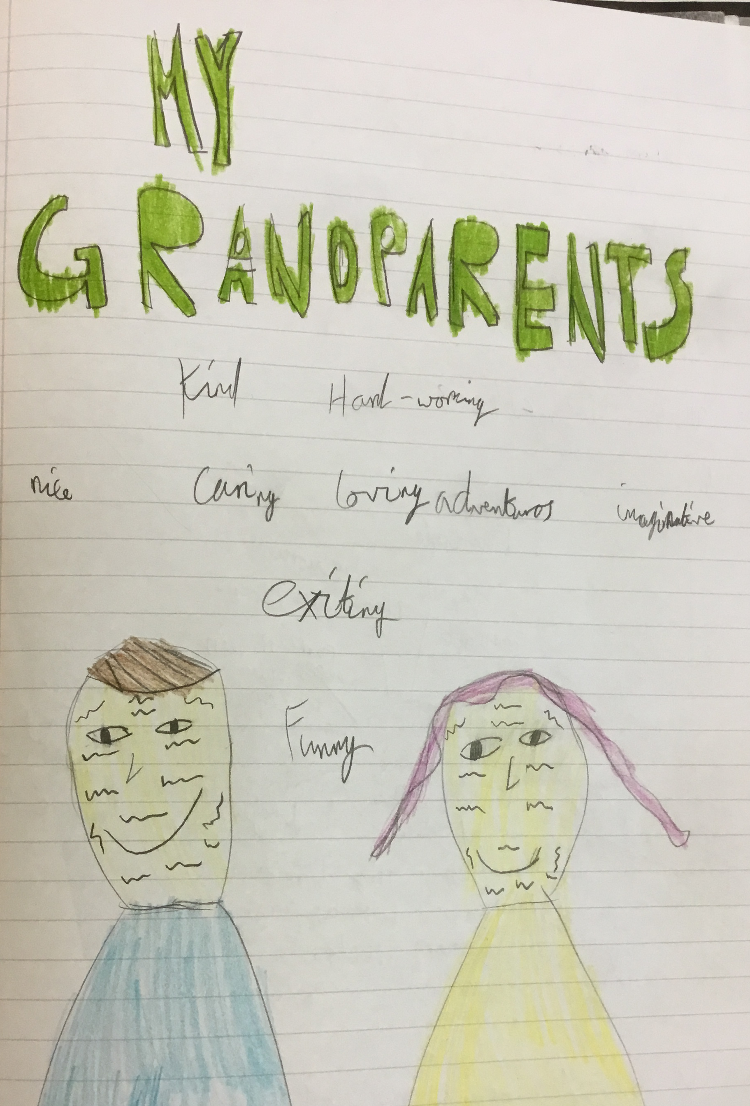
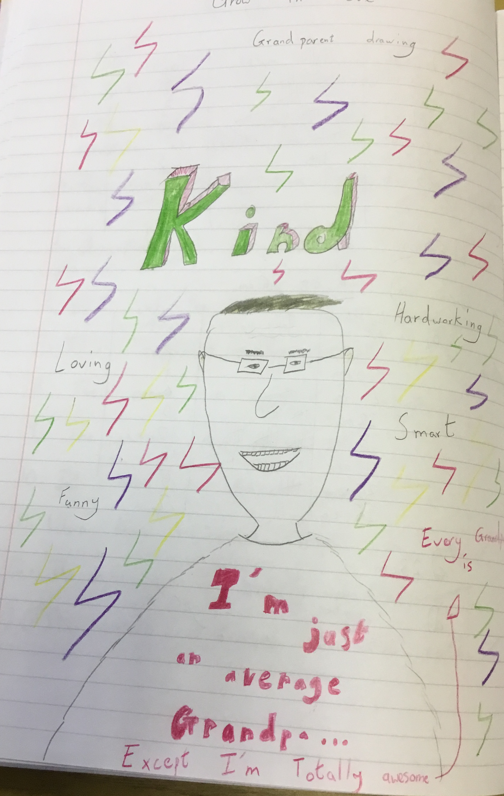
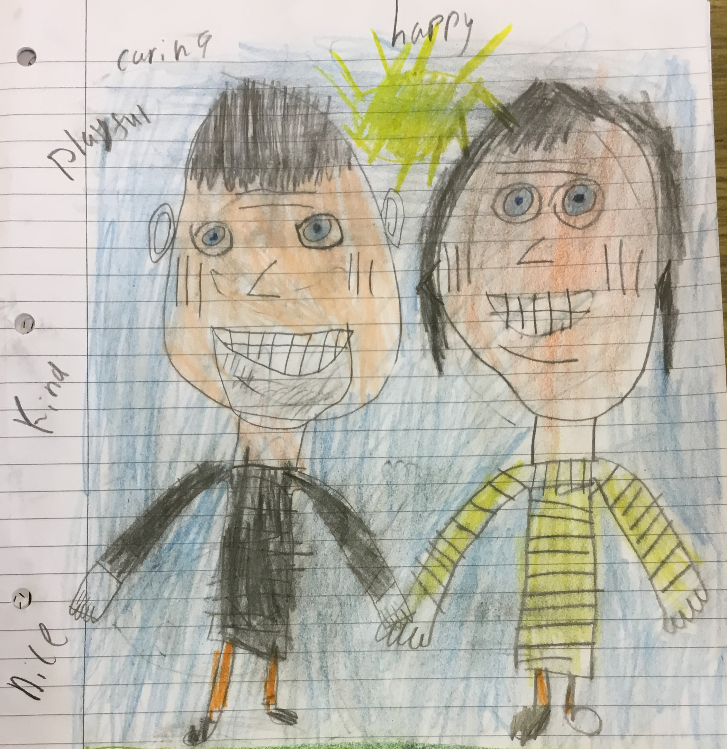
My Grandparents
By Charlie
My Grandpa
By Alex
By Jamie

Slide 14
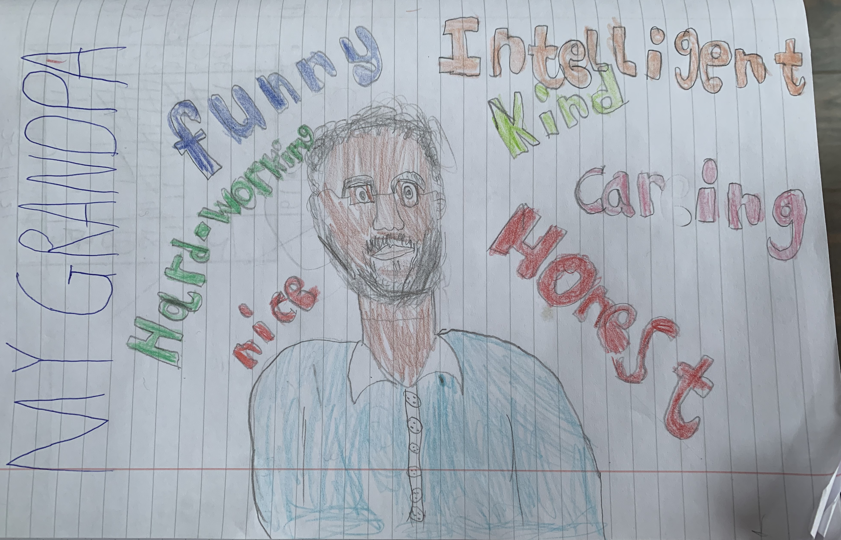
My Grandpa
‘nana’
By Riyan

Slide 15
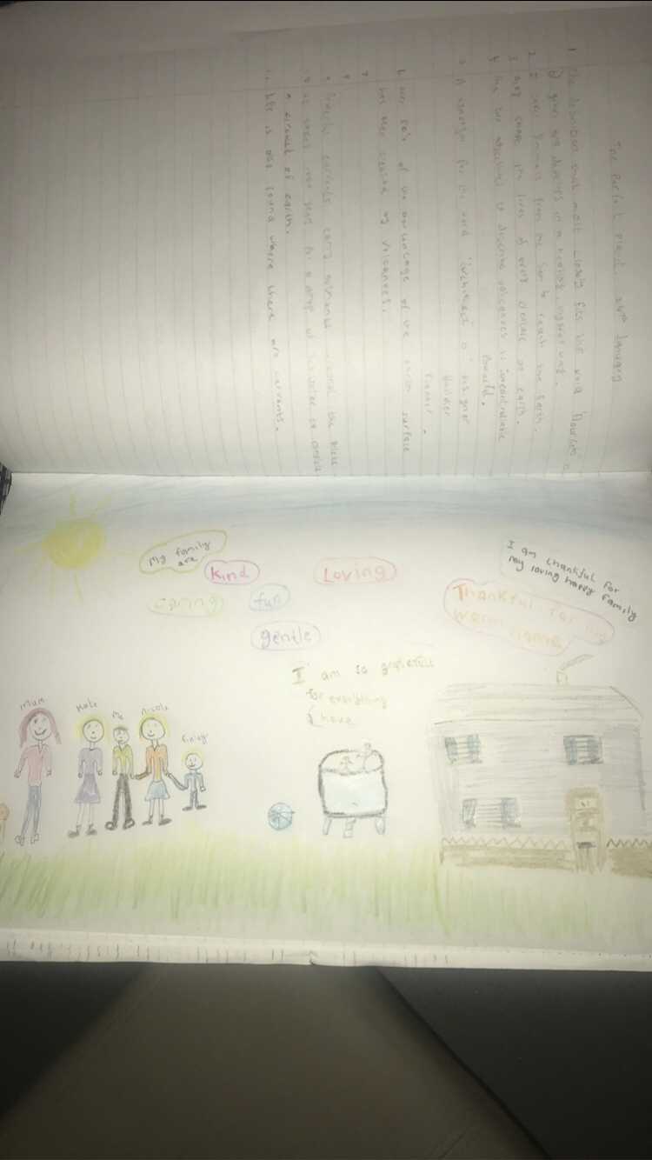
My loving
Family
By
Joseph

Slide 16

To ALL
The
Grandparents
of Children in P6K
You are loved more than you will ever know
xoxo

