Slide 1
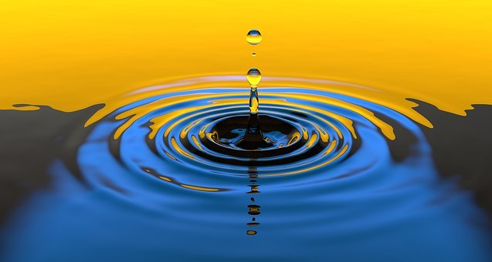
Why do we need water in our lives?
By Meabh Maguire

Slide 2
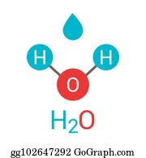
What is water made of?
Water is made out of three atoms, two hydrogen and one oxygen.
This is called H2O.

Slide 3
Can water exist in different forms?
Water is the only substance on Earth that is naturally in three forms
Solid - Ice
Liquid - Water
Gas – Steam or Clouds

Slide 4
Where does it come from?
The water cycle provides all the water on Earth.
The sun heats the water in the rivers and sea.
It evaporates and cools to form clouds.
As it cools it condenses and when the clouds are full of water it rains.
The rain runs into the rivers and sea and the cycle starts all over again.

Slide 5
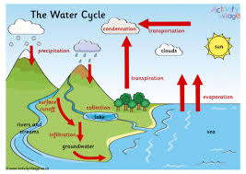

Slide 6
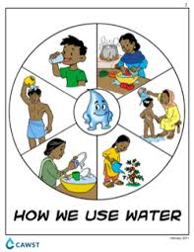
What is it used for?
Water is used for cooking, drinking, helping to grow food, washing , keeping clean, for having fun and for making lots of products that we use eg bricks, cars, clothes.
We can’t live without water because it is essential.

Slide 7
Why is water called liquid gold?
Not everyone in the world can turn on a tap in their house to get water.
In lots of countries people, especially children, have to walk a long distance to get water. This takes lots of time.
Imagine if you had to spend all of your free time collecting water for you and your family and you had no time to go to school.
If you can’t go to school you won’t get a very good job and you won’t earn much money.

Slide 8
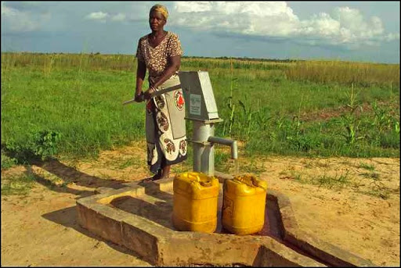

Slide 9
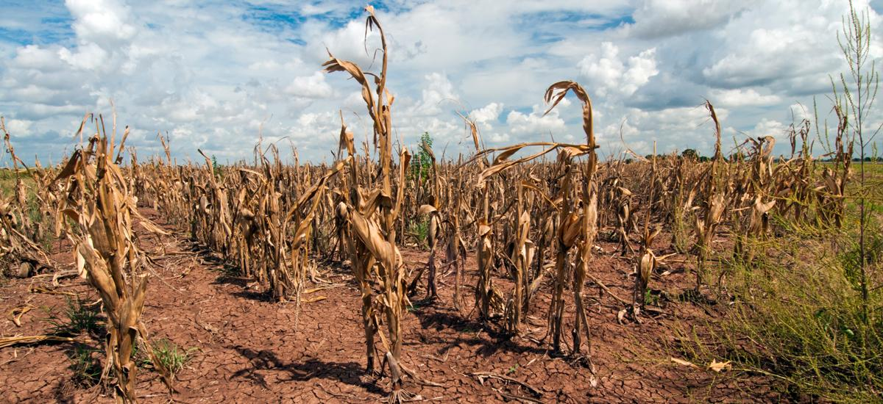
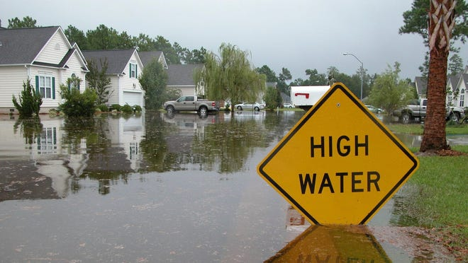
What happens if there is too much water or too little water?
If there is too much water it can flood an area and people could die and people’s houses could be destroyed. It takes lots of money to fix everything after a flood.
If there is too little water people could starve because we need water to grow food and also there could be a drought if there is too little water.

Slide 10
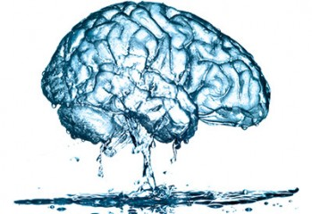
Interesting Facts!
70% of an elephant is made up of water.
The usage of water has increased by 70% since 1970.
About 6,800 gallons of water is needed to grow a family of four’s food for a day.
Only 3% of water is fresh water, the other 97% is salty.
70% of the human brain is made up of water.

